Slide 1
World War II
War in the Pacific Ocean

Slide 2
WWII Casualties
Which country do you think suffered the most deaths?
China had the second most deaths in WWII
Country | Military Deaths | Civilian Deaths
United States | 407,000 | 6,000
China | 1.8 million | 7.5 million

Slide 3
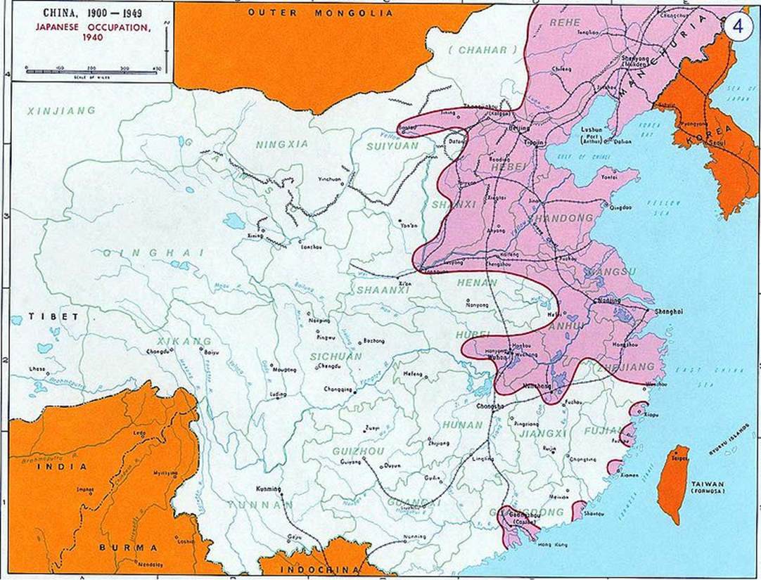
Japan Invades China
Japan saw the Western Imperial powers and wanted to be the Imperial power of the East
Take over Pacific Islands for resources
Save Asia from European Powers
Japan
invaded
Manchuria
Notes:
Japan felt like they were ignored in the agreements after WWI and they wanted to take what they felt they deserved
They also don’t have many resources in Japan, and rely on resources of other countries
Japanese military blew up a Japanese built railway in Manchuria and then blamed it on China, to start a conflict

Slide 4
Empires in Pacific at the Beginning of WWII

Slide 5
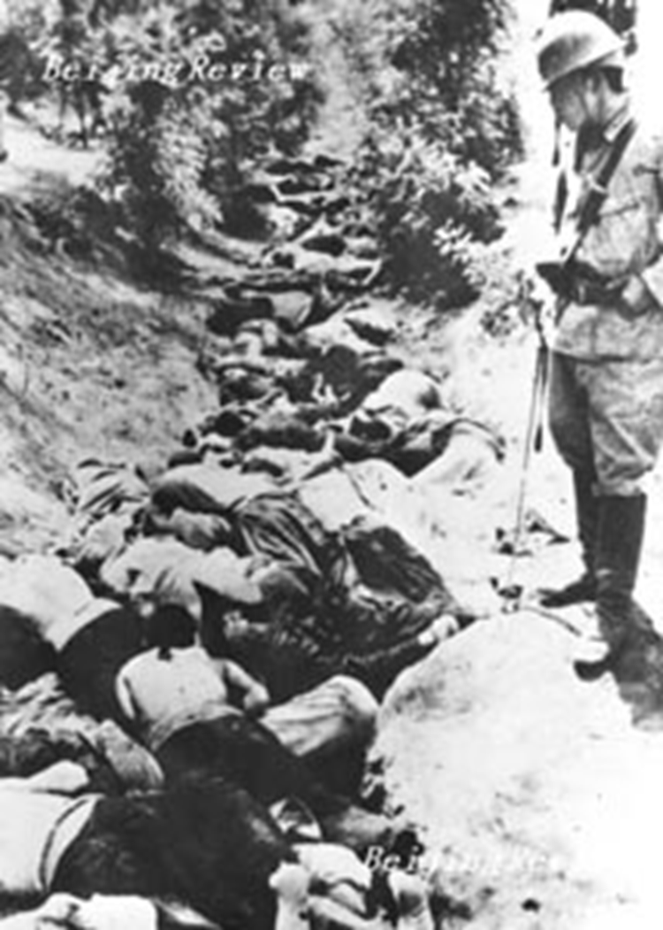
Rape of Nanjing
Japan attacks China’s capital (Nanjing) in the beginning of WWII
Japanese were inflamed by war passion and an idea of racial superiority
Spent two months murdering, raping and burning
400,000 Chinese lost their lives (mostly civilians)
Notes:
7,000 Chinese women were raped
Japanese soldiers used Chinese for bayonet practice and machine gunned them into open pits

Slide 6
Pearl Harbor
U.S. embargoes Japan for invading China
Japan joins forces with Hitler
They know U.S. will eventually get involved, they want to strike first
Japanese hope to destroy American naval capacity in the pacific
December 7, 1941 Japan attacked Pearl Harbor
FDR Speech: http://www.history.com/topics/world-war-ii/pearl-harbor

Slide 7
Japanese Attack the Philippines
December 8, 1941
Japanese attack the Philippines
American (soldiers stationed on the Philippines) and Filipino forces surrender to the Japanese
Japanese don’t know how to deal with those who surrender, it isn’t within their concept

Slide 8
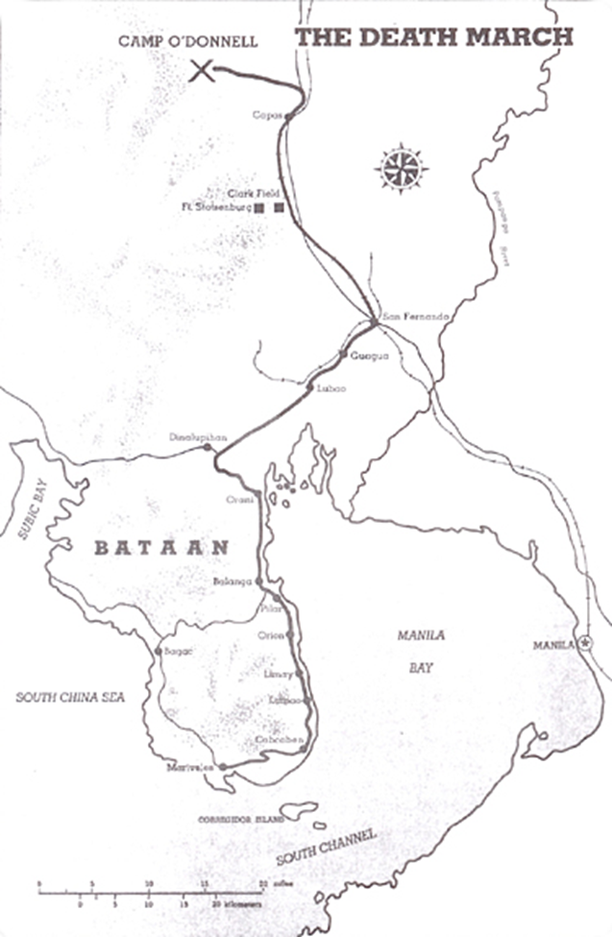
Bataan Death March
All soldiers forced to walk to Japanese prison camps
Brutal March: cruelty, disease, exhaustion
By the time they arrived at the death camp- over 600 American soldiers had been killed and 10,000 Filipino soldiers had been killed.
Notes:
Soldiers who stopped for any reason were instantly killed by the Japanese

Slide 9
Pacific Theater- WWII
After Pearl Harbor, Japan has many early victories and invades islands nearly to Australia
Battle of Midway changes the tides in favor of the allies
United States break the Japanese code and discover Japanese plans
Island Hopping Strategy: Allies gradually retake islands in the Pacific by hopping from one island to another
Deadly, tenacious fighting characterized these battles

Slide 10
Research Battles

Slide 11
Decision to Drop the Bomb

Slide 12
War in the Pacific- 1945
Clear that allies will win the war
Japan refuses to surrender
Loyal subjects to their emperor

Slide 13
Potsdam Conference
Allied Powers Demand
Japan must surrender unconditionally
Japan would be occupied by allied forces
Japan will become a democratic government
Fear of unconditional surrender caused the Japanese to refuse these terms

Slide 14
America’s Decision
Land invasion
1.7 to 4 million American casualties, including 400,000 to 800,000 fatalities, and five to ten million Japanese fatalities
Blockade/ Strategic bombing
Starve the Japanese to death through bombing of infrastructure.
Firebombing
Incendiary Bombs: Used to create fire storms that spread and destroy; very demoralizing
New weapon…
?
Warn Japan to give them a chance to surrender
Drop the bomb on a remote island first to demonstrate the power
Use the element of surprise and drop it directly on Japan in population centers
If you were Truman what would you do?

Slide 15
Atomic Bomb

Slide 16
Hiroshima
First Atomic Bomb was called “Little Boy”
Dropped August 6, 1945
Killed 90,000 people immediately. By 1950, around 166,000 people had died.

Slide 19
Nagasaki
Second Atomic Bomb, called “Fat Man,” was larger than the first Atomic Bomb.
Dropped August 9, 1945
Killed 60,000 people instantly, final death tally of 80,000

Slide 20
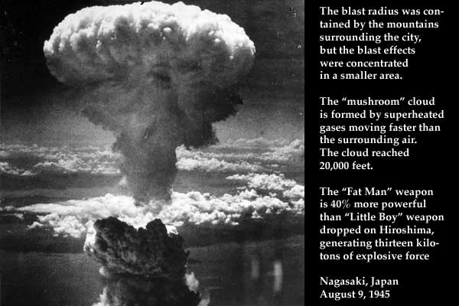
Slide of 20 (Refresh off)

Slide 21
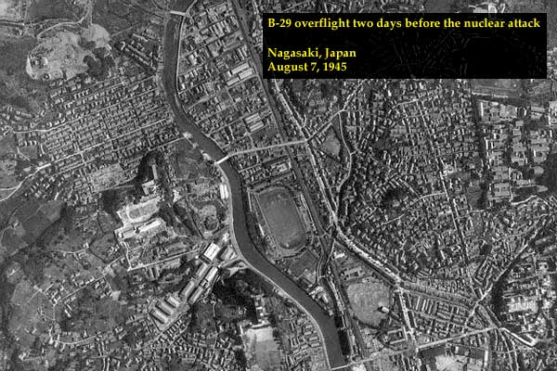
Slide of 20 (Refresh off)

Slide 22
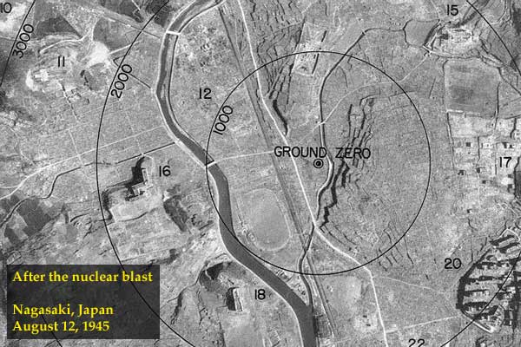
Slide of 20 (Refresh off)

Slide 23
Slide of 20 (Refresh off)

Slide 24
Japan Surrenders
Japanese surrender after the bomb was dropped on Nagasaki
They were afraid of another atomic attack

Slide 25
While the deaths and casualties overall may have been lowered by using the atomic bomb, what other negative effects did this cause?
Some may argue it was necessary to drop one, but two?
What sort of international precedent did this establish?
Of all the horrible dictators in the world, the only country to ever use this weapon is the U.S.

Slide 26
Story of a Girl in Hiroshima

Slide 27
Should Proportionality be a guideline in war?
Robert McNamara: https://www.youtube.com/watch?v=gekdt0QwFQw
Firebombing v. Atomic Bomb v. Land Invasion
General LeMay (American) was destroying dozens of Japanese cities using firebombing
In order to win a war, should you kill 100,000 people in one night?
What makes it immoral if you lose and moral if you win?
Was the United States behaving as a war criminal in destroying so many cities and then dropping two atomic bombs? Was it proportional to the goal they were trying to achieve?

