Slide 1
World War II
The Greatest Generation

Slide 2
Rise of Hitler
Germany’s desire to reestablish economic stability and German pride led them to allow the rise of Hitler
1933: Hitler and the Nazi Party come to power in Germany.
1933: Hitler starts building up German Military. (against Treaty of Versailles)
1936: Hitler appoints himself Supreme Chancellor of Germany.
1937: Persecution of German Jews begins under Hitler.

Slide 3
How the Jew Cheats. Jews are our misfortune.

Slide 4
Nazi Propaganda: https://www.youtube.com/watch?v=GHs2coAzLJ8
Nazi Parade: https://www.youtube.com/watch?v=5yS-grbhaUM
Hitler’s Speech: https://www.youtube.com/watch?v=EV9kyocogKo

Slide 5
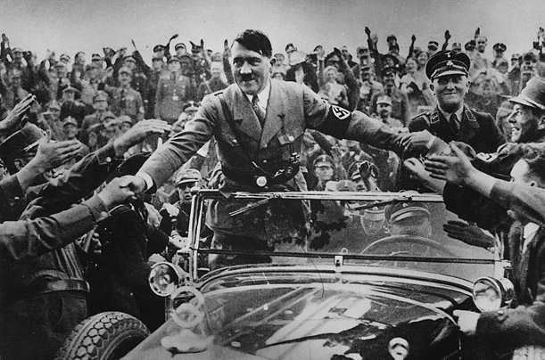

Slide 6
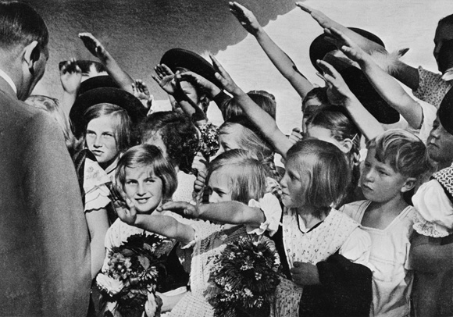

Slide 7
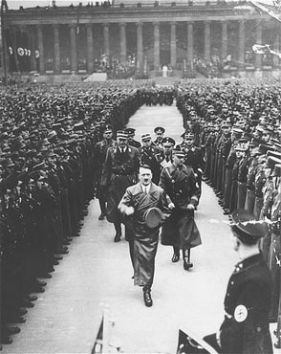

Slide 8
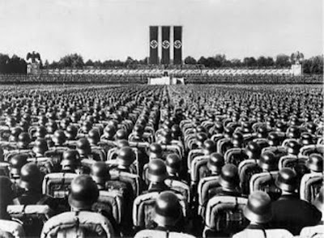

Slide 9
Origins of World War II
Treaty of Versailles ended World War I
Dismantled German Empire
Forced Germany to pay for war damages
Because of economic distress in Europe and Germany’s desire to reestablish the German Empire
Germany began a campaign of territorial expansion
ALLIED POWERS
France
Great Britain and its Commonwealth
Soviet Union
China
United States (1942)
AXIS POWERS
Germany
Japan
Italy

Slide 10
Munich Conference
Germany invades land that was taken from them at the end of WWI
European powers meet at the Munich Conference to decide how to deal with Hitler’s expansion
To avoid another World War, the Prime Minister of Britain (Neville Chamberlain) allowed Hitler to take the land Germany invaded as long as Hitler promised to stop his expansion there
Chamberlain returns to Britain exclaiming there is “Peace for our Time!”
He was never more wrong

Slide 11
Invasion of Poland
Hitler soon took over all of Czechoslovakia and continued by invading Poland
World War II had begun
Next Year Define Blitzkrieg Here

Slide 12
Hitler video
http://www.youtube.com/watch?v=hRHhPNzQXHI

Slide 13
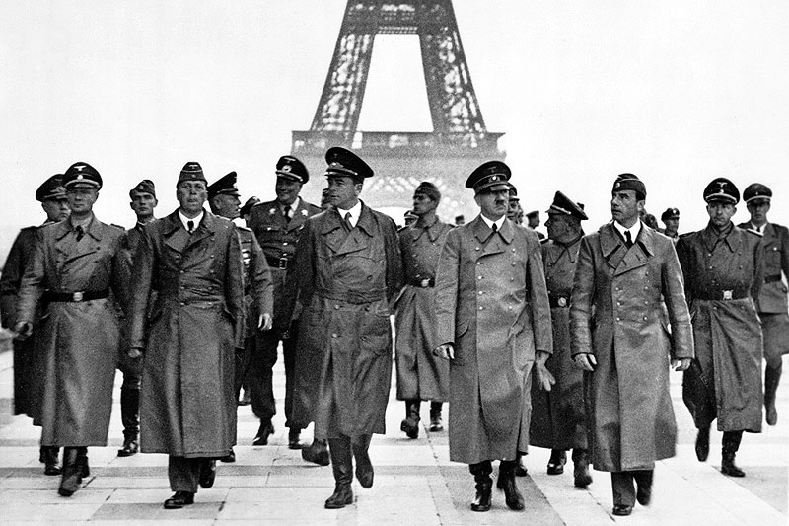
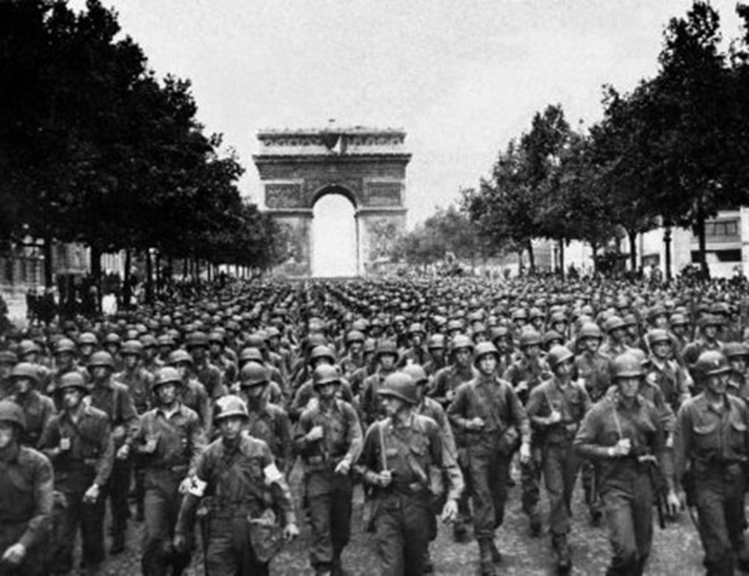
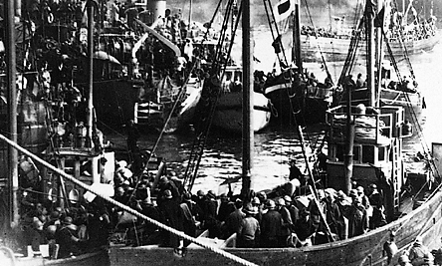
Fall of France
After conquering Poland, Hitler quickly moved to France
France fell within two months
Hitler forced France to signed their armistice in the very railroad car in which the Germans were forced to sign the agreement that ended World War I
Allied forces quickly retreated from France in an incredible retreat across the English Channel
This retreat is known as Dunkirk
339,000 British and French Soldiers were rescued in the course of 9 days

Slide 14
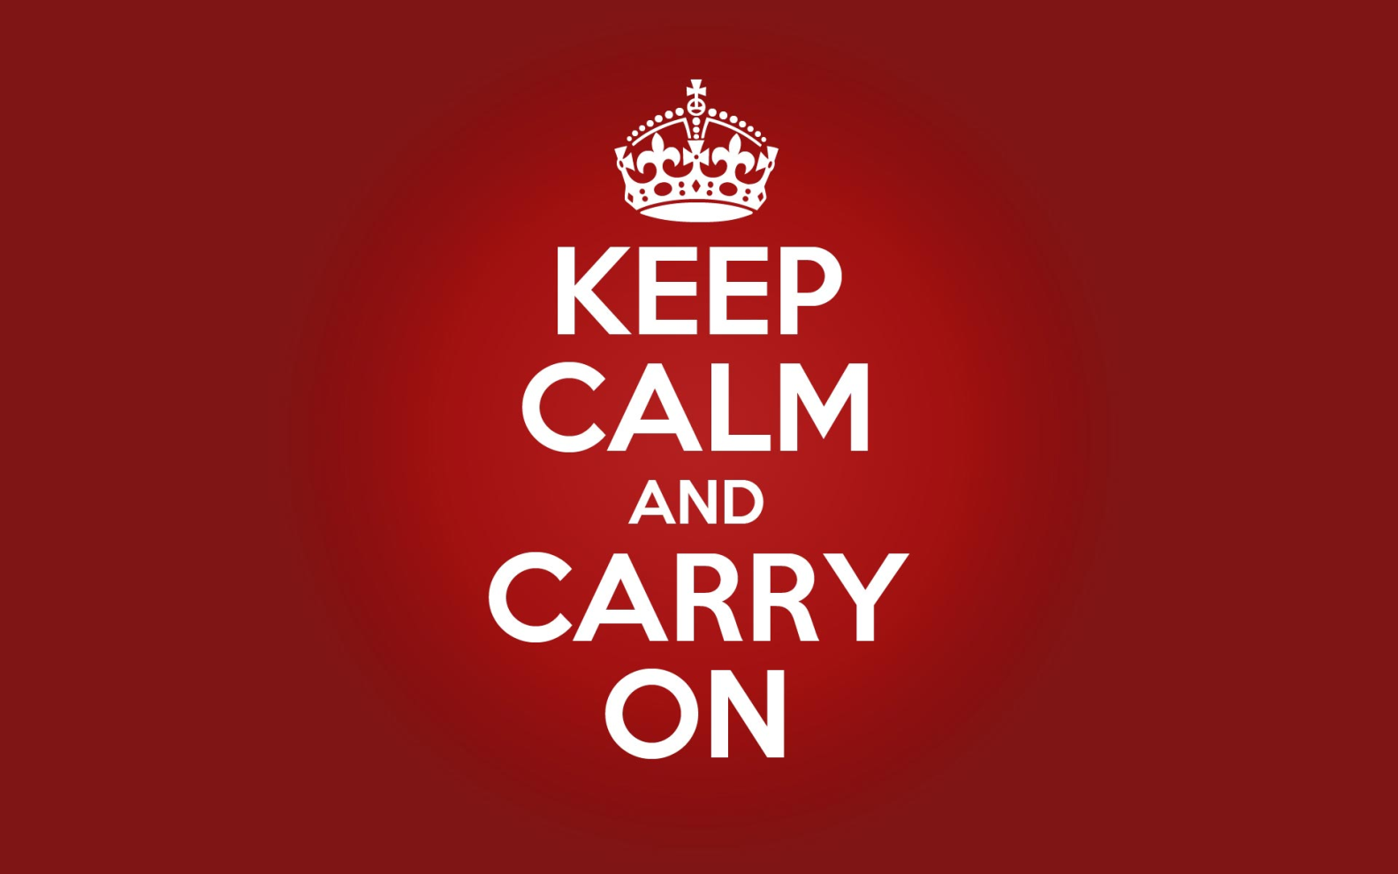
The Battle of Britain
After the fall of France, Germany launched an air war on Britain
This became known as “The Blitz”
Germany rained bombs on heavily populated areas
The Royal Air Force was able to avoid defeat
But Hitler had already taken over most of Europe from Paris to Athens

Slide 15
Strength of the Allies
Only after the entrance of the U.S. did the tide turn toward the Allied Powers
The entrance of the Soviet Union and the United States guaranteed an Allied victory
In the end, World War II was won by industrial strength
The Soviet Union and the U.S. out-produced Hitler’s empire
The U.S. automotive industry alone produced more than 4,000,000 armored, combat and supply vehicles during the war

Slide 16
Stalingrad
One of the most important battle in WWII
Fought between Hilter Nazis and the Soviet Union
Stalingrad-Huge industrial city for the Soviets
Losing this city would have greatly hurt Soviet Union
Soviets won this battle
Marked the beginning of Hitler’s retreat across Russia, back to Germany

Slide 17
D-Day
Soviet Union fought the Germans on the Eastern Front
British and U.S. forces initially attacked the Germans from the Southern Front
On June 6, 1944 they opened a western front in France (D-Day)
This 3 front war and round-the-clock bombing of German cities by the U.S. overwhelmed the Germans

Slide 18
Defeat of the Axis powers
The Soviet Union surrounded Berlin and although Hitler’s defeat was eminent, he refused to surrender
This resulted in brutal street-by-street battle for weeks
Hitler eventually committed suicide
One week later, Berlin fell to the Soviets
Russians went on a several week revenge rampage through Berlin
This unfortunate atrocity would have been avoided if Hitler had just surrendered to the U.S. and Britain

Slide 19
United Nations
The superpowers of the world agreed to create the United Nations
Dedicated to maintaining world peace and creating international guidelines

Slide 20
Fatalities

