Slide 1
World War I
The Great War

Slide 2
Causes of the War
World War I

Slide 3
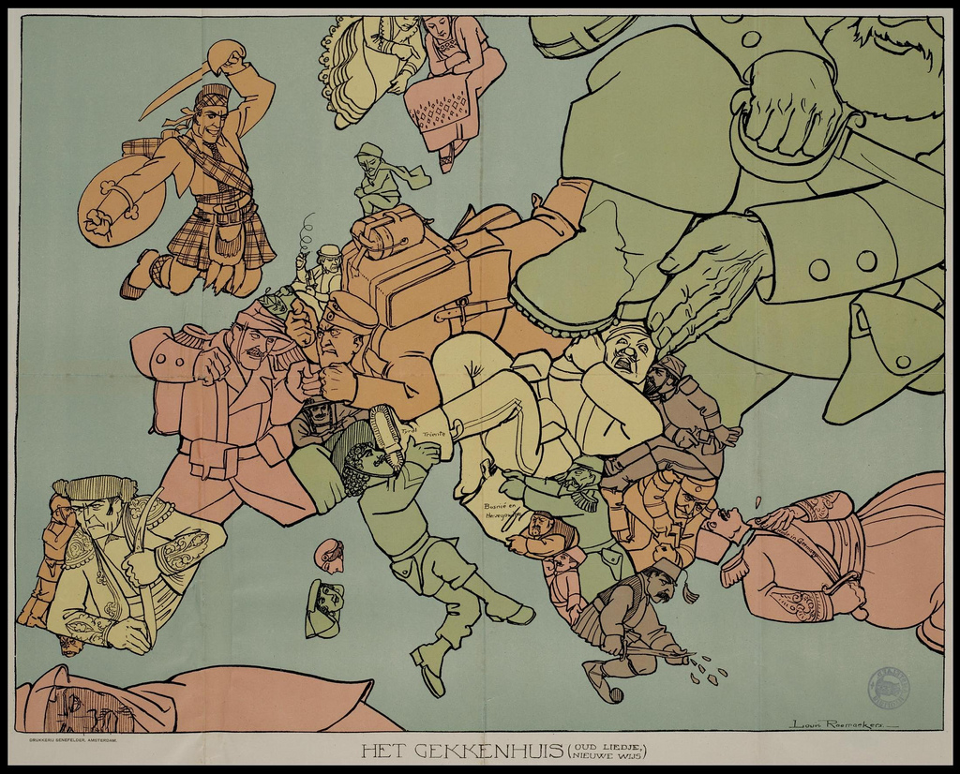
1. Militarism
Late 1800’s and early 1900’s showed huge increases in military spending in Europe
More soldiers, more weapons
Everyone was ready to use their military

Slide 4
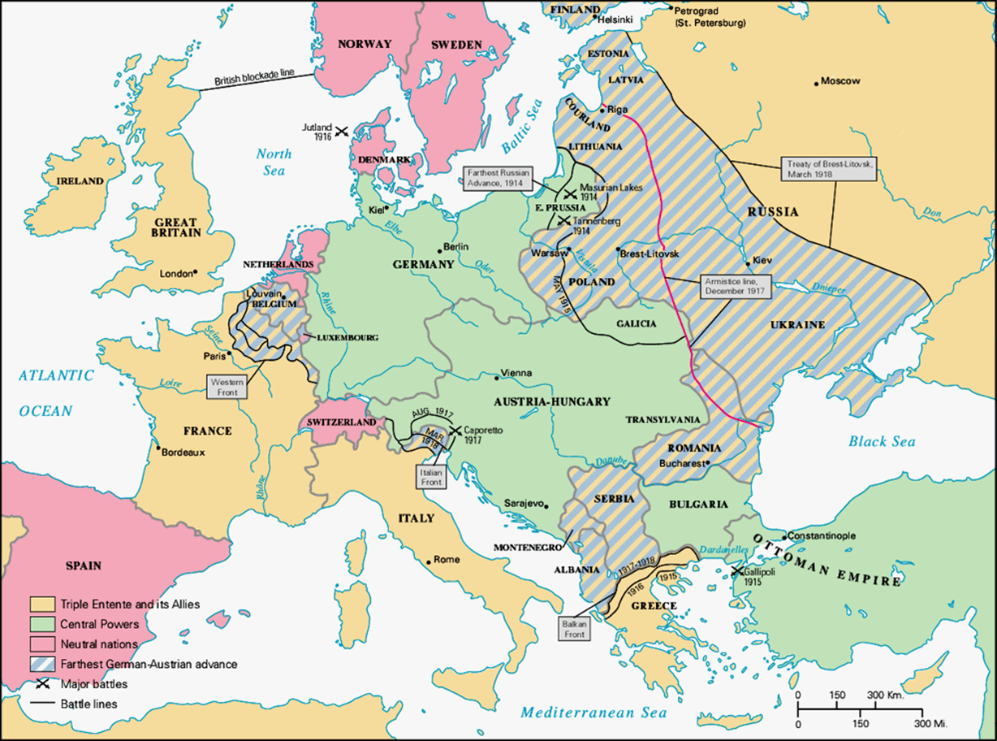
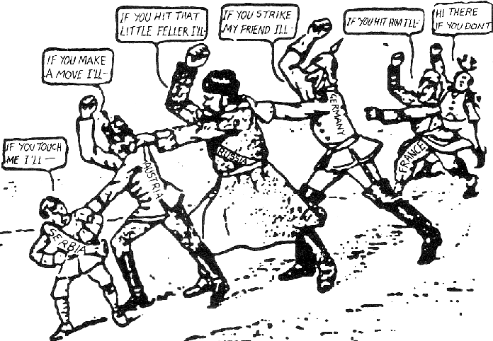
2. Alliances
Fear of other European Powers led each empire to join an alliance
In case of war, allied nations promised to help each other
Europe broke into two major alliances
CENTRAL POWERS
(Triple Alliance)
German Empire
Austro-Hungarian Empire
Italy
These three groups feared war with France, they swore to protect each other
ALLIED POWERS
(Triple Entente)
Russia
Britain
France
Feared the Triple Alliance threatened the balance of power in Europe

Slide 5
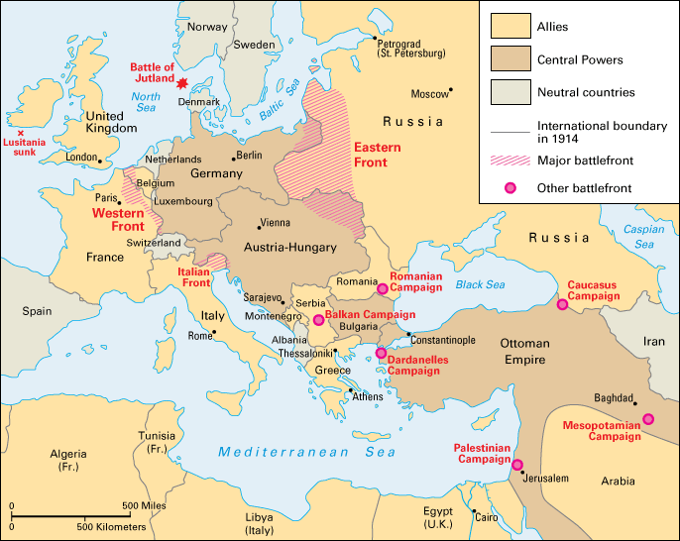
3. Imperialism
Define: Extending a country’s power and influence
European countries had worked under a mindset of imperialism for hundreds of years
Now most of the world’s land had been claimed by European powers
This caused tension throughout Europe

Slide 6
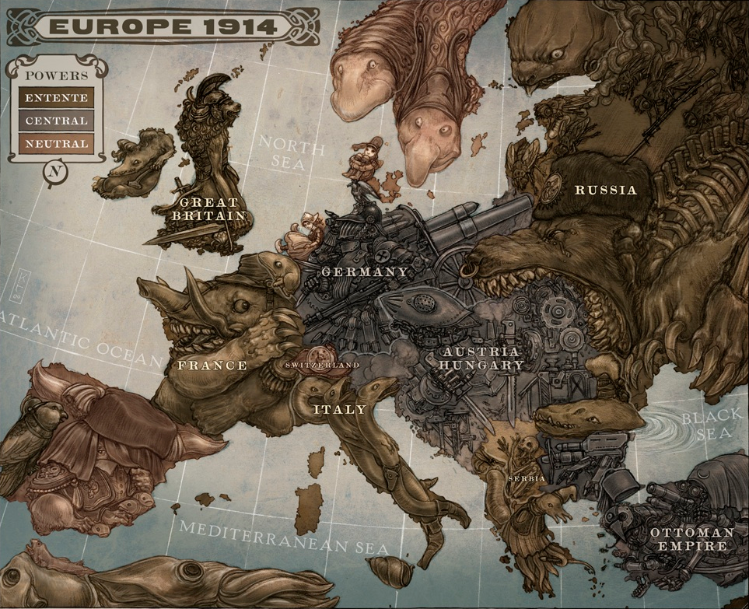
4. Nationalism
Deep patriotism and an idea of superiority
Each country wanted to prove their national strength

Slide 7
Remember MAIN
M: Militarism
A: Alliances
I: Imperialism
N: Nationalism

Slide 8
The Spark: The assassination of Franz Ferdinand
Franz Ferdinand (Duke of Austro-Hungarian Empire) was shot by a Serbian
Austro-Hungarian Empire declares was on Serbia
Alliances dragged everyone into war
Russia mobilizes to defend Serbian allies
Russia mobilized against Germany just in case Germany entered the war
Germany declares war on Russia (defend themselves and the Austro-Hungarians)
Knowing France will enter the war on Russia’s side, Germany declares war on France before France got the chance
Britain joins to protect their French and Russian allies

Slide 9
Course of the War
World War I

Slide 10
Schlieffen Plan
German Strategy to win the war
Swift knockout of France
Then focus on Russia
Avoid two war fronts
Plan Backfired
Once Russia mobilized, Germany quickly attacked France
Germany was unable to knock out France
Opened two fronts

Slide 11
U.S. Enters War, 1917
United States initially declared neutrality, but economically favored the allied powers
Germany bombed ships headed for Britain
Killed Americans and destroyed American goods/equipment
Zimmerman Telegram
This was a telegram from Germany to Mexico that was intercepted by the Americans
Germans were trying to convince Mexico to attack America

Slide 12
Recipe Card

Slide 13
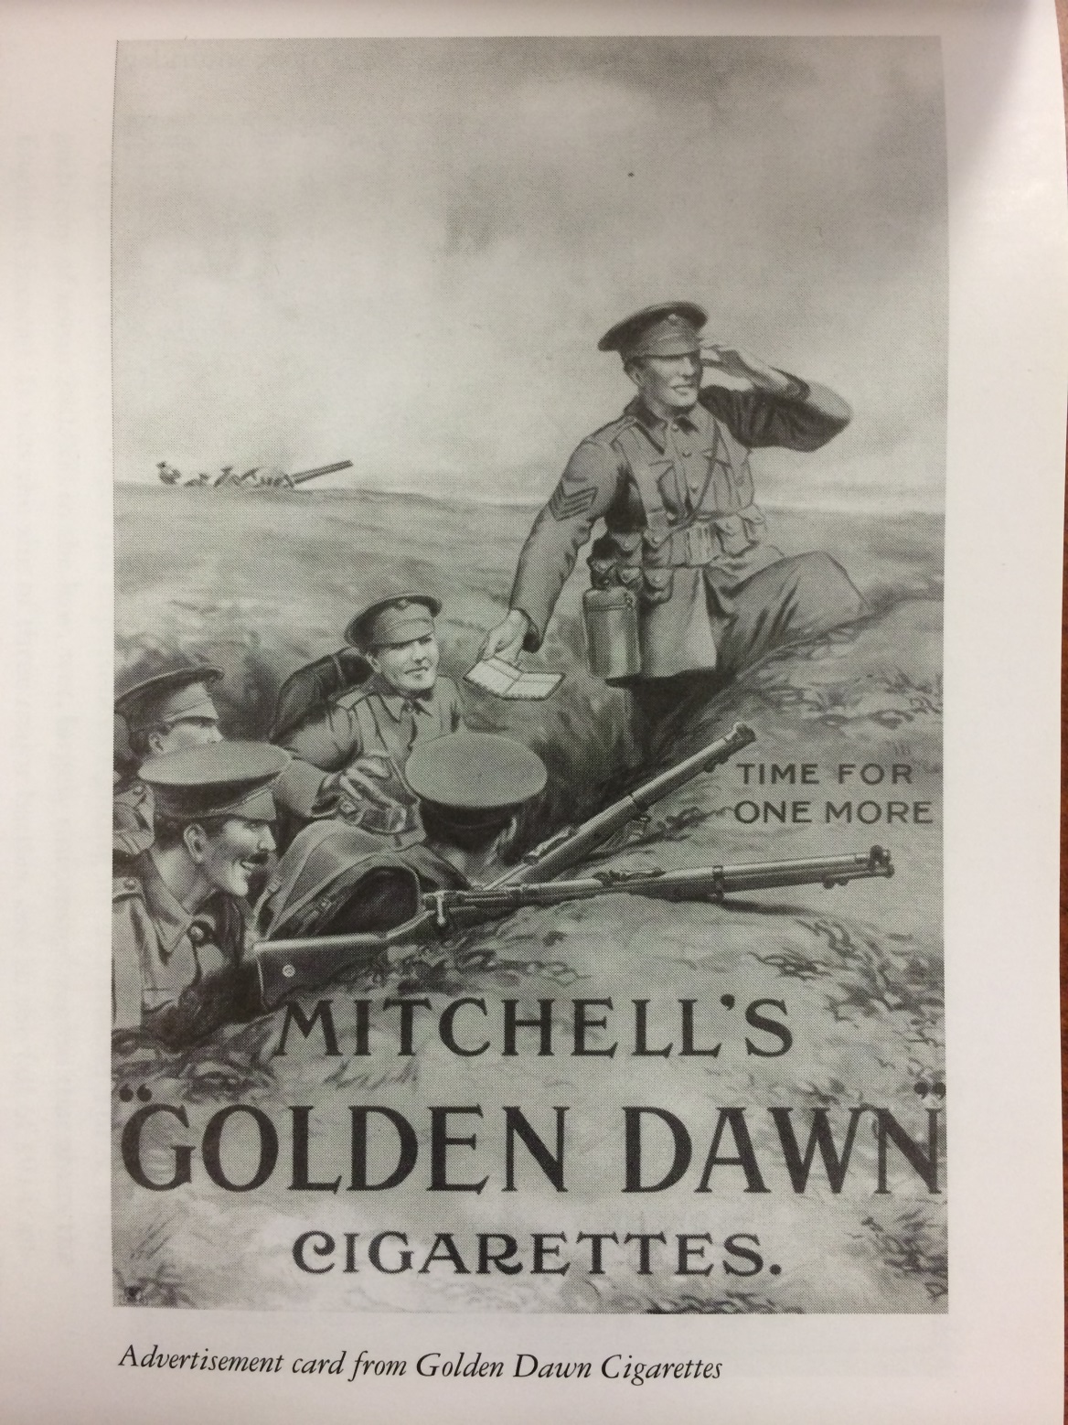
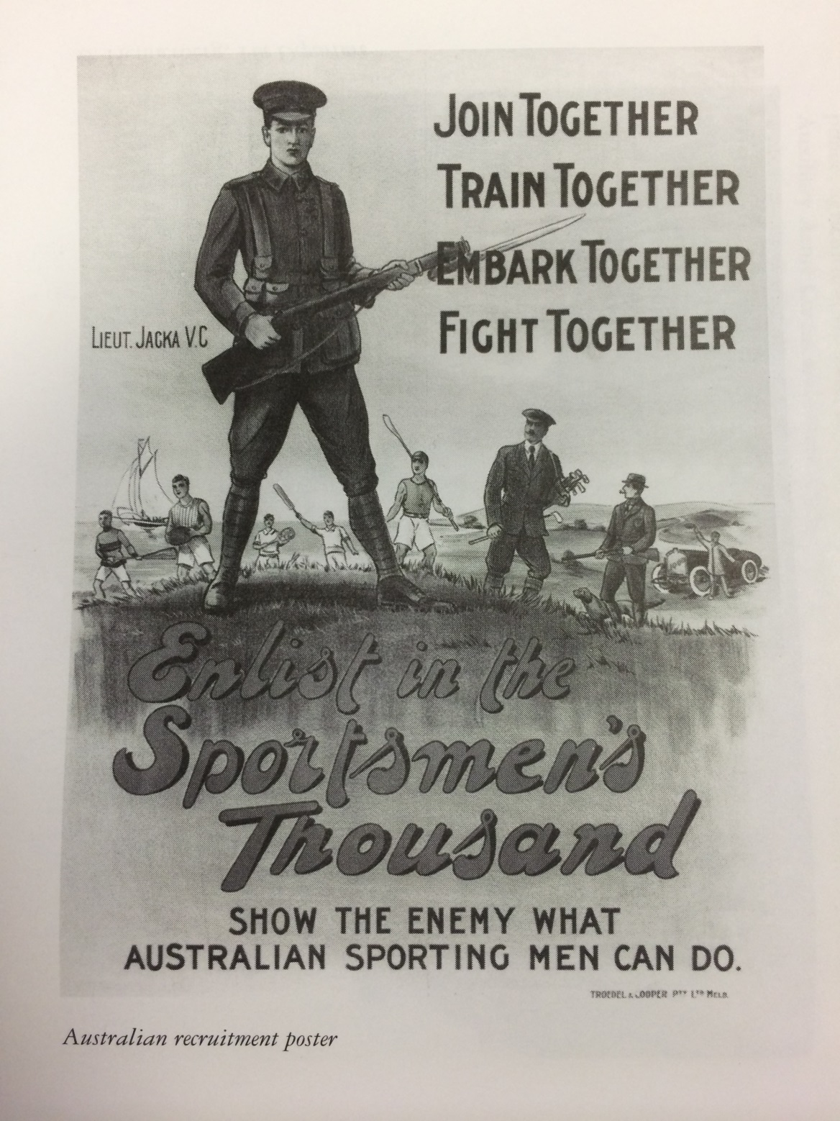
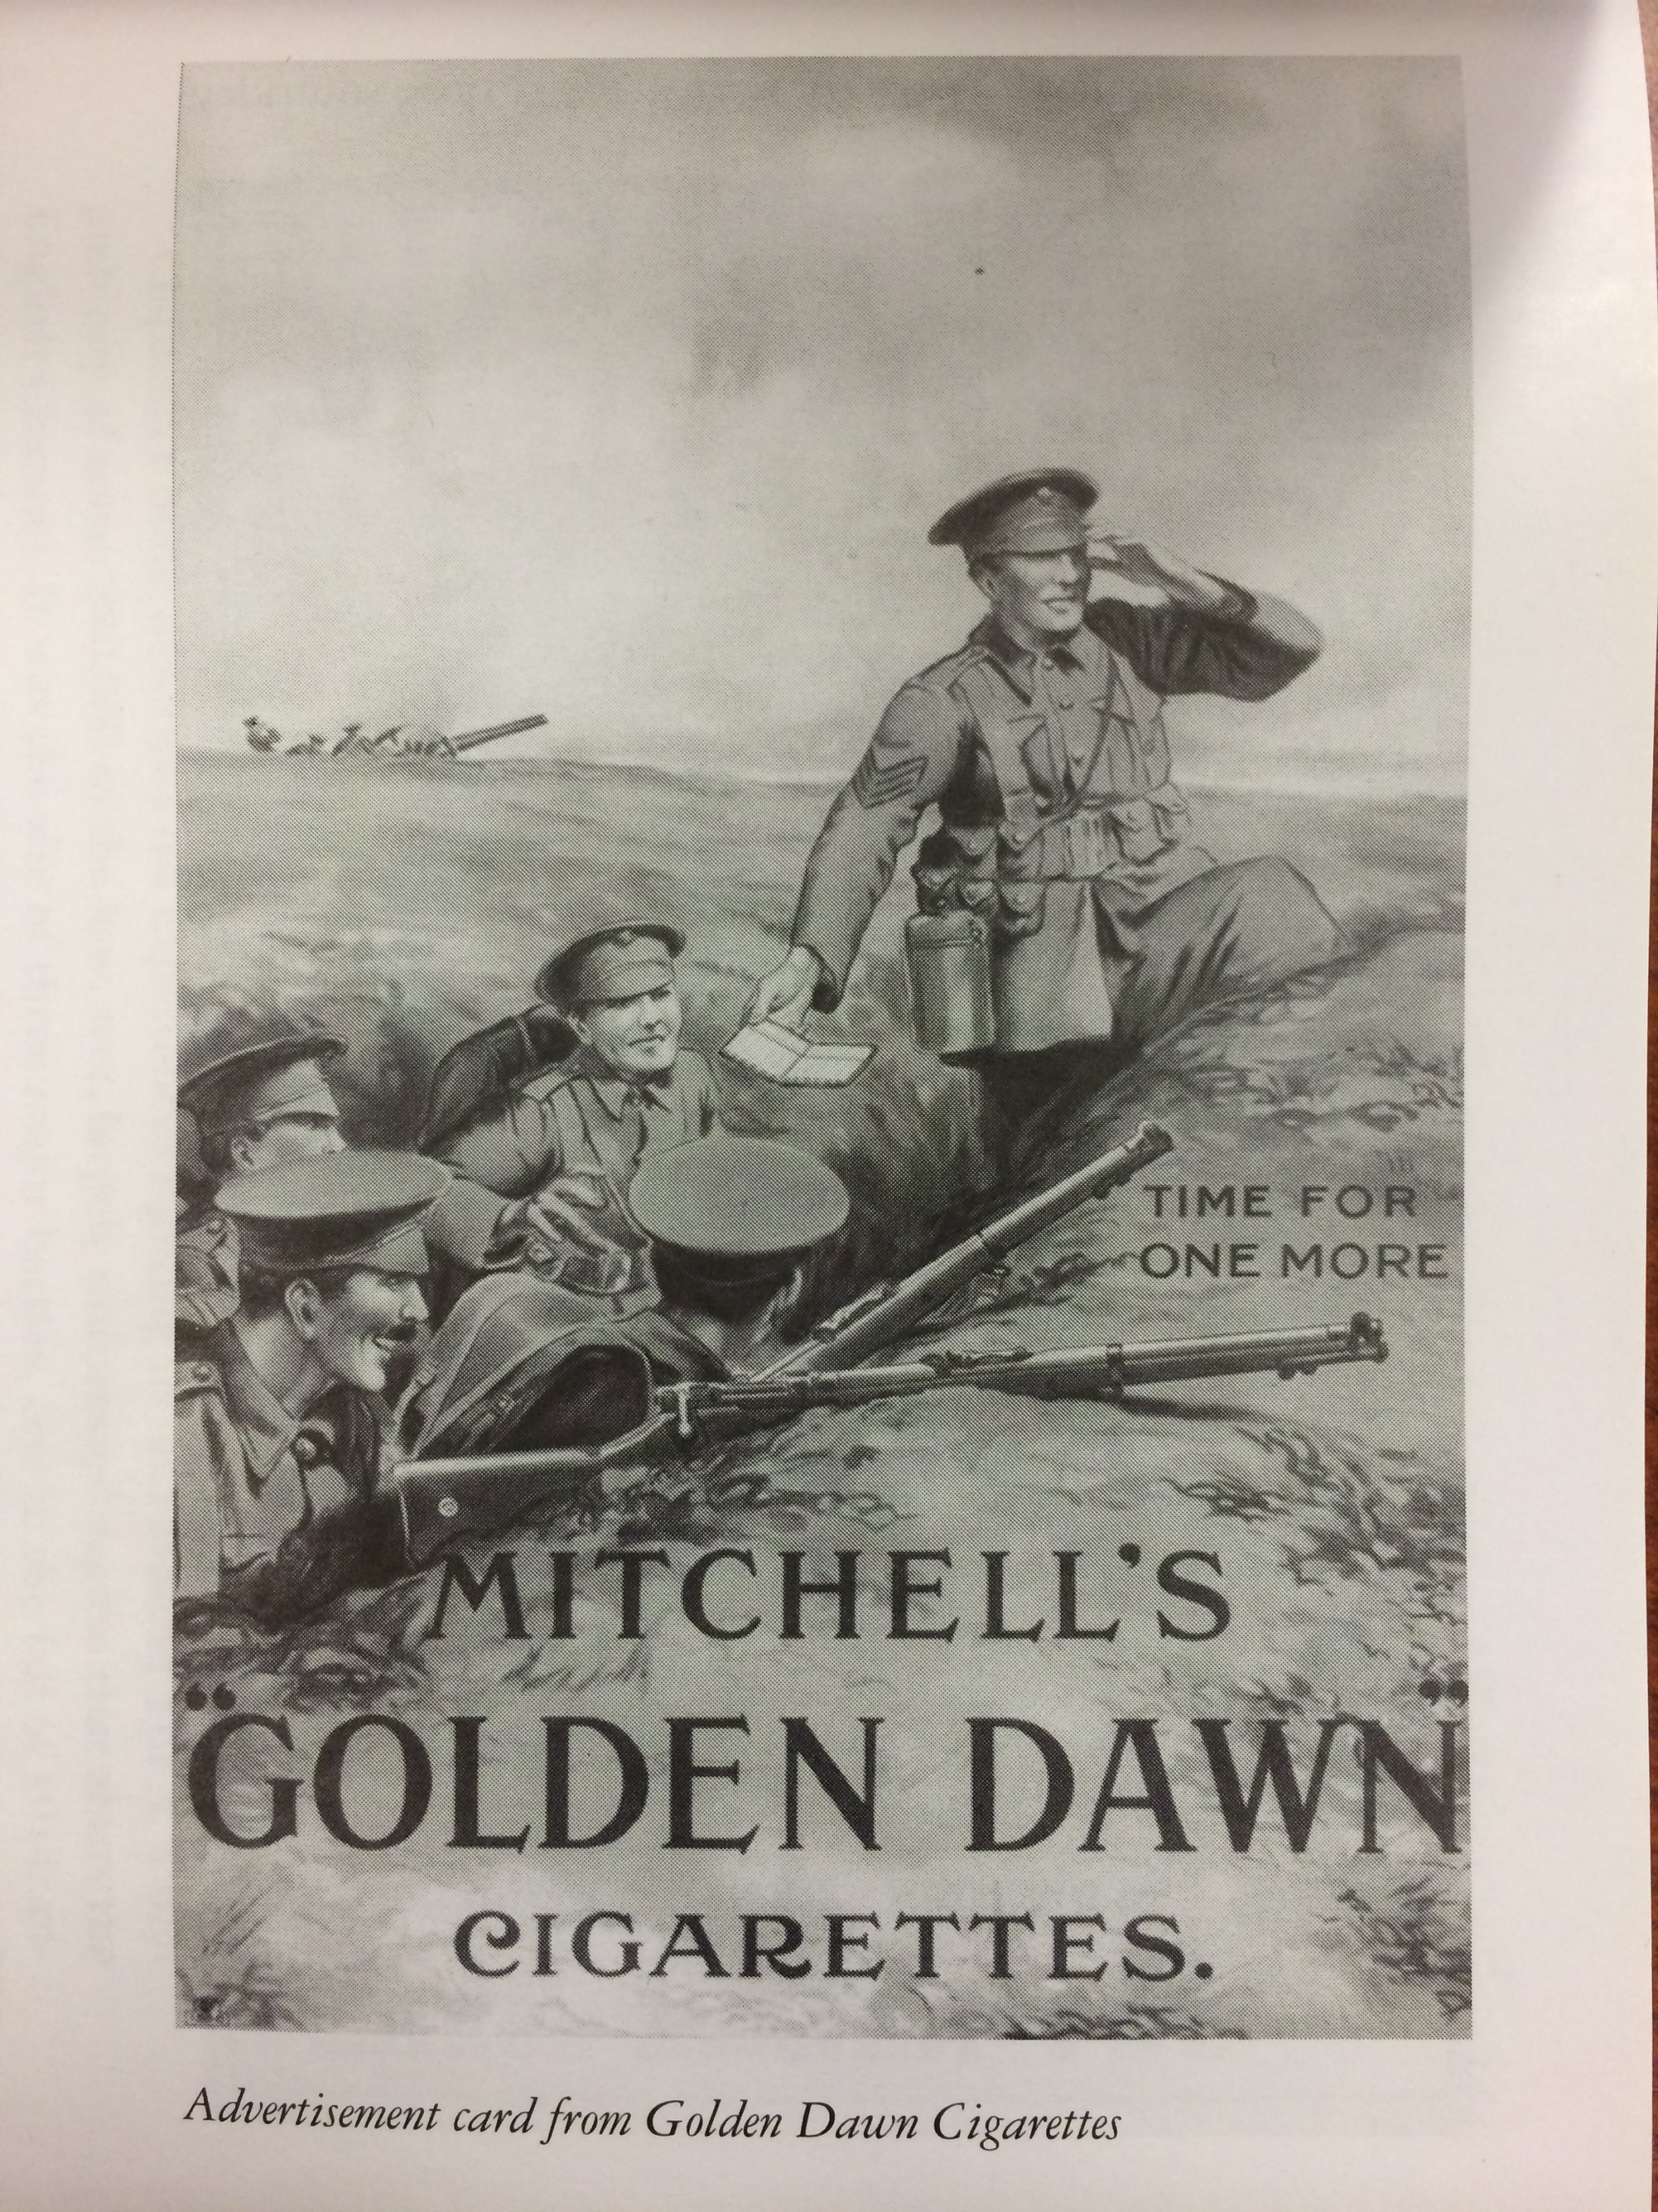
The Great War
Everyone jumped at the chance to prove National strength
People danced when war was declared
Crowds cheered
Parades
Everyone was convinced it would last only a short while
Turned out to be the opposite of a “Great War”
The most brutal war fought up to that point
Lasted from 1914-1918

Slide 14
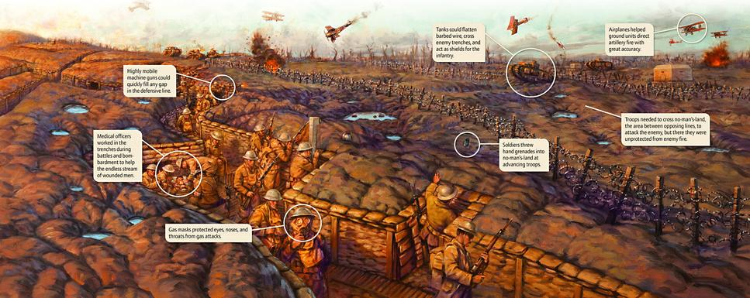
Trench Warfare
Trench warfare
Each group dug in on opposite sides
No man’s land in-between sides, covered in barbed wire
Opponents went for weeks and months with no gains

Slide 15
Horrors of Trench Warfare
Rats
Disease
Constant bombardment of heavy artillery
Mud, human waste
No success
Waiting
Mustard Gas: Rotted the body from both within and without
Why was this war so much different?

Slide 16
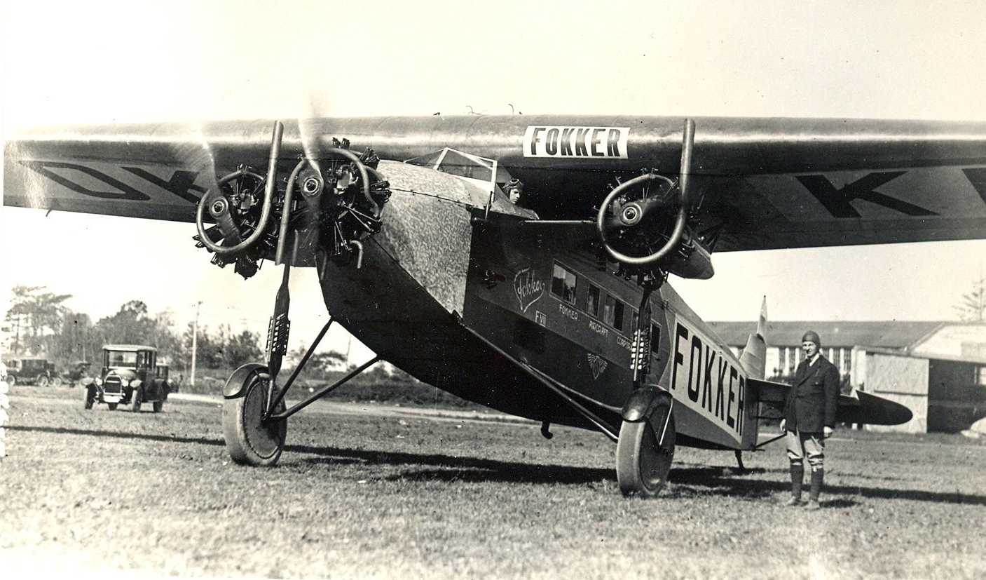
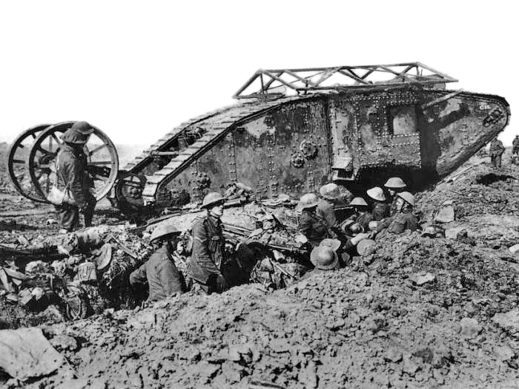
Weapons of World war i
Our weapons had advanced further than our war strategies allowed
This resulted in Trench Warfare

Slide 17
Weapons of WWI Activity

Slide 18
Dulce et Decorum Est World War I Poem Wilfred Owen
Bent double, like old beggars under sacks, Knock-kneed, coughing like hags, we cursed through sludge, Till on the haunting flares we turned out backs, And towards our distant rest began to trudge. Men marched asleep. Many had lost their boots, But limped on, blood-shod. All went lame, all blind; Drunk with fatigue; deaf even to the hoots Of gas-shells dropping softly behind.
Gas! GAS! Quick, boys!--An ecstasy of fumbling Fitting the clumsy helmets just in time, But someone still was yelling out and stumbling And flound'ring like a man in fire or lime.-- Dim through the misty panes and thick green light, As under a green sea, I saw him drowning.
.
In all my dreams before my helpless sight He plunges at me, guttering, choking, drowning
If in some smothering dreams, you too could pace Behind the wagon that we flung him in, And watch the white eyes writhing in his face, His hanging face, like a devil's sick of sin, If you could hear, at every jolt, the blood Come gargling from the froth-corrupted lungs Bitter as the cud Of vile, incurable sores on innocent tongues,-- My friend, you would not tell with such high zest To children ardent for some desperate glory, The old Lie: Dulce et decorum est Pro patria mori.
Dulce et Decorum Est Pro Patria Mori means: tis sweet and right to die for your country
Notes:
Dulce et Decorum Est Pro Patria Mori means: tis sweet and right to die for your country

Slide 19
Propaganda Activity

