Slide 1
Industrial Revolution
West and Transportation

Slide 2
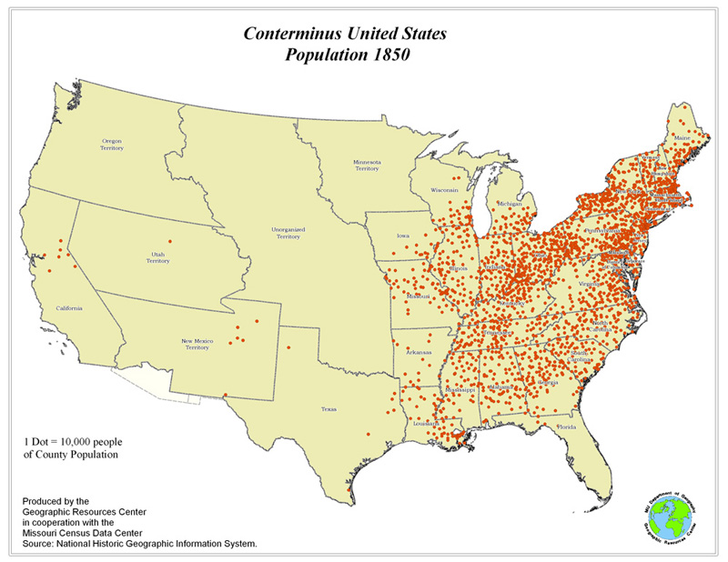
What’s the Problem?
Industrialism Needs:
Raw Materials
Factory System
Transportation to export finished products

Slide 3
TRANSPORTATION
Industrial Revolution in the West

Slide 4
Transportation Revolution
Two most important innovations
Steamboat
Railroad
A period of rapid growth in the speed and convenience of travel

Slide 5
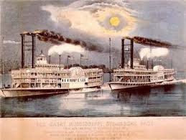
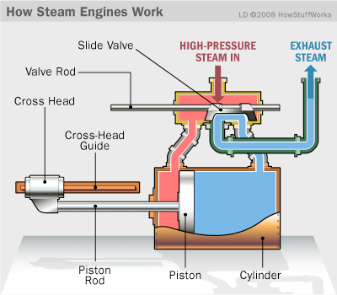
Steam Engines
Invention of steam powered engine offered first breakthrough of the Transportation Revolution
Allowed for Robert Fulton to create steamboat
Move quickly against the current no matter weather conditions

Slide 6
Railroad
Railroad revolutionized land travel
Used steam engine to power the railroads
Made transportation more efficient and cost effective

