Slide 1
Religions Role
English Settlement

Slide 2
Protestant Reformation
“Protest” the Catholic Church
Began by Martin Luther
95 Theses: Writes everything he thinks is wrong with the Catholic Church
Many Europeans break away from the Catholic Church
Remain deeply Christian

Slide 3
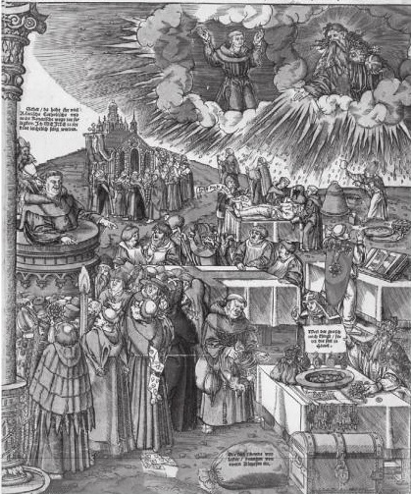
Problems with Catholicism
Sell of Indulgences
Rely on Saints, not on Christ
Looking down on man instead of up to God
Preaching words not from the Bible
Gambling and other secret sins amongst church leaders
Materialism and wealth amongst church leaders
No Christian acts of kindness

Slide 4
Church of England
One such break off is the Church of England
King Henry VIII of England
Obsessed with providing an heir to throne
Wife doesn’t birth a son
King Henry VIII wants the marriage annulled
Pope says no
King Henry creates a new church
Church of England

Slide 5
King Henry’s Attempt to Provide an Heir
WIFE | HEIR? | END OF MARRIAGE
Catherine of Aragon | Daughter named Mary | Divorced
Anne Boleyn | Daughter named Elizabeth | Executed by Henry
Jane Seymour | Son named Edward; sickly and dies at 16 | Died in child birth
Anne of Cleves | No Son | Divorced
Kathryn Howard | No Son | Executed by Henry
Katherine Parr | No Son | Widowed

Slide 6
Puritans and Pilgrims

Slide 7
PURITANS v. SEPARATISTS
Puritans: Protestant group trying to purify the Church of England
Separatists: Most extreme group of Puritans. Wanted to completely separate from the Church of England

Slide 8
Pilgrims Establish Plymouth
Pilgrims were Separatists
Left England in 1620
Sailed on the Mayflower
Established Plymouth

Slide 9
Mayflower Compact
Mayflower compact was a document written by the Pilgrims that made general guidelines for self government

Slide 10
The First Thanksgiving and Culture
Squanto and Samoset: 2 Indians that helped the pilgrims
Taught them how to farm and fertilize the ground
First Thanksgiving with the Wampanoag Indians to celebrate the fall harvest
Religion played a major role in society.

