Slide 2
Islam
The five pillars and traditions

Slide 3
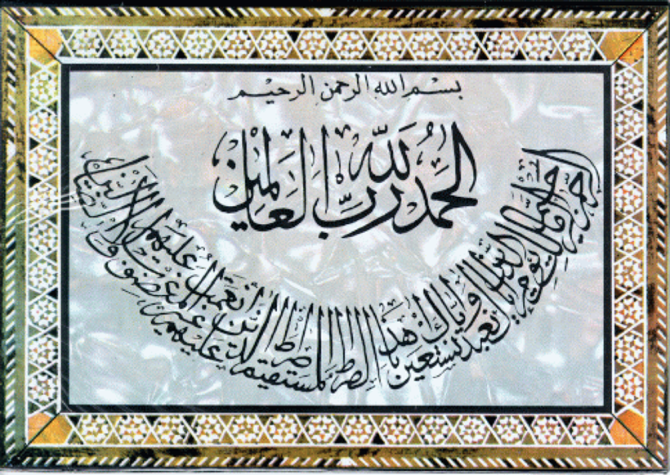
Pillar One: Faith
There is no God but Allah. Muhammad is his Prophet and Messenger.

Slide 4
Pillar Two: Prayer (Salat)
PRAY 5 TIMES A DAY.
Face Mecca.
Forehead to the ground.

Slide 5
Pillar Three: Charity (Zakat)
Muslims are required to give alms (help) to those less fortunate than themselves and to support the mosque.
2.5% every year

Slide 6
Pillar Four: Fasting
RAMADAN: Holy month of fasting and celebration.
9th month of the Islamic calendar (changes every year).
Fasting from dawn to dusk.
It is seen as a great celebration

Slide 7
Pillar Five: Pilgrimage (Hajj)
HAJJ: A pilgrimage (trip) to Mecca once in their lifetime to visit the Kaaba and participate in other religious ceremonies.

Slide 8
Mecca
The most holy city to Muslims
It has the Ka’aba
  It is a structure said to me built by Abraham and Ishmael
  The Black Stone is found within this structure
    Said to be a stone given by the angel Gabriel to Abraham

Slide 9
Medina
Medina is the #2 holy city to Muslims--this is where followers first accepted Muhammad.

Slide 10
JERUSALEM
Jerusalem is the #3 holy city. The Dome of the Rock is where Muhammad ascended to heaven.

Slide 11
More beliefs
Islam forbids alcoholic beverages, gambling, and eating pork
Also forbids lending money and charging interest
On judgment day God will separate the good from the bad, God decides who has salvation
Jihad is the struggle against good and evil within yourself or in war (inner struggle most important).

Slide 12
QUR’AN
(Koran, Quran)
The holy book of Islam
Teachings of the Prophet Muhammad who Muslims believe spoke the word of God
Similar stories and accounts to those found in the Old Testament and Torah

