Slide 1
Washington’s Presidency
Foreign and Domestic Policy

Slide 2
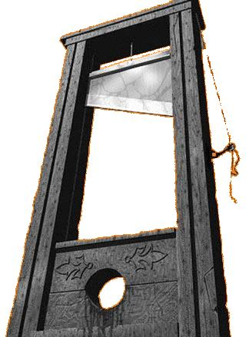
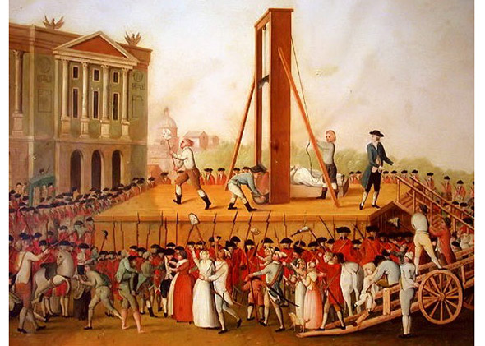
French Revolution and US Neutrality
Rebellion of French People against Monarch
Stormed Bastille
Declaration of the Rights of Man
“liberty, equality, and Fraternity [brotherhood]”
Thomas Jefferson initially supported the French Revolution
European Liberty
Shortly after the Revolution started Great Britain went to war with France
Washington proclaimed neutrality

Slide 3
Citizen Genet
French Representative to U.S.
Recruited ordinary citizens to help fight the British
Privateers
Upset that U.S. refused to help France
Jefferson resigned from his cabinet position

Slide 4
Jay’s Treaty
British seized all ships carrying food to the French West Indies
Stop supplies to French during their war with France
British captured hundreds of neutral American merchant ships
John Jay was the US Chief Justice
Sent to London to work out peaceful resolution
Treaty
Small American merchant ships were allowed to continue trading items in Caribbean
British would abandon forts in frontier
U.S. would pay pre-Revolutionary debts to British merchants

Slide 5
Pinckney’s Treaty
Pinckney was the U.S. ambassador to Spain
Disputed border in Florida cause Spain to close port in New Orleans
Treaty
Spain agreed to change the Florida border
Reopened port in New Orleans
Opens frontier to further expansion
FAVORED U.S.

Slide 6
Conflict in Northwest Territory
Natives were upset about Americans settling in the Northwest Territory (Ohio Valley)
With help from the British Natives begin a war with the Americans
American initially lose battles
Win Battle of Fallen Timbers
Burn American Indian villages and fields
Treaty of Greenville
Gave U.S. access to American Indian lands in Northwest Territory

Slide 7
Whiskey Rebellion
Congress taxed American made Whiskey that Farmers who made the Whiskey couldn’t afford.
Farmers refused to pay the tax and tarred and feathered tax collectors
Some called themselves the new Sons of Liberty
Washington needed to prove federal authority under their new Constitution
Washington sends 13,000 militiamen
Rebels saw the army and disbanded without a battle
Whiskey Rebellion proves the strength and authority of the new federal government

