Slide 1
Vietnam War

Slide 2
Fighting Imperial Powers
Vietnam struggled for independence against France for 20 years
After the fall of France in WWII, Japan invaded Vietnam
Vietnam fought the Japanese until the end of WWII
They hoped to gain an independent country

Slide 3
Fighting the French
After WWII, France wanted to regain their broken empire
Communist Vietnamese led a campaign of Guerilla warfare to oust the French
China supported the Vietnamese

Slide 4
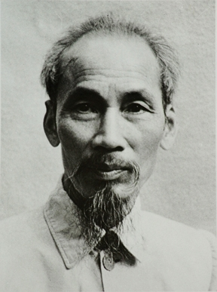
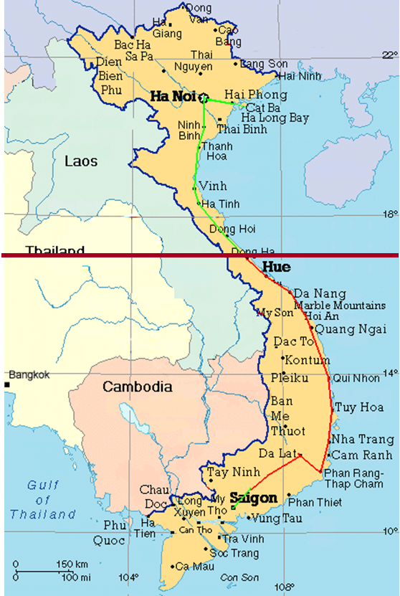
Geneva Conference
France gave Vietnam independence, but it would be divided in half
North: Communist
South: Non-Communist
U.S. supported South Vietnam in creating a non-communist government
S. Vietnam skipped elections so as to avoid the election of a Communist leader
Many Vietnamese wanted Ho Chi Minh (Communist) as their leader since he led them against the Japanese and French
Leaders of South Vietnam didn’t have support of people
Notes:
The people in South Vietnam like HO Chi Minh even though he was Communist because he led them to independence

Slide 5
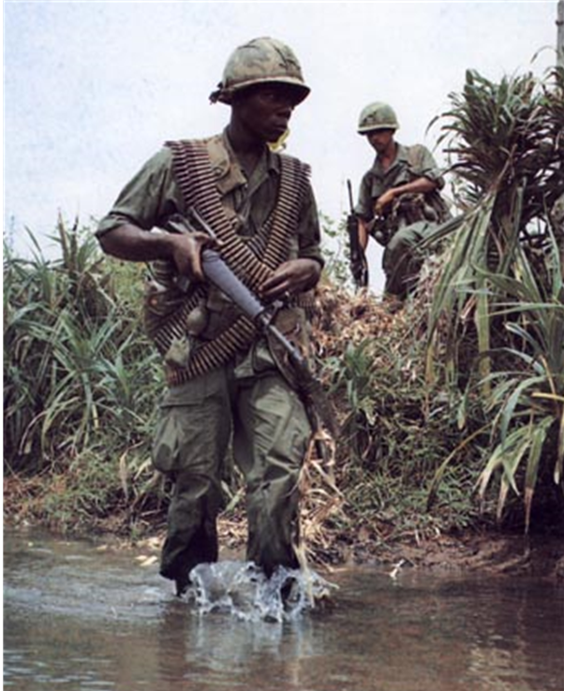
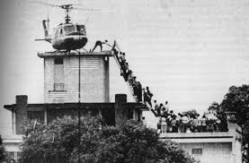
Cold War Stalemate
South Vietnamese who wanted to reunite the country under Communism, fought against U.S. military involvement
United States aided the South (those who wanted to stay separate)
USSR and China aided the North
3 Major powers ensured the war would be a long, bloody, expensive stalemate
1975 U.S. withdrew
1976 North Vietnam conquered South Vietnam and declared independence

