Slide 1
Treaty of Versailles
1. Declared that Germany was responsible for starting the war
2. Germany had to pay “reparations”. For all damages that the Allies had received during the war.
Had to reduce army to 100,000 men and eliminate air force.

Slide 2
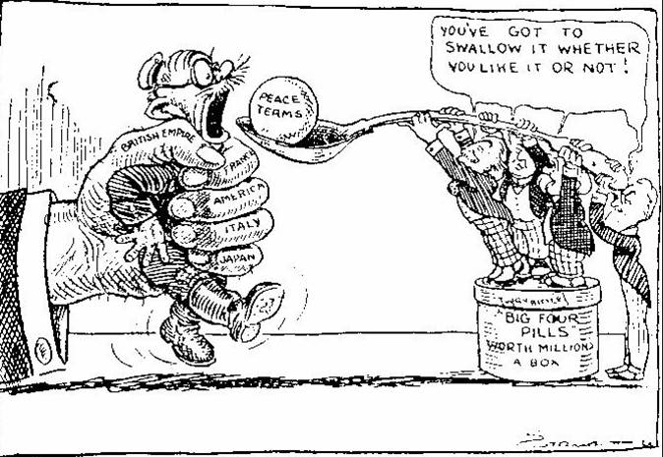

Slide 4
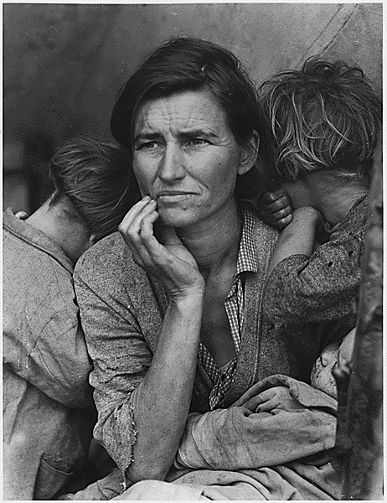
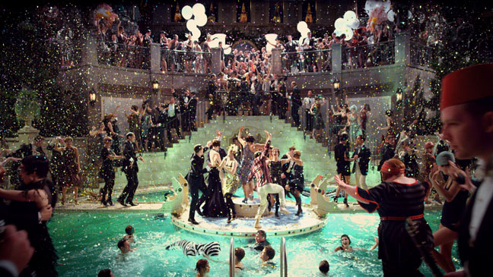
Result of the War
Define Disillusion: to realize that a belief or an ideal is false.
People stopped believing in the idea of progress and human goodness
If humans were good and always progressing, WWI would never have happened
Art and literature become more abstract and less concrete
They are disillusioned with reality
Europe falls into a time of depression
Germany tries to pay back damages (this economic crisis and destruction of Germany will lead to WWII)
America enters an age of care-free materialism
Followed by a depression

Slide 5
Effects on Germany
Feelings of Bitterness
Poverty
Inflation
A street car ride cost more than a long trip.
4 eggs = 2 million marks

Slide 13
Exit Slip Quiz
Use complete sentences to answer the following questions on a separate piece of paper.
Describe 2 causes of World War I? (Full sentences)
What led the Americans to enter the War?
What did the Treaty of Versailles do to Germany? What did this eventually lead to?

