Slide 1
The West
States and Capitals

Slide 2
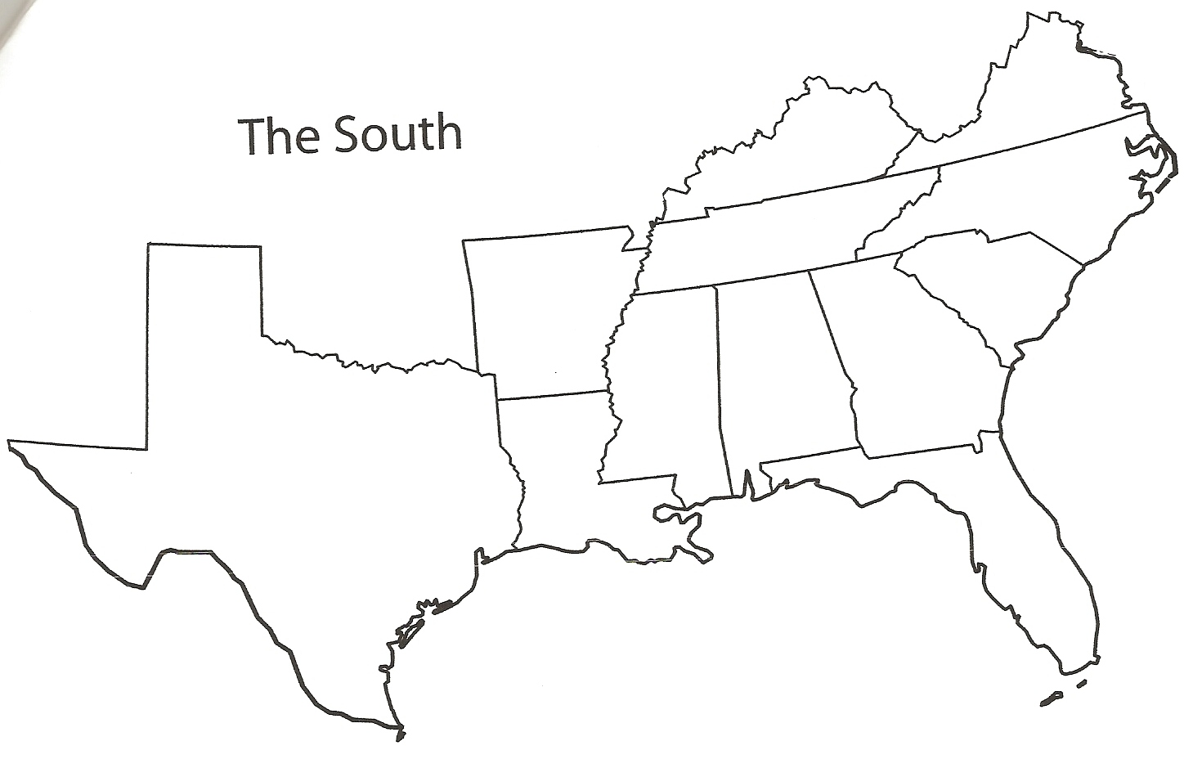
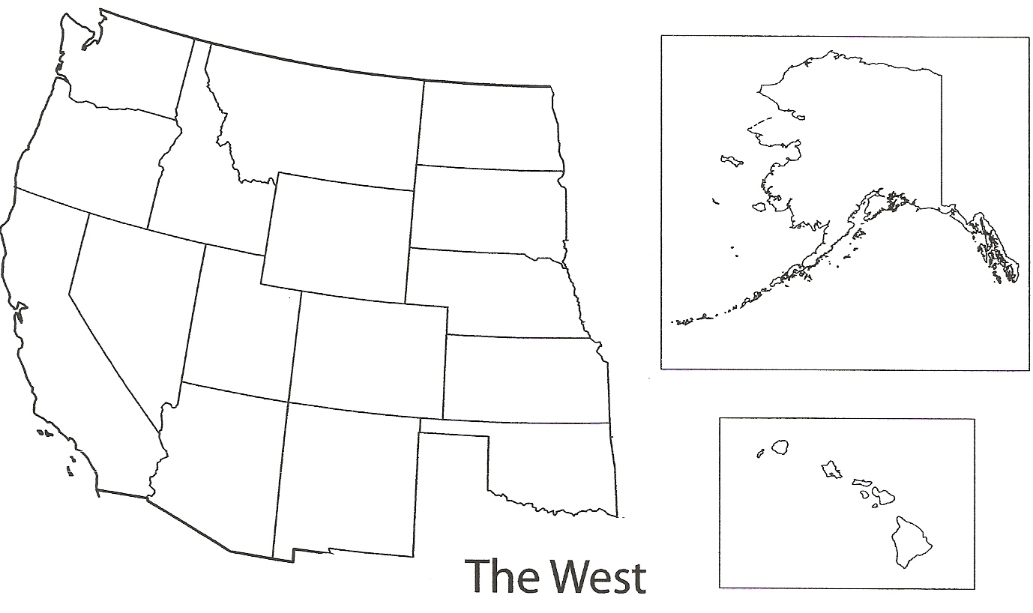

Slide 3
Washington
Washington
Home of Starbucks, soft serve ice cream, Bill Gates and the Microsoft Corporation

Slide 4
Oregon
Oregon
Home of Crater Lake—the deepest lake in the United States and the only lake formed in the remains of a volcano.

Slide 5
California
California
It is estimated there are approximately 500,000 detectable seismic tremors in California annually.

Slide 6
Nevada
Nevada
Las Vegas has more hotel rooms than any other place on earth. They also have 205,726 slot machines.

Slide 7
Idaho
Idaho
Rigby is known as the birthplace of television.

Slide 8
Utah
Utah
Home of the first department store—ZCMI.

Slide 9
Arizona
Arizona
At one time, camels were used to transport goods across Arizona.

Slide 10
Montana
Montana
46 out of Montana's 56 counties are considered "frontier counties" with an average population of 6 or fewer people per square mile.

Slide 11
Wyoming
Wyoming
The equality state-first state to give women the right to vote. Also home of the first national park, coal mine, and JC Penney.

Slide 12
Colorado
Colorado
Colorado is the only state in history to turn down the Olympics.

Slide 13
New Mexico
New Mexico
Albuquerque hosts the worlds largest air balloon fiesta every October.

Slide 14
North Dakota
North Dakota
The town of Rugby is the geographical center of North America.

Slide 15
South Dakota
South Dakota
Home of Mount Rushmore and Crazy Horse, which when finished will be the world’s largest scupture.

Slide 16
Nebraska
Nebraska
The Naval Ammunition Depot located in Hastings provided 40% of WWII's ammunition.

Slide 17
Kansas
Kansas
Home of the first Pizza Hut.

Slide 18
Oklahoma
Oklahoma
Beaver, Oklahoma holds a World Championship Cow Chip Throw each April

Slide 19
Alaska
Alaska
Alaska is two times the size of Texas. They also have areas that receive 24 hours of daylight or darkness.

Slide 20
Hawaii
Hawaii
Hawaii produces 1/3 of the world’s supply of pineapples.

