Slide 1
The South
States and Capitals

Slide 2
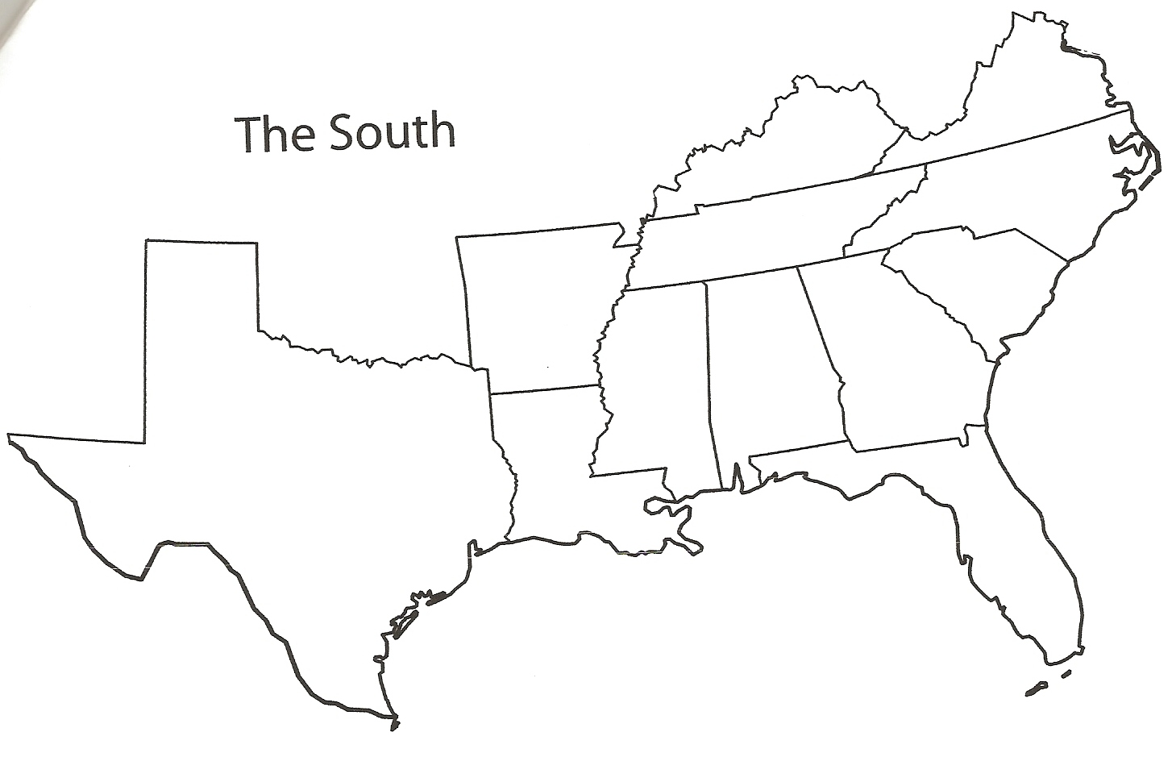

Slide 3
Texas
Texas
The world’s first rodeo was held in Texas on July 4, 1883

Slide 4
Arkansas
Arkansas
The World Championship Duck Calling Contest is held in Stuttgart, Arkansas

Slide 5
Louisiana
Louisiana
The Battle of New Orleans was fought in Louisiana two weeks after the War of 1812 ended.

Slide 6
Kentucky
Kentucky
The oldest horse race in the country, the Kentucky Derby, is held at Churchill Downs in Louisville, Kentucky.

Slide 7
Tennessee
Tennessee
Davy Crockett, Casey Jones (Casey Jr.), Dolly Parton, and Elvis Presley all lived in Tennessee.

Slide 8
Mississippi
Mississippi
The International Checkers Hall of Fame is in Petal, Mississippi.

Slide 9
Alabama
Alabama
The first rocket to put humans on the moon was built in Huntsville, Alabama

Slide 10
Georgia
Georgia
Coca-Cola was invented in Atlanta, Georgia.

Slide 11
Florida
Florida
Florida has two different rivers that have the same name, Withlacoochee

Slide 12
South Carolina
S. Carolina
The first battle of the Civil War took place at Fort Sumter.

Slide 13
North Carolina
N. Carolina
Krispy Kreme Doughnut was founded in Winston-Salem, North Carolina

Slide 14
Virginia
Virginia
Seven Presidents are buried in Virginia: Washington, Jefferson, Madison, Monroe, Tyler, Taft and Kennedy.

