Slide 1
The Northeast

Slide 2
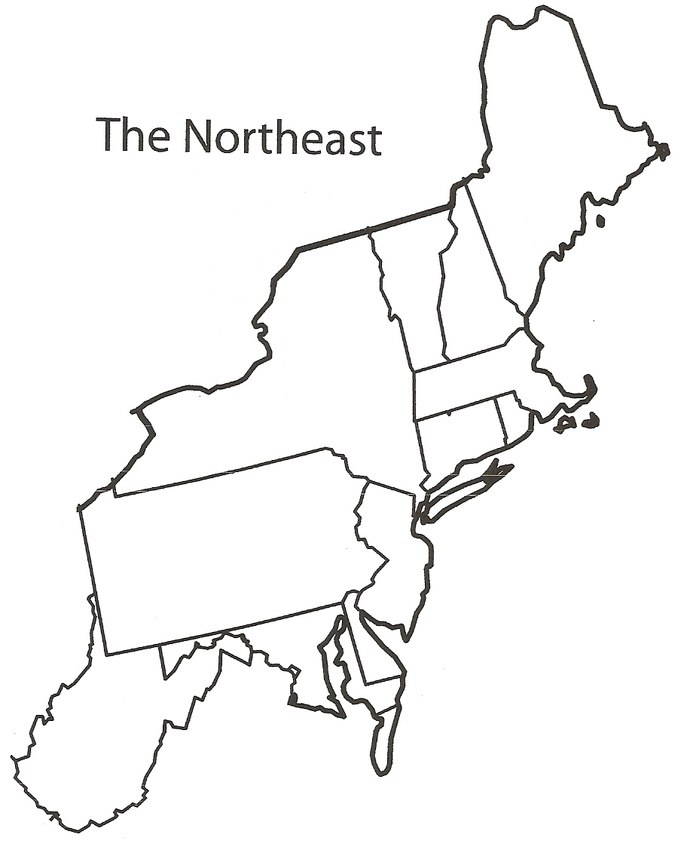

Slide 3
Maine
Maine
90% of the country’s toothpick supply is produced in Maine

Slide 4
New Hampshire
The first public library in the United States was founded in 1833 in Peterborough, New Hampshire.
New Hampshire

Slide 5
Massachusetts
Home of the Basketball Hall of Fame, the first Dunkin Donuts, and Harvard—the first college in North America.
Massachusetts

Slide 6
Vermont
Montpelier is the smallest state capital and the only one without a McDonalds. Also, it is the largest producer of maple syrup in the U.S.
Vermont

Slide 7
Connecticut
Home of the first hamburger, colored television, helicopter, and Polaroid camera.
Connecticut

Slide 8
Rhode Island
Rhode Island’s founder, Roger Williams, is often given credit for the first amendment—freedom of speech, religion, and assembly.
Rhode Island

Slide 9
New York
An average of 4.9 million people ride the New York City subway each weekday.
New York

Slide 10
New Jersey
New Jersey has the highest population density in the U.S.—1030 people per sq. mi.
New Jersey

Slide 11
Pennsylvania
Home of Crayola Crayons, Hershey Chocolate, and Silly Putty.
Pennsylvania

Slide 12
West Virginia
West Virginia’s nickname is the Mountain State, yet its highest point is only 4861 feet (about the same elevation as Payson).
West Virginia

Slide 13
Maryland
Babe Ruth was born in Baltimore, Maryland
Maryland

Slide 14
Delaware
Delaware was the first state to ratify the United States Constitution.
Delaware

