Slide 1
The Midwest

Slide 2
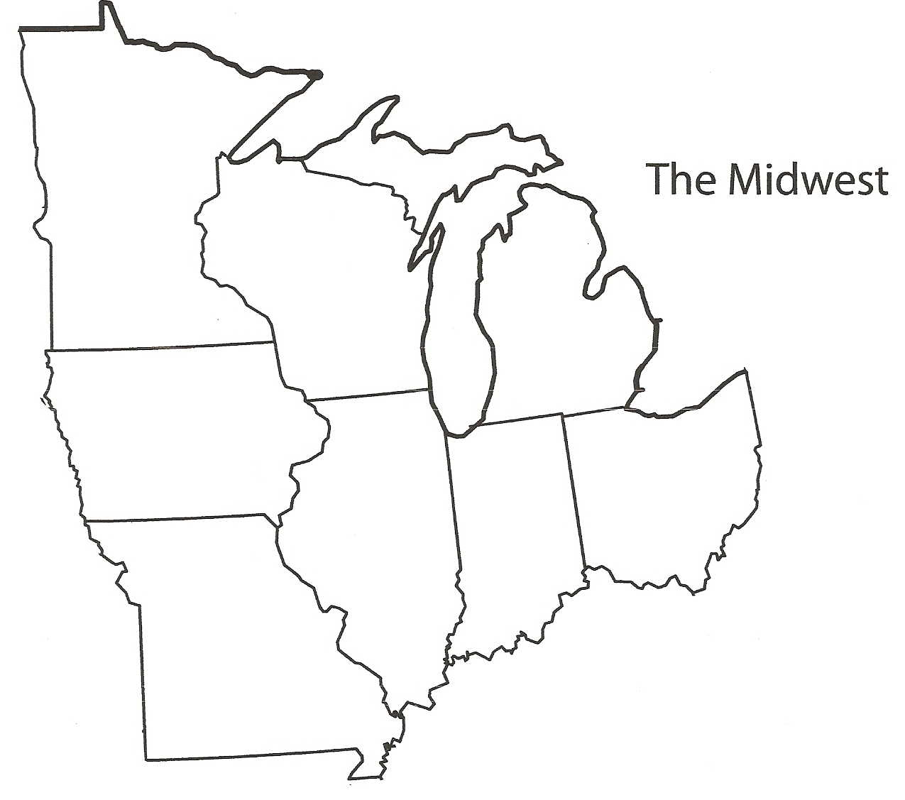

Slide 3
Minnesota
Minnesota
Home of the Mall of the America (the size of 78 football fields), Mars candy bars, Tonka Trucks, and Laura Ingalls Wilder.

Slide 4
Iowa
Iowa
John Wayne, Buffalo Bill, and Frederick Maytag are all from Iowa.

Slide 5
Missouri
Missouri
The tallest man in documented medical history was Robert Pershing Wadlow from St. Louis. He was 8 feet, 11.1 inches tall

Slide 6
Wisconsin
Wisconsin
There are 14,000 lakes in the state of Wisconsin.

Slide 7
Illinois
Illinois
Home of the Sears Tower (tallest building in North America) and the first Mcdonald’s.

Slide 8
Michigan
Michigam
Detroit is known as the car capital of the world. Michigan is also the home of Kellogg Company.

Slide 9
Indiana
Indiana
The first professional baseball game was held in Fort Wayne, Indiana on May 4, 1871

Slide 10
Ohio
Ohio
America’s first traffic light was in Cleveland, Ohio. Ohio is also home of the Rock and Roll and the Pro Football Halls of Fame.

Slide 12
