Slide 1
Texas Independence

Slide 2
American Settlers in Texas
Mexico wanted more settlement in Texas
Mexico sent agents to bring settlers to Texas
20,000 Americans moved to Texas for cheap or free land

Slide 3
Trouble in Texas
Mexico required all foreign immigrants
Become Mexican citizens
Obey Mexican laws (which included no slavery)
Support Catholic Church
Texans didn’t like these requirements
Especially anti-slavery laws
After seeking peaceful independence
Stephen F. Austin called for Texans to rebel against Mexico

Slide 4
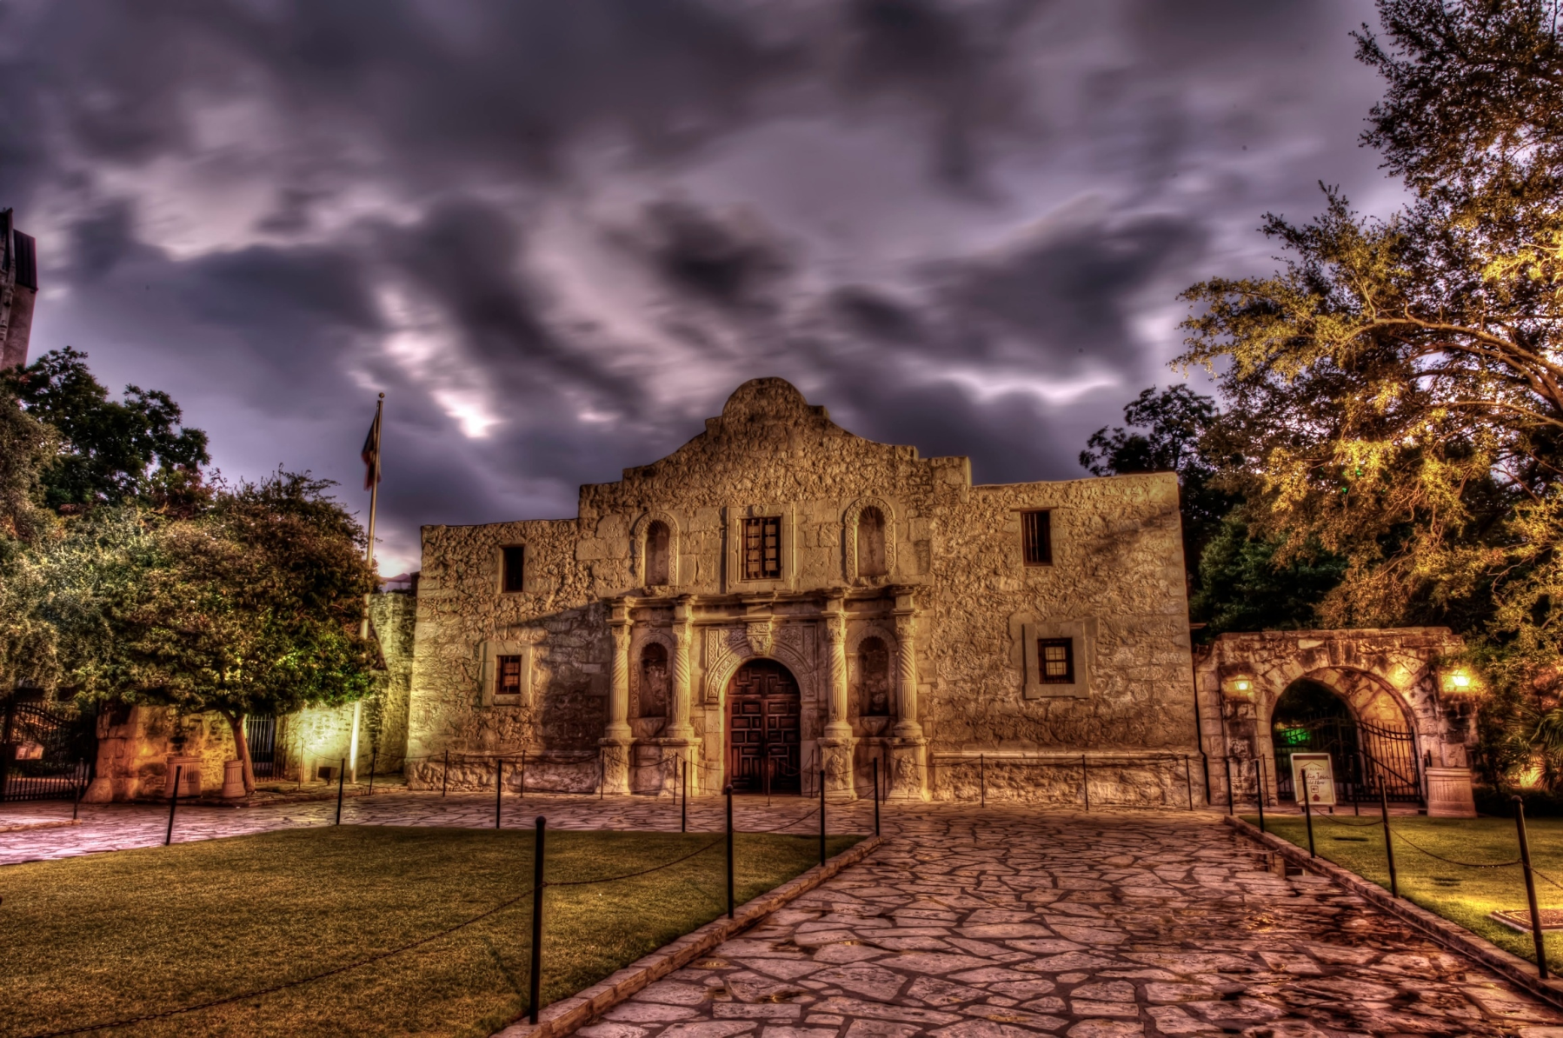
Texan Revolution
Revolution begins (cannon story pg 494)
The Alamo
189 Texans occupied an old Mission in Texas
1,800 Mexican soldiers surrounded the Texans
Texans held off the Mexicans for two weeks
All the Texan defenders of the Alamo were killed
“Remember the Alamo” became a rallying cry in Texas to continue the fight against Mexico
Sam Houston eventually became commander of the Texans
He led the Texans to victory against Mexico
http://www.history.com/topics/alamo/videos/the-alamo?m=51896f7467b39
Notes:
Mexican army tried to remove a cannon located in a Texas city, rebels stood next to cannon with a flag reading “come and take it”, Texans defeated Mexican soldiers

Slide 5
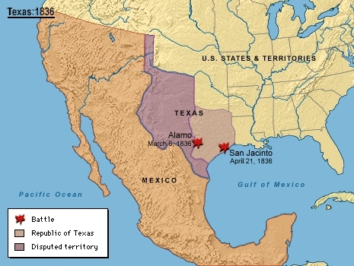
Texas Independence
Houston defeats Santa Anna (Mexican leader)
Houston forced Santa Anna to sign a treaty giving Texas Independence
Santa Anna was thrown out of power when he returned
Sam Houston became the first president of the Republic of Texas
Many Mexicans didn’t accept Texas as an independent country
Notes:
Santa Anna became overly confident and carelessly chose his campsite, Houston was able to surprise Santa Anna and defeat his army

Slide 6
Struggles of the New Texas Republic
Economic Problems
Difficult Transportation
Increased Debt; near bankruptcy
Inflation
Lack of funds made it difficult to defend the large republic
Much of Mexico still considered Texas part of its property
Notes:
Houston disbanded the Texas army because of money issues, created the Texas Rangers, frontier defense force that later acted as law officers as well

