Slide 1
Industrial Revolution
South and Agriculture

Slide 2
Agriculture
Industrial Revolution in the South

Slide 3
Why did the South not use factories like the North?
Economy relied more on agriculture and less on Industry
Less navigable rivers
Less Transportation developments

Slide 4
Eli Whitney
Inventor who created
Interchangeable Parts
Cotton Gin

Slide 5
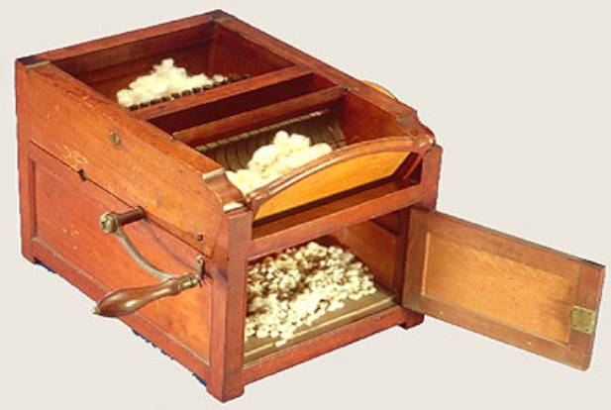
Cotton Gin
Textile factories across the world needed cotton
South produced lots of cotton
Removing seeds from cotton took hours
Cotton gin fixes this problem
Cotton gin was a machine that pulled cotton fibers from seeds

Slide 6
Interchangeable Parts
Page 401-402
Write a summary
What are interchangeable parts?
What do they make possible?
Products with Interchangeable Parts are made from pieces that are exactly the same
Makes products easier to assemble
Broken parts are easier to replace
INTERCHANGEABLE PARTS MAKES MASS PRODUCTION POSSIBLE!
Also promotes slavery
Notes:
You can make 10,000 barrel and 10,000 handles and then put them together, they will all fit
More effiecient

Slide 7
Video
http://www.biography.com/people/eli-whitney-9530201

