Slide 1
Seasons

Slide 2
I Can:
Explain the reasons for the seasons.

Slide 3
Earth / Sun relationship
Rotation:
The term for one complete spin of the Earth on its axis. (takes 24 hrs)
We see rotation as the sun“rising”in the east and “setting” in the west

Slide 4
Earth / Sun relationship
Revolution:
The term for one elliptical orbit of the Earth around the Sun.
365.25 Days

Slide 5
Tilt
The Earth is tilted at a 23.5 degree angle perpendicular to the sun.
This causes uneven heating and cooling and results in different seasons.
The tilt, combined with the Earth’s Revolution, creates seasons across the world.
Notes:
What else is 23.5 degrees?
If there was no tilt, there would be 12 hours of day and 12 hours of night throughout the entire year.
Sometimes the North pole points toward the sun and sometimes it points away from the sun.

Slide 6
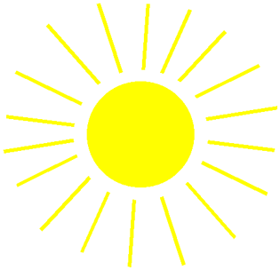
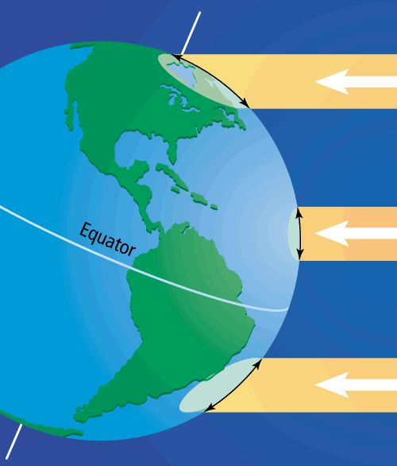
Angle of incidence

Slide 7
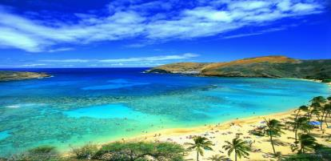
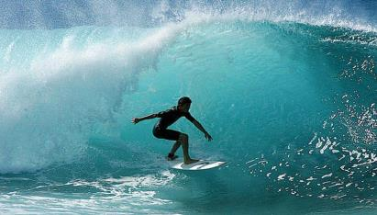
Tropics
Tropic of Cancer and Capricorn: 23.5 degrees N/S; edges of the tropic regions.
Always warm, never any freezing temperatures year round.
Found close to the Equator. (low latitudes)

Slide 8
Middle Latitudes
Between the Tropics and the Polar Regions. (23.5-66.5 degrees N/S) The Middle latitudes are the only latitude that have four true seasons.
Is Salem, Utah in the Tropics, Middle Latitudes, or Polar Regions?
Notes:
We are at about 39 degrees North.

Slide 9
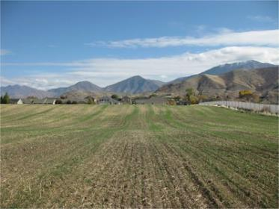
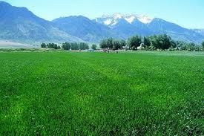
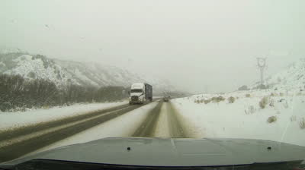
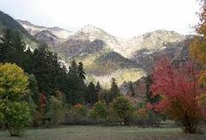

Slide 10
Polar regions

Slide 11
Polar regions
Arctic and Antarctic Circles: 66.5 degrees N/S, edges of the polar regions
Never have truly warm temperatures year round, usually below freezing.
Farthest from the equator (High latitudes)

Slide 13
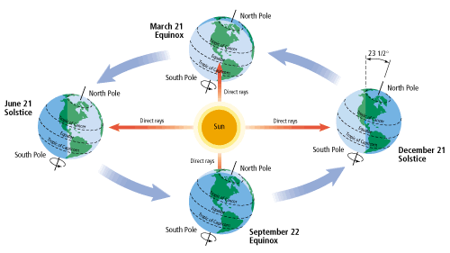
The Seasons

Slide 14
equinox
Equinox:
The two days a year when the sun crosses the earth’s equator making night and day equal length (12 hours)
Equinox means “equal night”
Spring: March 21
Fall: September 22

Slide 15
Solstices
Solstice:
The two days a year when the sun is directly overhead at its greatest distance north or south of the equator (Tropic of Cancer and Capricorn)
Summer: June 21
Longest day of the year (24 hrs of sunlight for the north pole)
Winter: December 21
Shortest day of the year (0 hrs of sunlight for the north pole)

Slide 16
Review
What term means equal hours of daylight and darkness, and occurs twice a year?
When it is summer in the Northern Hemisphere, what season is it in the Southern Hemisphere?
What season is it in the Northern Hemisphere on September 22? What season is it in the Southern Hemisphere?
On December 21 the South Pole receives how many hours of daylight?
Why are there seasons?

