Slide 1
Roman Republic

Slide 2
Legend of Remus and Romulus
Two boys descended from Greek ancestors who migrated to Italy
Abandoned in the Tiber River; expected to die
She-wolf saved them and nursed them to health
Boys grew strong and courageous
Romulus founded the city of Rome and established himself as King

Slide 3
Social Structure
Patricians: Wealthy land owners; ruling class
Plebeians: Less wealthy landowners, merchants and small farmers; largest group
Both could vote, only patricians could be elected to office

Slide 4
Rome’s Republic
Define Republic: Government ruled by elected representatives
2 Consuls
Chosen every year
Led Army
Ran Government
Power to become dictator in emergencies
2 Praetors
Civil Law- Law for citizens
Assemblies
Elected Consuls and Praetors
Passed laws
Organized by classes based on wealth; wealthiest citizens always had a majority
Plebeians voice often went unheard
Senate
300 Patricians
Served for life
They started out just giving advice
Eventually their advice had the force of law
Notes:
Rome was initially ruled by Kings, they were eventually overthrown
Eventually the Senate took control of everything, directed war, controlled foreign and domestic policy, over finances

Slide 5
Decline of Republic
Senate gained total control of government
Senate controlled by small group of wealthy and powerful
Corrupt and selfish
Economic and Social Crisis
Backbone of Rome was small farmers, but they were being bought out by these wealthy aristocrats
Formed a large class of landless poor and slaves
Plebeians came together and passed land-reform bills
Take back land from the wealthy and give it to the poor
The leaders of these Plebeians were assassinated by members of the Senate
Rome broke into a series of civil wars
Notes:
Civil Wars between aristocrats trying to gain power or poor v. rich
One man even created an army of landless poor, swear fealty to general rather than to state, he was killed by Senators
They were loyal to the general not to the Senate

Slide 6
First Triumvirate
Three men came to hold power
Crassus, Pompey and Caesar
Senate felt threatened by all three but especially by Caesar
Voted Caesar to give up his power
However, Caesar used his loyal army to defeat Pompey
Declared himself dictator
Notes:
All three had tremendous wealth
Caesar was greatly respected because of his military success

Slide 7
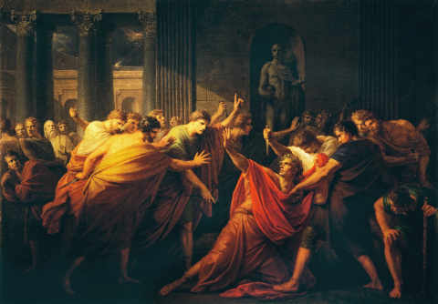
Assassination of Julius Caesar
Senate felt threatened so they assassinated Julius Caesar

Slide 8
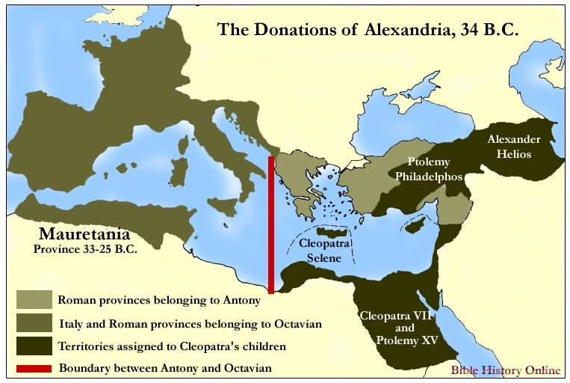
Second Triumvirate
Power in Rome divided between Octavian and Antony
They came to conflict
Antony allied with the Egyptian Queen Cleopatra
Octavian forces defeated Antony and Cleopatra
They fled back to Egypt and committed suicide a year later
Octavian became the first Roman Emperor
He claimed to restore the Republic, but in reality a true republic was never again established
Octavian changed his name to Augustus- “Revered one”
Notes:
Octavian was Caesar’s heir
Antony was Caesar’s ally and assistant
Cleopatra already had a relationship with Caesar and then with Antony

Slide 9
End of Roman Republic
Beginning of Roman Empire

Slide 10
Advantage and Disadvantages of a Republic
Advantages
Disadvantages
Practical- smaller groups of people making decisions
Representatives can make informed decisions (it is often their full time job)
Laws passed by people educated on the topics
Efficient- They can act more quickly
Voice of people is sometimes lost
Easier to corrupt
Tends to be wealthy people, who only represent a small portion of society

