Slide 1
Roman Empire

Slide 3
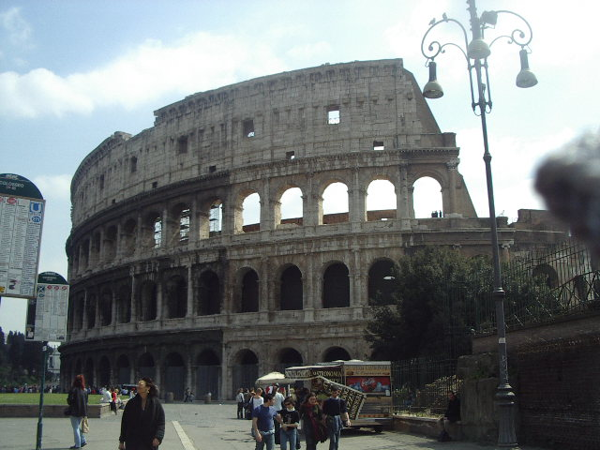
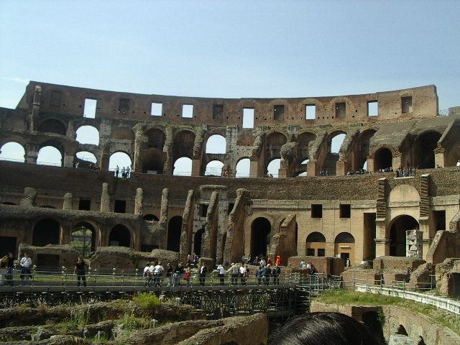
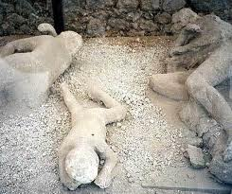
Accomplishments of Roman Empire
Legacies of Roman Empire
http://www.history.com/shows/mankind-the-story-of-all-of-us/videos/mankind-the-story-of-all-of-us-aqueducts
http://www.history.com/topics/ancient-history/ancient-rome/videos/mankind-the-story-of-all-of-us-roman-roads?m=5189719baf036&s=All&f=1&free=false
Indoor Plumbing
http://www.history.com/topics/ancient-history/ancient-rome/videos/deconstructing-history-pompeii?m=528e394da93ae&s=undefined&f=1&free=false
http://www.history.com/topics/ancient-history/ancient-rome/videos/mankind-the-story-of-all-of-us-birth-of-christianity?m=528e394da93ae&s=undefined&f=1&free=false
Gladiators

Slide 4
Fall of ROme
The downfall of the Roman Empire

Slide 5
Fall of Rome
Plague
Civil War
Lack of Cash Flow- Too dependent on slaves and conquering land
Emperor Diocletian divides empire into four sections to make it more manageable
Emperor Constantine creates Constantinople as a second Roman Capital
Eventually the empire breaks into two
West: Follow the Emperor in Rome
East: Follow the Emperor in Constantinople; continues as the Byzantine Empire
Both believe they are the rightful heirs to the Roman Empire
Western Roman Empire is invaded by Germanic Tribes
Lose control of borders combine with internal problems and Western Roman Empire Falls
http://www.history.com/topics/ancient-history/ancient-rome/videos/mankind-the-story-of-all-of-us-rome-falls

