Slide 1
THE FIRST ENGLISH COLONIES

Slide 2
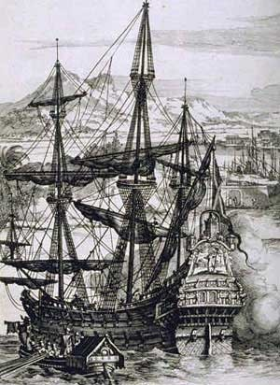
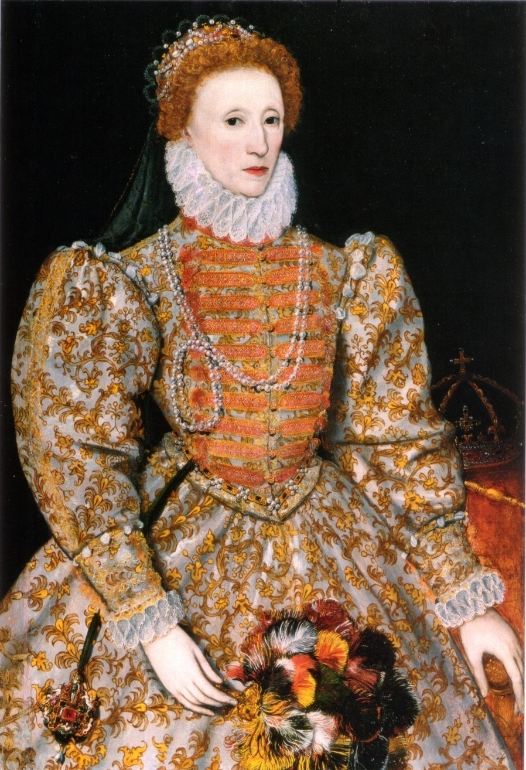
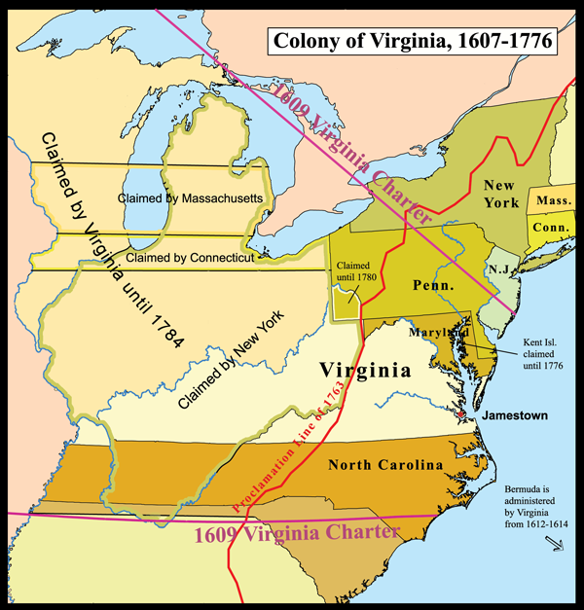
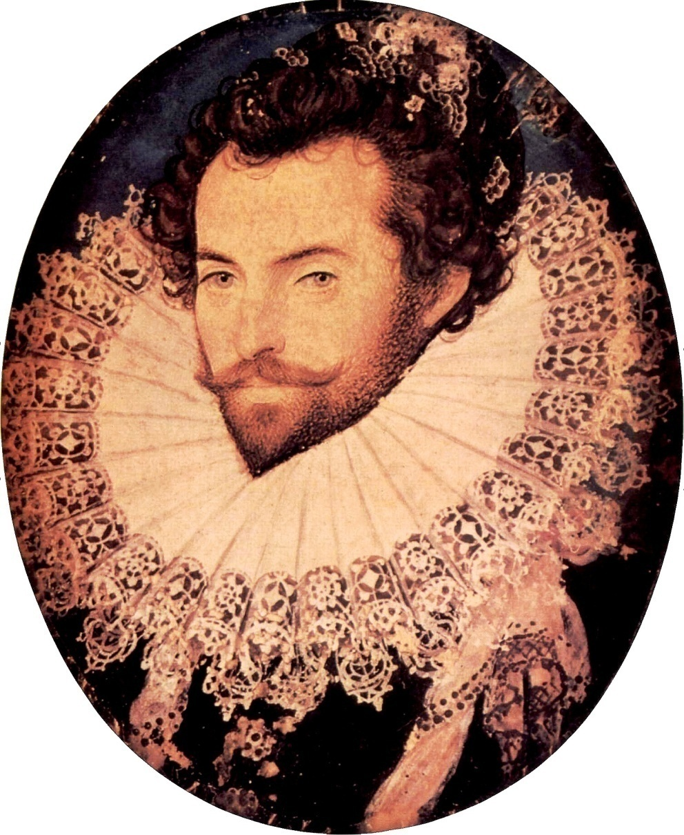
Raleigh received a charter, or permission, to create a colony in Virginia
Sir Walter Raleigh
The purpose was to get riches from the New World and raid the treasure fleets of Spain
Queen Elizabeth I

Slide 3
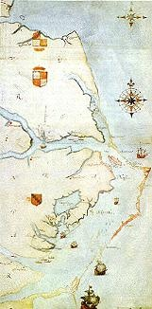
1585
7 ships and 100 men set sail for North Carolina.
They land on Roanoke Island.

Slide 4
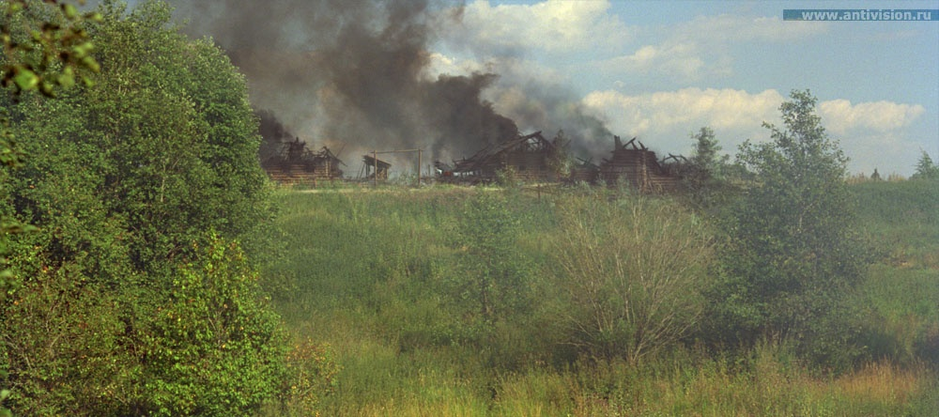
The local Native American tribe, the Aquascogok, were blamed for stealing a silver cup from the colonists.
The British colonists then burned the Native American chief.
The British colonists burned the Native American village.

Slide 5
Within a year the colonists ran out of food and fought with their Native American neighbors.
They would often kidnap local Indians and hold them for ransom until the other Indians brought them food in exchange for their freedom.

Slide 6
The English colonists decided to return to England.
Two weeks after they left, a ship arrived with supplies.
This ship left 15 soldiers to guard the Colony until others could take over.

Slide 7
In 1587 Raleigh asked his friend, and original settler, John White, to return to Roanoke. Women and children came this time, as well.

Slide 8
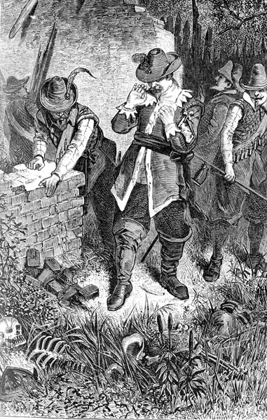

Slide 9
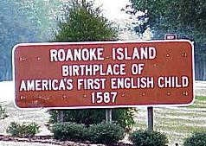
These new settlers tried to re-establish the colony of Roanoke.
Supplies ran low so John White returned to England to get more. He left 117 settlers at Roanoke, including his daughter, her husband, and their newborn daughter.

Slide 10
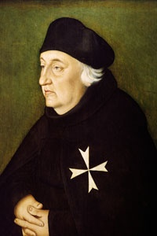
He told the colonists if they encountered danger they should leave the “Maltese Cross” as a sign.

Slide 11
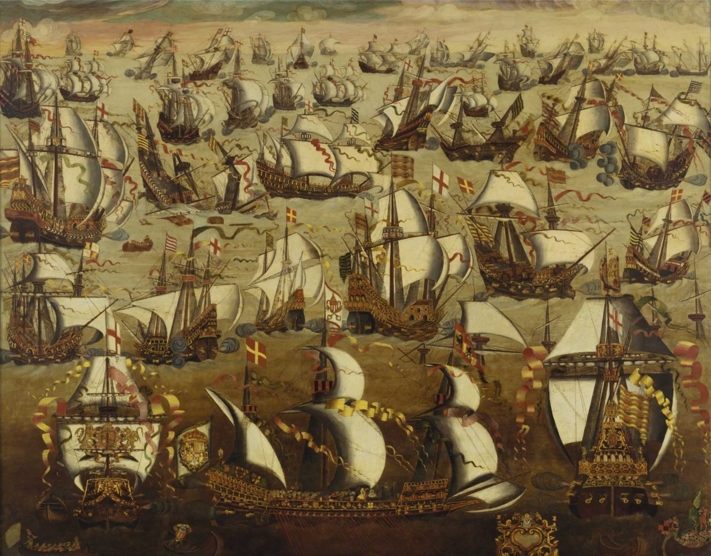
England and Spain went to war, delaying John White and the relief ships for three years.

Slide 12
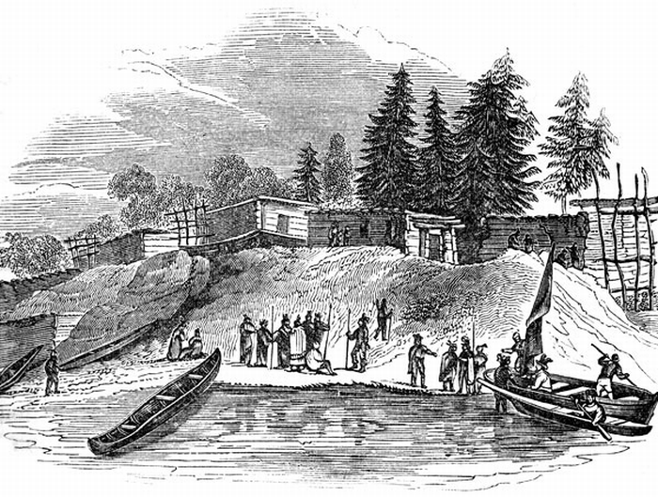
White found the colony deserted . . .

Slide 13
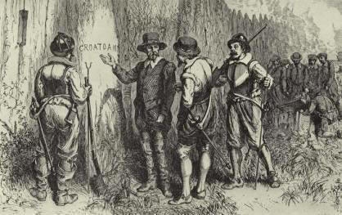
White wanted to investigate, but a storm came, the men refused to explore further, and they returned to England.

Slide 14
WHAT HAPPENED?

Slide 15
HERE ARE SOME POSSIBILITIES

Slide 16
1. Some think that the colonists moved due to starvation and drought.
American Indians told the Jamestown settlers of other Englishmen living 50 miles away.

Slide 17
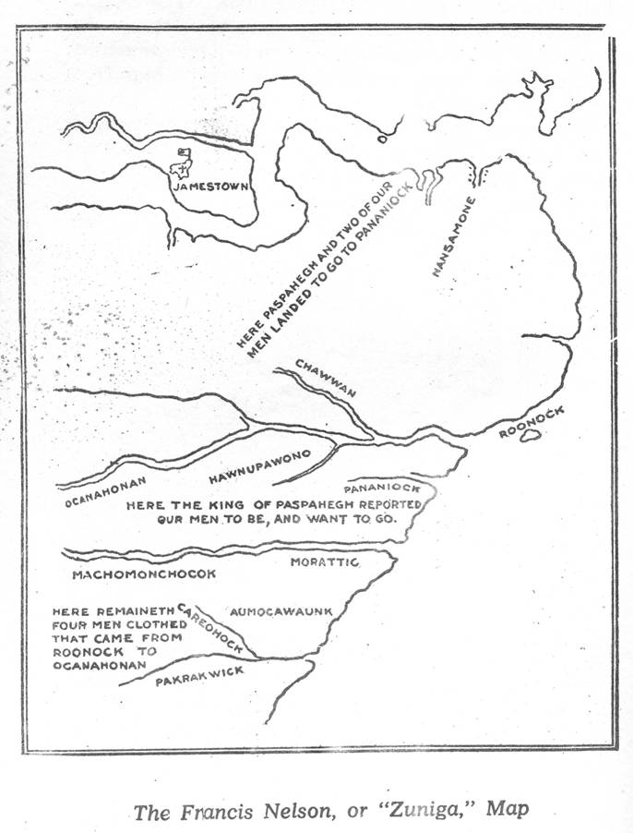
The Jamestown colonists found four white men living under the leadership of an Indian chief known as Gepanocan
1608

Slide 18
There is a legend that the American Indians living in Person County, North Carolina are descendants of members of the Roanoke Colony.
These American Indians already spoke English and knew about Christianity.
They also had European physical features.

Slide 19
2. Others believe colonists were killed by American Indians.
Chief Powhatan told John Smith that he had the Roanoke settler killed because they were living with a tribe that refused to join his confederacy.
He showed English-made iron tools to prove his claim.

Slide 20
3. Others speculate that the Roanoke settlers may have grown tired of waiting for John White to return and tried to return to England on their own.
They may have used small boats that have never been found and were lost at sea.

Slide 21
4. Others blame the Spanish for attacking the colony.
This is unlikely because Spain was still looking for the colony as late as 1600, ten years after John White discovered the abandoned colony.

Slide 22
SO, WHAT DO YOU THINK HAPPENED?

