Slide 1
Renaissance

Slide 2
Middle Ages/ Dark Ages
Concerned with the church and religion
Activities centered around getting to heaven rather than life here on earth
After the Black Death people started to think more about life on Earth.
Art depicts these ideas

Slide 5
What was the renaissance?
Renaissance: French word meaning rebirth
1300-1500
Marked the time of financial, artistic, social, scientific and political growth

Slide 6
Renaissance: Humanism
Humanism: Focusing on the study of progress and human nature
The rise of humanism can be seen by studying the progression of art during the middle ages

Slide 7
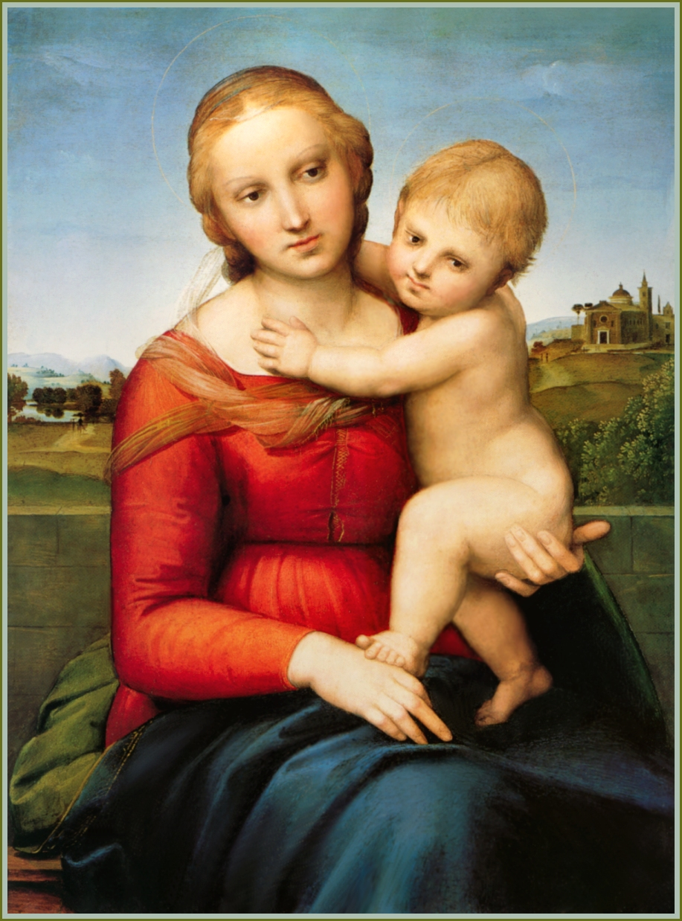
Which is more humanistic?

Slide 8
Renaissance: Classicism
Classicism: A return to traditional ideas of Greece and Rome.

Slide 9
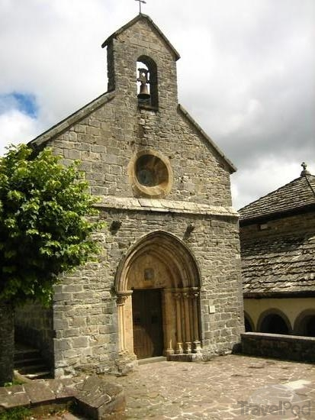
Classicism

Slide 11
How is the Renaissance a Rebirth?
Write descriptions of what you see in the left column and take notes on how each topic is a rebirth to prepare for your essay.

Slide 12
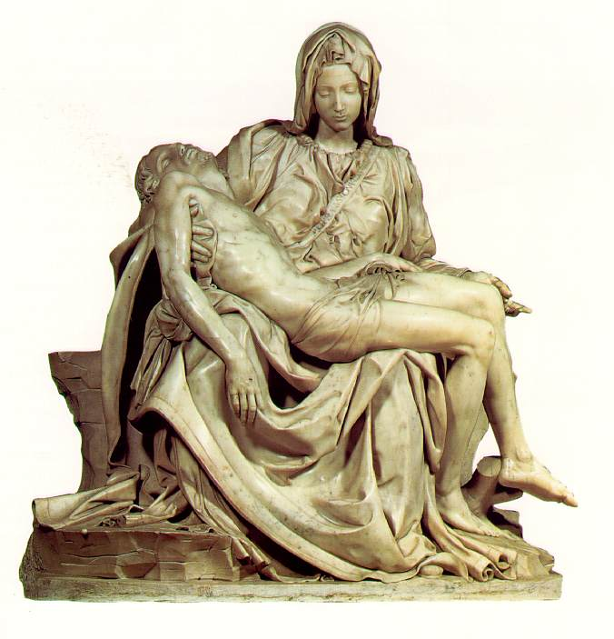
ART: michaelangelo
http://www.biography.com/people/michelangelo-9407628

Slide 14
Art and Science: davinci
http://www.biography.com/people/leonardo-da-vinci-40396

Slide 15
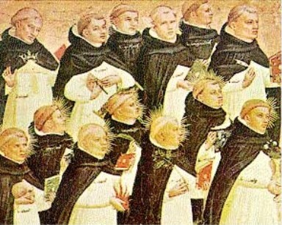
Music
Gregorian Chants – (Middle Ages)
https://www.youtube.com/watch?v=3ElL8hdQD_4 (blank screen and just listen)

Slide 16
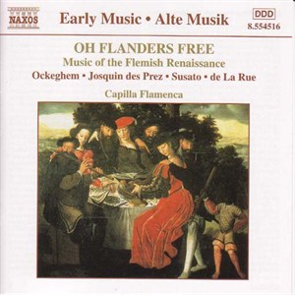
Music: Thomas Fabri (Renaissance musician)
https://www.youtube.com/watch?v=xZdoBTRKyzk
How is this music different?

Slide 17
Theater: WILLIAM Shakespeare
English play-writer and poet
Wrote 37 plays in 23 years (Stories still used today)
He expressed universal themes in everyday, realistic settings
For instance, Romance

Slide 18
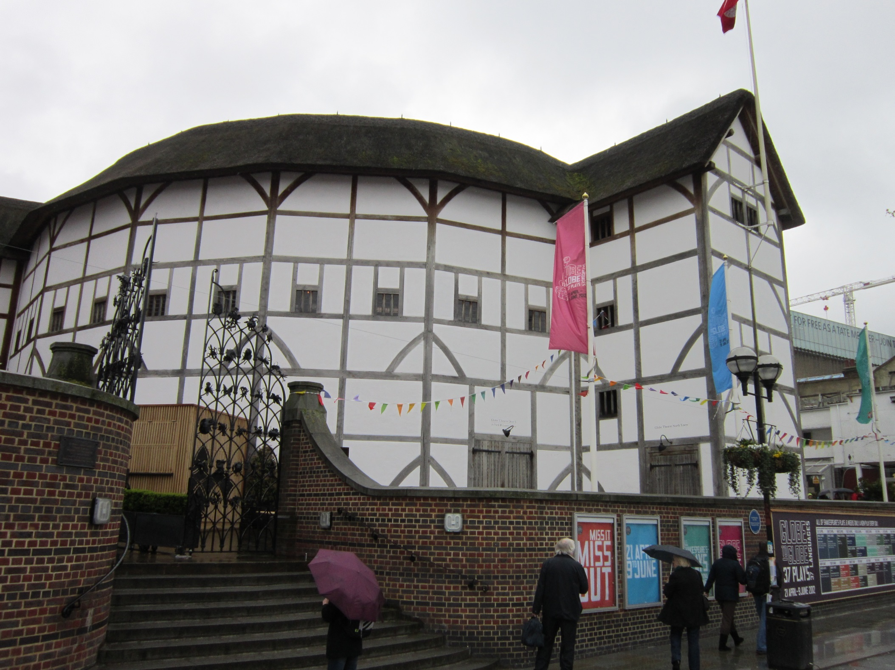
Shakespeare
Look for elements that make this speech effective and persuasive.
Old men forget; yet all shall be forgot, But he’ll remember, with advantages, What feats he did that day. Then shall our names, Familiar in his mouth as household words- Harry the King, Bedford and Exeter, Warwick and Talbot, Salisbury and Gloucester- Be in their flowing cups freshly rememb’red. This story shall the good man teach his son; And Crispin Crispian shall ne’er go by, From this day to the ending of the world, But we in it shall be remembered- We few, we happy few, we band of brothers; For he to-day that sheds his blood with me Shall be my brother; be he ne’er so vile, This day shall gentle his condition; And gentlemen in England now-a-bed Shall think themselves accurs’d they were not here, And hold their manhoods cheap whiles any speaks That fought with us upon Saint Crispin’s day.

Slide 19
How does this clip appeal to Humanism (Human Nature)?
St. Crispin’s Day Speech https://www.youtube.com/watch?v=A-yZNMWFqvM
Notes:
Speech appeals to human nature

Slide 20
Science: Galileo
http://www.biography.com/people/galileo-9305220

Slide 21
SCIENCE AND LITERATURE: Gutenberg
Johann Gutenberg: Invented the first printing press and revolutionized printing in Europe
Before the printing press there were only a few thousand hand written books in Europe and most people were illiterate.
By 1500 15-20 million volumes had been printed using the press
People are able to read the Bible and learn for themselves what to believe rather than having a Priest give them the answers
http://www.history.com/topics/middle-ages/videos/mankind-the-story-of-all-of-us-the-printing-press

Slide 22
Literature – Sir thomas more
Writer who pushed for social reform.
He wrote a book called Utopia which described an ideal society
Tried to show societies problems by creating a perfect world
Today the word Utopian describes any ideal society
Books today often focus on Dystopias: Hunger Games, Divergent, The Giver, 1984, The Road, etc.
Notes:
Compare to dystopia’s of today: Hunger Games, Divergent, Matched. Etc.

