Slide 1
What did People Believe 1600
Unclean souls went to Purgatory or straight to hell
Priest much cleanse your soul at church
Clean souls went straight to heaven
Crusaders or pilgrims could earn time out of Purgatory
Buy Indulgences from Pope that gave you time out of Purgatory

Slide 2
Corruption of Catholic Church
Pope Leo X
“He would have made an excellent pope if he had only been a little religious”
Cardinal
Corruption
Church offices gained money from peasants
Indulgences
Evolved to a corrupt way to make money

Slide 3
Martin luther
German Priest who sees problem with the Catholic Church
PROBLEMS WITH CATHOLIC CHURCH
Church isn’t necessary for a clean soul
Sale of indulgences is wrong
Read Bible in your native language, not Latin
Sell of Indulgences
Rely on Christ, not on Saints
Focus on looking up to God not down on Man
Preaching words from the Bible
Gambling and other secret sins amongst church leaders is wrong
Materialism and wealth amongst church leaders is wrong
Christian acts of kindness is necessary

Slide 4
Protestant Reformation
“Protest” the Catholic Church
Began by Martin Luther
95 Theses: Writes everything he thinks is wrong with the Catholic Church
Many Europeans break away from the Catholic Church
Remain deeply Christian

Slide 5
BIRTH of Reformation
“These words ‘just’ and ‘justice of God’ were a thunderbolt to my conscience… I soon had the thought [that] God’s justice ought to be the salvation of every believer… There fore it is God’s justice which justifies us and saves us. And these words became a sweeter message for me. This knowledge the Holy Spirit gave me on the privy in the tower.”
Where did he gain this knowledge of the reformation?

Slide 6
Spread of Reformation
Gutenberg Press helped spread the ideas of the Reformation
Question authority

Slide 7
Church Comparison
Catholic Church
Protestant Church

Slide 8
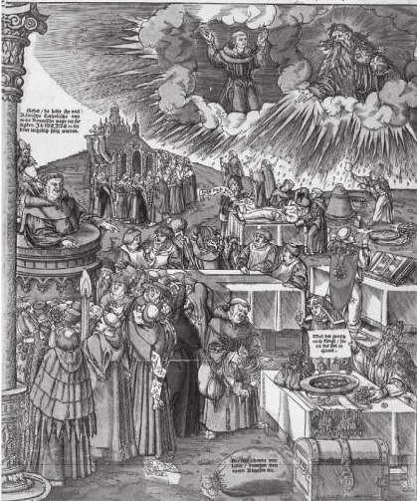
Problems with Catholicism
Sell of Indulgences
Rely on Saints, not on Christ
Looking down on man instead of up to God
Preaching words not from the Bible
Gambling and other secret sins amongst church leaders
Materialism and wealth amongst church leaders
No Christian acts of kindness

Slide 9
Church of England
One such break off is the Church of England
King Henry VIII of England
Obsessed with providing an heir to throne
Wife doesn’t birth a son
King Henry VIII wants the marriage annulled
Pope says no
King Henry creates a new church
Church of England

Slide 10
King Henry’s Attempt to Provide an Heir
WIFE | HEIR? | END OF MARRIAGE
Catherine of Aragon | Daughter named Mary | Divorced
Anne Boleyn | Daughter named Elizabeth | Executed by Henry
Jane Seymour | Son named Edward; sickly and dies at 16 | Died in child birth
Anne of Cleves | No Son | Divorced
Kathryn Howard | No Son | Executed by Henry
Katherine Parr | No Son | Widowed

Slide 11
