Slide 1
George WAshington

Slide 2
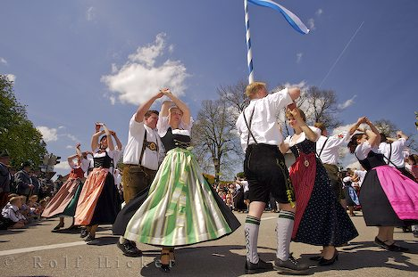
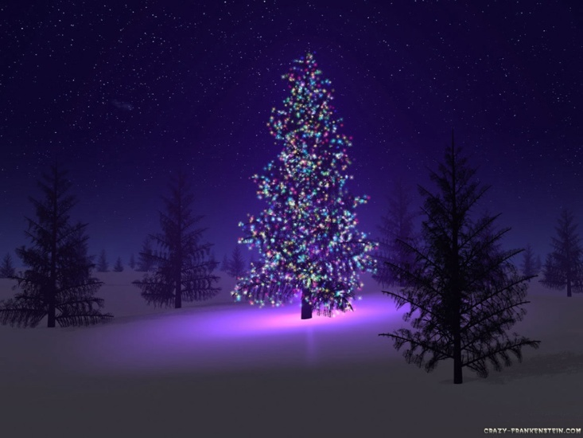
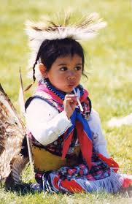
What family traditions do you have?
Describe your favorite family tradition. When did this tradition start? Why do you do it?
Notes:
Bellwork

Slide 3
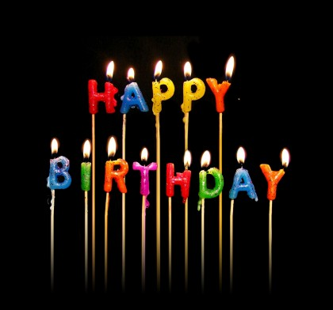
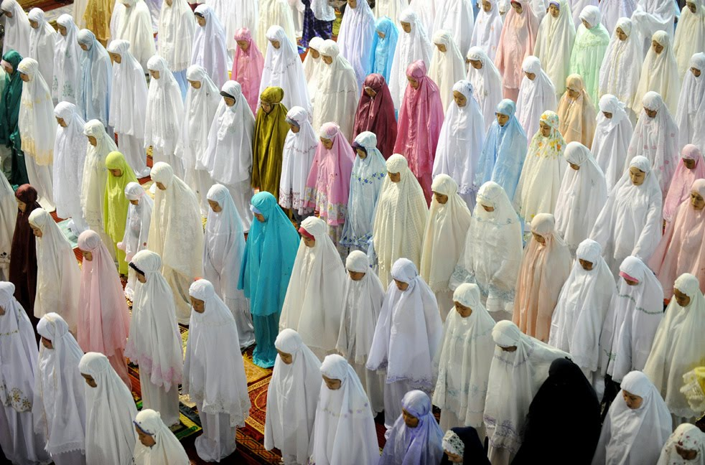
Traditions and Precedents
The family members that started those traditions set a precedent for the rest of the family to follow

Slide 4
Predict
What does the word precedent mean?

Slide 5
Definition
Precedent: an action or a decision that serves as an example for later generations.

Slide 6
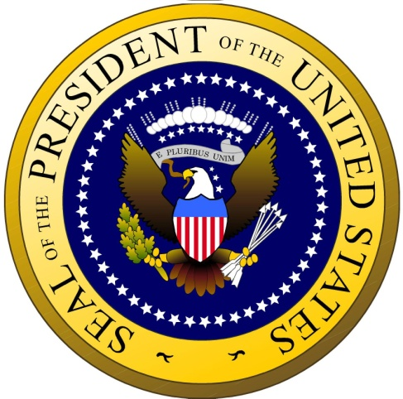
Importance of Precedence
Write the importance of precedence based on this quote
"Few can realize the difficult and delicate part which a man in my situation has to act I walk on untrodden ground. There is scarcely any part of my conduct which
may not hereafter be
drawn into precedent."

Slide 7
Video
Washington’s precedent
As we watch this short videos, answer the questions on your note sheet.

Slide 8
Whiskey Rebellion
Congress taxed American made Whiskey that Farmers who made the Whiskey couldn’t afford.
Farmers refused to pay the tax and tarred and feathered tax collectors
Some called themselves the new Sons of Liberty
Washington needed to prove federal authority under their new Constitution
Washington sends 13,000 militiamen
Rebels saw the army and disbanded without a battle
Whiskey Rebellion proves the strength and authority of the new federal government

Slide 9
Precedents
Neutrality in foreign wars
Cabinet- group of advisors to offer advice
Presidential Salary
So President wouldn’t always be wealthy individual
National Bank to fix National Debt
Farewell Address

Slide 10
Exit Slip:
Paragraph: (at least 5 sentences)
What were some of the precedents that Washington set for the presidency? Why are these precedents important?

Slide 12
Precedent set by other presidents
Precedents Set by Adams and Jefferson
Limited Undeclared Wars (many presidents will follow this one)
Typically use of Navy to take on France (Adams) or Barbary Pirates (Jefferson)
Purchase of New Territory (Jefferson)
Executive Privilege—Burr Trial (Jefferson declines to show up and testify against Burr when subpoenaed, claiming “executive privilege”); Nixon, Clinton, Reagan will all do the same when subpoenaed.

Slide 13
Precedent set by other presidents
Precedents Set by Lincoln
1. Use of Executive Order (Emancipation Proclamation; Martial Law in New Orleans)
2. Broad Interpretation of Police Power (suspended Habeas Corpus)
Precedents Set by TR and Wilson
1. Use of Executive Agreement (“handshake deals” with leaders of other nations
Wilson takes on role of chief legislator; calls Congress into session and will not let them adjourn for over a year

Slide 14
Precedent set by other presidents
Precedents Set by FDR
1. Civic Personality
2. Federal Government Provide— FDR found ways to communicate with the common people through “fireside chats for the People—Social/economic support role
Precedents Set by Truman
1. President in Charge of National Security (yet another role/persona)
2. President now in Charge of Military Response—Cold War mentality and the need for constant vigilance

Slide 15
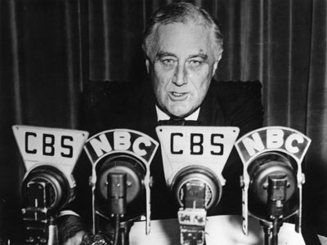
How other presidents did the same
Eisenhower’s stress upon direct communication with the public carried on the famous precedent set by Franklin Delano Roosevelt, whose “fireside chats” via radio had changed American politics.

Slide 16
Exit Slip:
Paragraph: (at least 5 sentences)
What were some of the precedents that Washington set for the presidency? Why are these precedents important?

Slide 17
T-chart
Precedence THEN, Washington | Precedence NOW, others

Slide 18
Primary Source: Letter
As you read through the letter, underline the precedents set by George Washington.

