Slide 1
POPUATIONS OF THE WORLD
7 Billion Humans in the World
http://www.youtube.com/watch?v=sc4HxPxNrZ0

Slide 2
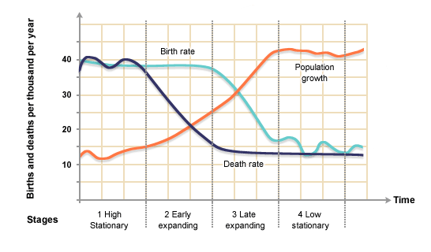
Population Stages

Slide 3
Stage 1
High Stationary
High Birth and Death Rates
Low Population
Longest Stage in World History
Only remote areas today

Slide 4
Stage 2
Early Expanding
Declining Death Rates, High Birth Rates
Population Explosion
Developing Countries (Africa, Latin America)

Slide 5
Stage 3
Late Expanding
Declining Birth and Low Death Rates
Growing Population
US is at the end of stage 3

Slide 6
Stage 4
Low Stationary
Low Death and Birth Rates
Population Stabilizes
Western Europe

Slide 7
Stage 5?
Geographers feel some industrialized countries are entering a fifth stage.
More people die than are born
Populations decrease
Italy and Japan
Some European countries pay citizens to have children

Slide 8
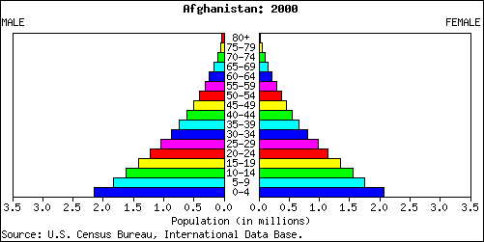
Population Pyramids
High Death Rate
Developing Countries
Male
Female
High Birth Rate
What problems might this cause?

Slide 9
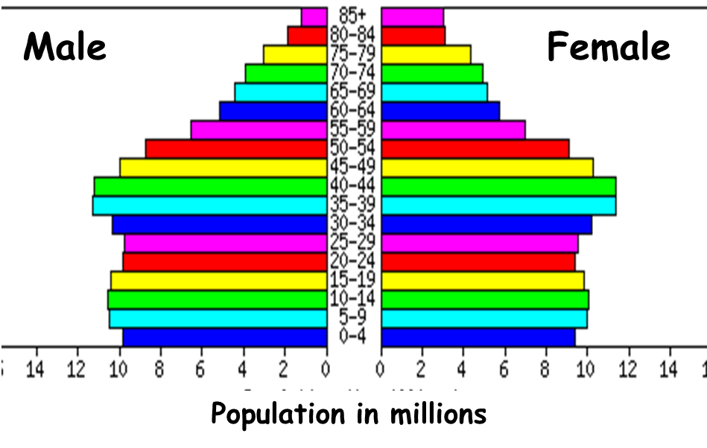
Population Pyramids
Low Death Rate
Developed Countries
Low Birth Rate
What problems might this cause?

Slide 10
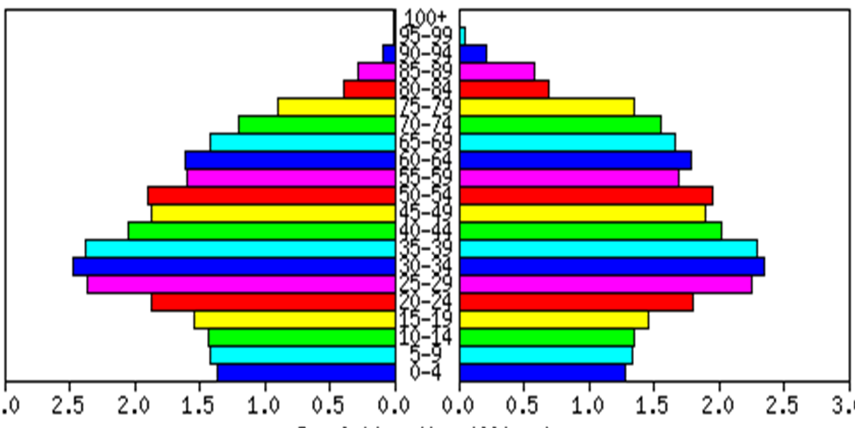
Population Pyramids
The elderly people will soon make up the largest section of this country’s population.
Future of Developed Countries

Slide 11
Population Distribution
People Per Square Kilometer
Where are the densest areas of the world?

Slide 12
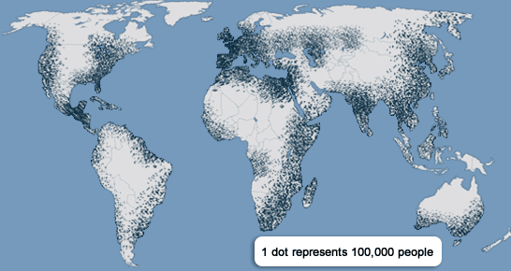
Population Distribution
Why are some places more dense than others?
Water
Coasts
Non-extreme Climates

Slide 13
Population Density
Arithmetic Density
Average number of people living in a given area
People
Land Area

Slide 14
Population Density
Physiologic Density
Average number of people per unit of agriculturally able land
People
Arable Land

Slide 15
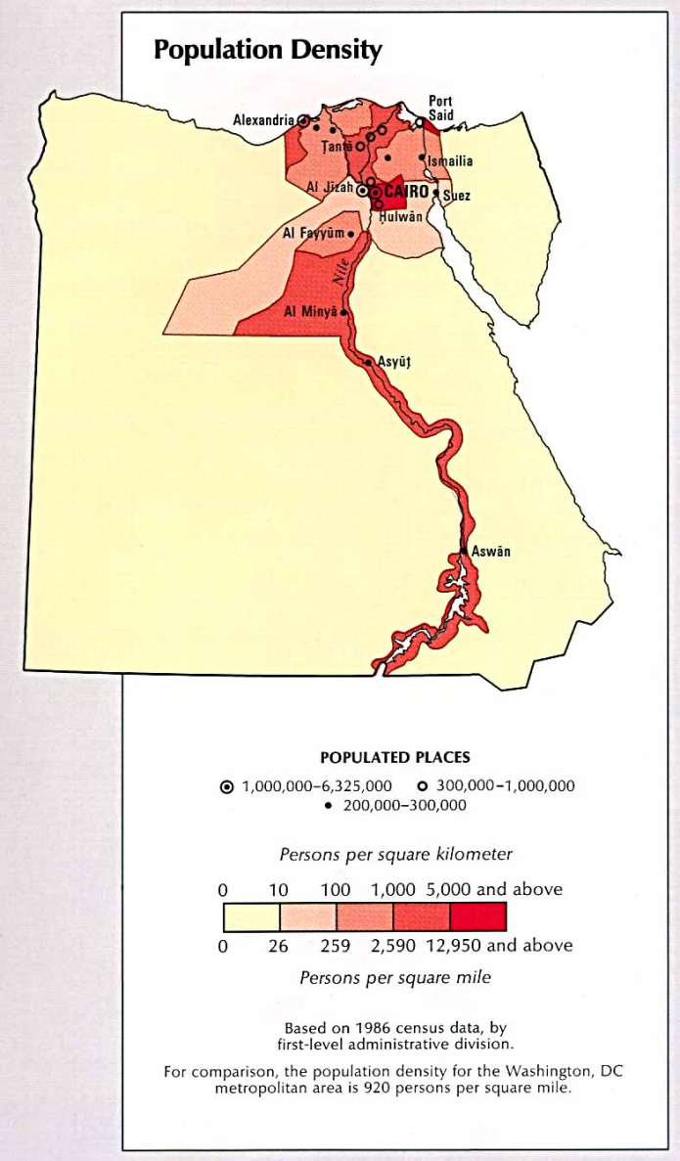
Population Density
ARITHMETIC DENSITY
United States | 67
Egypt | 142
Japan | 862
PHYSIOLOGIC DENSITY
United States | 335
Egypt | 7101
Japan | 6637
Why so different?

Slide 16
Population through History
http://www.youtube.com/watch?v=jbkSRLYSojo

