Slide 1
Political Parties
From Adams to Obama

Slide 2
Political Party
Groups that help elect government officials and shape government policy
What was George Washington’s advice regarding political parties?

Slide 3
Political Parties 1790’s
FEDERALIST PARTY
DEMOCRATIC-REPUBLICAN PARTY
Strengthen Central (federal) Government
Promote industry and trade
Led by Alexander Hamilton and John Adams
Limit power of the central government
Led by Thomas Jefferson and James Madison
Notes:
Argued so much that Abigail Adams said “I fear America will never go through another Election without Blood Shed.”
Whoever took second was Vice President which caused conflict
The fact that there isn’t bloodshed proves the strength of the Constitution

Slide 4
Republican or Democrat Quiz

Slide 5
Party Platforms
List of actions each party supports

Slide 6
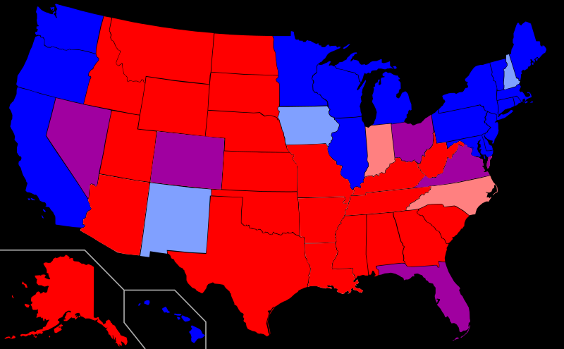
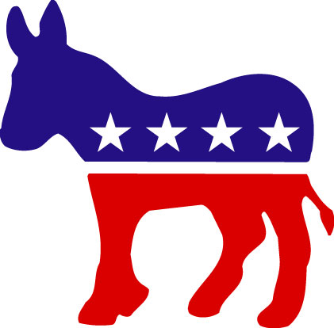
Political Parties 2014
Republican
Democrat
Pro Life
Anti Gay Marriage
Pro Capital Punishment
Anti Gun Control
Private Healthcare
Illegal drugs
Tight border control
Proactive military
Work for welfare
Individual Rights come first
Income taxes low
Pro Choice
Gay Marriage
Anti Capital Punishment
Gun Control
Federally funded healthcare
Legalize some drugs
Loosen borders and make citizenship easier to obtain
Limited military spending
Generous Welfare to help poor
Societal needs come First
High income taxes especially for wealthy

Slide 7
Is anyone 100% one party?
Most people are somewhere in-between

