Slide 1
Nullification Crisis
States Rights v. Federal Law

Slide 2
Protective Tariffs
A tax on an imported manufactured goods, so people will want to buy American goods
North Perspective: For Tariff
Boosts North’s economy
North’s economy relies on industry and manufacturing
Place a tax on European goods, then Americans will then buy Northern goods
South Perspective: Against Tariff
Hurts South’s Economy
Had very little industry and manufacturing
Increased prices on goods the South needed to buy
Bought imported goods from Europe and then sold raw materials to Europe
A tariff messes up this system

Slide 3
Tariff of Abominations
Giving in to Northern pressure, Congress passed a tariff with very high rates
This made it too expensive for the South to buy European goods

Slide 4
John C. Calhoun: Supporter of States’ Rights
Calhoun was a Southern politician
He believed the federal government was using too much power over Southern states
He argued states had a right to nullify or cancel any federal law they considered to be unconstitutional
What document written by Jefferson and Madison argued this same point?
Virginia and Kentucky Resolutions

Slide 5
Nullification Crisis
South Carolina passed a law that canceled tariffs in South Carolina
If Congress can force laws about tariffs on the South, what other laws might they enforce on the South?
The South was afraid the North might abolish slavery

Slide 6
President Jackson’s Response
President Jackson wanted to show the power of the federal government
He believed states could not ignore federal laws
He threatened to send troops to South Carolina to enforce federal law
They came to a compromise before this was necessary

Slide 7
The Real Question
Should states be able to nullify federal laws?
STATE PERSPECTIVE
Unconstitutional for Federal gov. to have so much power over state gov.
This is a country of united states
No state should gain power over another
Who will check the federal government if the states can’t?
Who will stop the federal government from passing unconstitutional laws?
What if the government passes laws that only favor a particular group?
Gun Control, Gay Marriage, Abortion, Socialized Medicine, etc.
FEDERAL PERSPECTIVE
States shouldn’t be able to pick and choose laws to follow
The federal government won’t pass laws that are unconstitutional

Slide 8
Discussion Panel
As a class we will discuss the central question
Should states be able to nullify federal laws?
You will receive points for participating
When you would like to talk, tap on a panel member who has already participated
Place the sticky note with your name on the board
Only people in the front 6 six seats may participate

Slide 9
U.S. just passed a law banning the ownership of guns
Should states be able to nullify this law?
Why?

Slide 10
Review Monroe Doctrine
U.S. and Latin American Relations

Slide 12
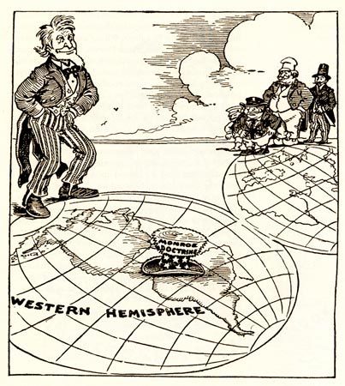

Slide 13
