Slide 1
Industrial Revolution
North and Urbanization

Slide 2
URBANIZATION
Industrial Revolution in the North

Slide 3
Urbanization
Increase in the number of people that live in urban areas
People move to cities in search of jobs in factories

Slide 4
Factories in the North
Why did the factory system take off in the North and not the South?
North’s economy already relied on Industry
Navigable rivers to transport manufactured goods
System of trade already established
Low agricultural production made manufacturing appealing

Slide 5
Lowell Mills
Water powered loom
Spin thread and weave cloth in the same mill
Hire young unmarried women
Women came from across New England to work in Lowell Mills

Slide 6
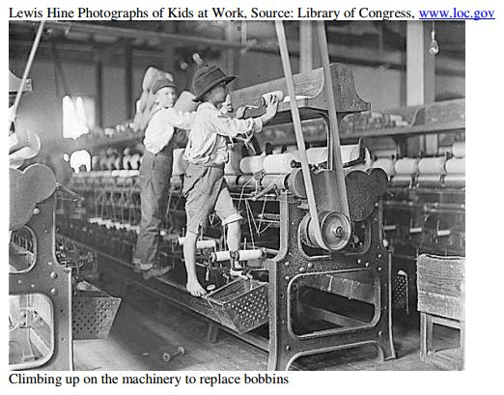
Child Labor: Why Employ Children?

Slide 7
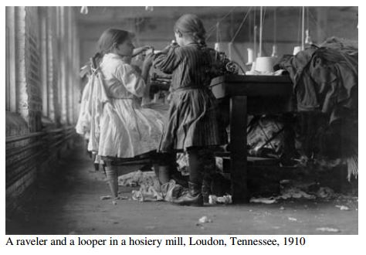

Slide 8
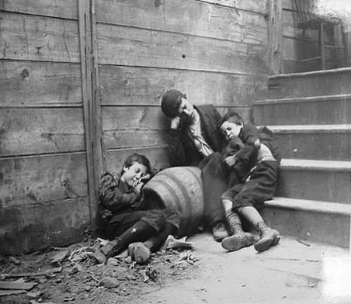

Slide 9
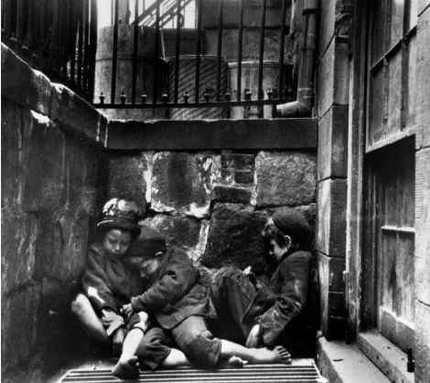

Slide 10
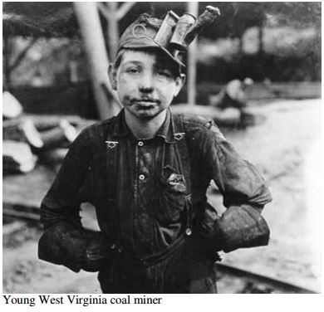

Slide 11
Child Labor
Why employ children?
Small to work in tight places
Unskilled work
Cheap Labor

