Slide 1
National Debt

Slide 2
Then: 1790

Slide 3
National Debt
The total amount of money owed by the United States to its lenders
Foreign Debt: 11.7 Million
Owed about 40.4 million to U.S. citizens

Slide 4
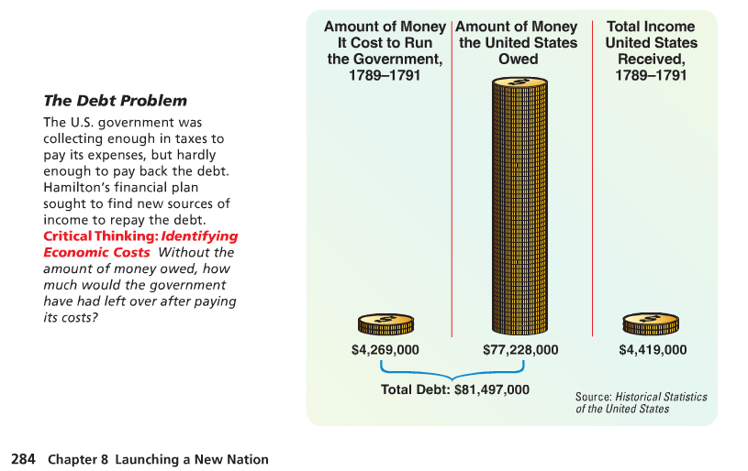

Slide 5
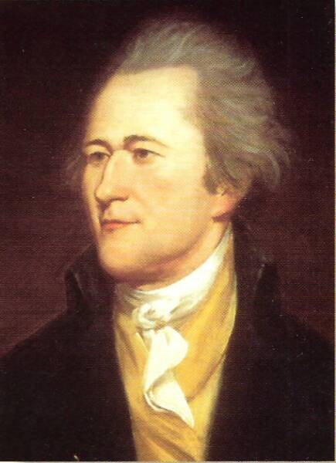
Alexander Hamilton
George Washington is concerned about how to fix debt problem
He turns to his Secretary of Treasury
Alexander Hamilton

Slide 6
Different Opinions
HAMILTON
Jefferson
Strong central government
Little faith in common man to run government
Focus on business and manufacturing
Create a National Bank to put America on solid financial footing
Keep power within the states
Educate the common man so they can participate
Focus on agriculture, they made the best voting decisions
Constitution didn’t give the government power to create a bank

Slide 7
Bank of the United States
George Washington agrees with Hamilton
They charter a bank that will last 20 years
Improves the U.S. economy and offers more economic security and stability

Slide 8
Now: 2014

Slide 9
U.S.A. Today
Total Debt: $17,322,052,300,000
Per Citizen: $54,561
Increases $2.44 billion per day since September 30, 2012
Debt calculator

Slide 10
Top 4 Expenses
Medicare/Medicaid: Health insurance for elderly or poor
Social Security: Benefits to retired people
Defense/Wars
Income Security: Provides necessities to low income or unemployed

Slide 11
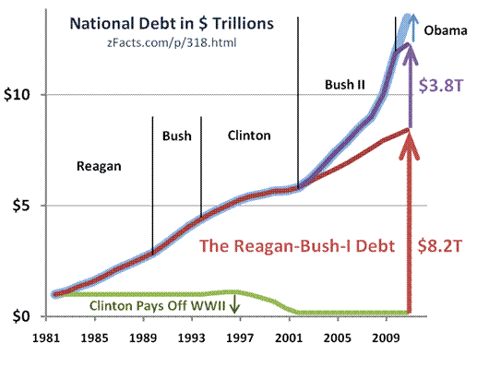

Slide 12
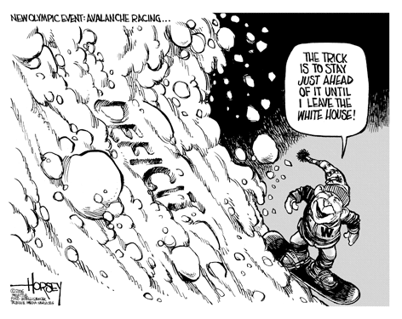

Slide 14
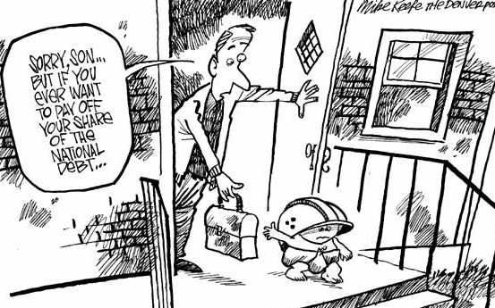

Slide 15
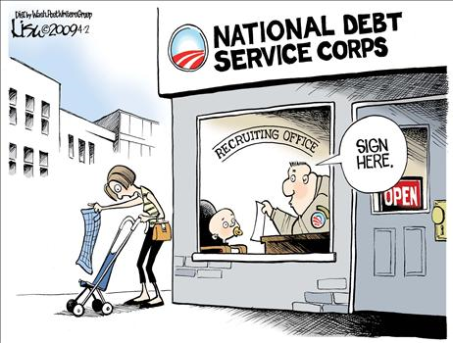

Slide 16
Cut National Debt
List some things that we could do to pay off the national debt.
Raise Taxes
Cut Spending

Slide 17
Solve the National Debt Problem

Slide 18
The Problem
Government sold bonds to raise money
Promised to buy back these bonds with interest
Government could not pay back all the bonds.
Notes:
Hyperlinked picture

Slide 19
The Problem
People started selling their bonds for less than their original value to speculators.
Speculators – people who buy items at low prices in the hope that the value will rise.

