Slide 1
History of Modern Iraq
The Tyranny of Saddam Hussein

Slide 2
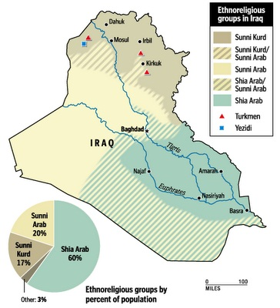
Ethnic Groups in Iraq
Kurds: an ethnic group in Iraq who wish for independence
Shia:
Majority in Iraq, but they were not in control under Saddam
Majority in Iran
Sunni:
Most Muslims in the world are Sunni
Saddam Hussein is a Sunni

Slide 3
Saddam’s Rise
Born in Tikrit, Iraq
Joined the Baath Party
Socialist Government in Iraq
After multiple failed attempts, Saddam finally participated in a successful coup
Coup: sudden, violent overthrow of a government
Saddam became a major leader in the new government
Saddam “persuaded” the new President to step down in 1979

Slide 4
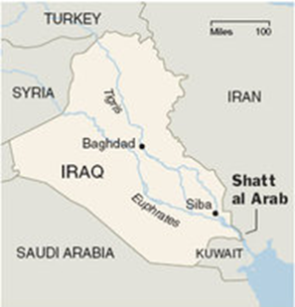
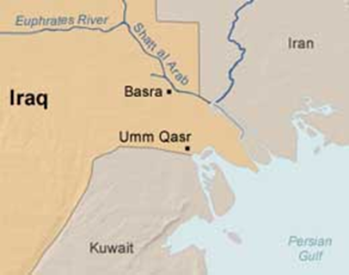
Tyranny of Saddam
Death to members of opposing parties
Execution of any rival political leaders
Used chemical weapons or violence against Kurds who sought independence
Iraq dropped mustard gas, Sarin, and Tabun bombs on a major Kurdish city (up to 5,000 killed)
Anfal Offensive: Up to 100,000 Kurds killed or went missing in 7 months
Fought war with Iran over the Shatt al-Arab waterway
8 years, 1 million dead
US supported Iraq because Iran was a radical Islamic state, supporting Iraq seemed like the lesser of two evils
War ends in a stalemate

Slide 5
Persian Gulf War
President Bush: “We will not fail.”
Saddam Hussein: “The mother of all battles is underway.”
Saddam claimed Kuwait and sent soldiers to occupy the country in 1990
UN orders Iraq to withdraw
US leads a huge campaign
85,000 tons of bombs dropped in 6 weeks
Desert Storm
Cruise missiles used for the first time
As part of this war, Iraq launched attacks against Israel
Notes:
Missile guided to it’s target by a computer, “smart bomb”

Slide 6
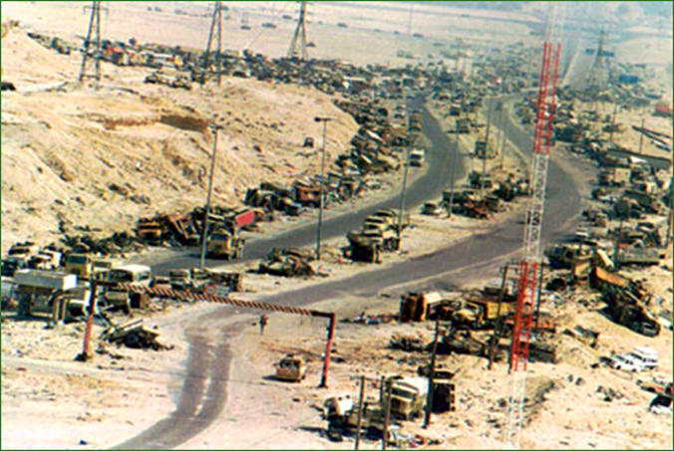
Gulf War Continued
Iraq failed to meet deadline for withdrawal
Iraq set fire to hundreds of Kuwaiti oil fields
US forces took control of main highway from Iraq to Kuwait, cut off supply lines
Iraq announced it would withdraw
As Iraqi troops withdrew from Kuwait on the main highway, allied forces bombed thousands of troops in their vehicles
“Highway of Death”

Slide 7
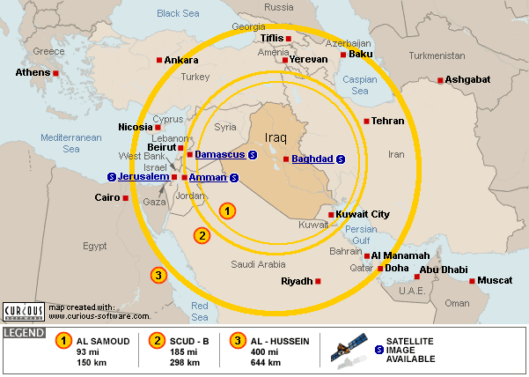
Iraq War, 2003
Course of the War
US, afraid of Saddam’s support of Terrorism and the possibility of him developing nuclear weapons (WMD’s), invaded Iraq
Saddam escaped and remained hidden
He was eventually captured and put on trial by the democratically elected government in Iraq
He was sentenced to death by hanging
The weapons of mass destruction were never found in Iraq
Reasons to go to War
Saddam kicked out UN weapons inspectors
US believed they were developing WMD’s (Weapons of Mass Destruction)
Saddam refused to obey the No-Fly Zone limitations
Saddam was a savage dictator-killed innocent people
Stop Saddam before he can launch nuclear missiles against Israel, Europe or US

Slide 8
Iraq Today
Government established by violence and military force was the norm in Iraq for so long, it is difficult for an elected government to maintain legitimacy and power
The ethnic groups in Iraq (Kurds, Sunni and Shia) have a difficult time getting along, almost a Civil War between Sunni and Shia in 2006
Violence and political unrest continue in Iraq despite the end of the war
Violence against neighbors like Iran and Israel
This allows extremist groups like ISIS to gain power
People want stability and an end to the chaos

Slide 9
Sources
http://news.bbc.co.uk/2/shared/spl/hi/middle_east/03/v3_iraq_timeline/html/western_support.stm
http://www.history.co.uk/biographies/saddam-hussein

