Slide 1
Missouri Compromise
Free States v. Slave States

Slide 2
The Problem
In 1819 U.S. had 11 free states and 11 slave states
Missouri was a territory that applied for statehood
Should it be a slave state or a free state?
North wanted a free state
South wanted a slave state
No one wanted the other to gain too much power

Slide 3
North Argument
The North’s economy didn’t rely on slaves, so they felt like it was an unnecessary cruelty
“The existence of slavery [harms] the industry and the power of a nation”

Slide 4
South Argument
The South was afraid the North (free states) would abolish slavery if they gained a majority.
“Why depart from the good old way, which has kept us in quiet, peace and harmony”

Slide 5
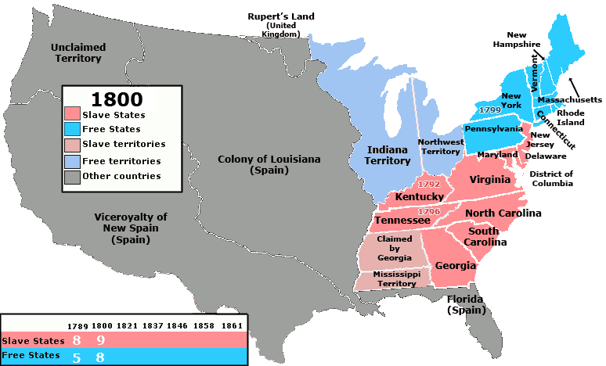
Group Compromise Activity
As a group come up with a solution to the problem

Slide 6
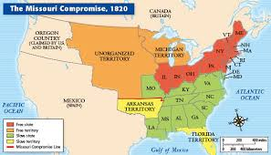
Missouri Compromise
Henry Clay (Senator from Kentucky) came up with a compromise
Missouri would enter the Union as a slave state
Maine would join the Union as a free state
Slavery would not
be allowed in any
new territories or
states formed north
of 36 degrees latitude

