Slide 1
Manifest Destiny

Slide 2
Mexican-American War

Slide 3
Texas Annexation
American government wanted to help the struggling Texas Republic
United States annexed Texas into the United States in 1845

Slide 4
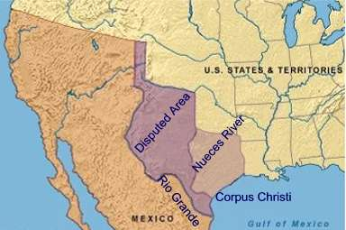
Border Conflict
U.S. claimed the border ran along Rio Grande
Mexico claimed in ran along the Nueces River

Slide 5
War
President Polk orders General Taylor to take U.S. troops into Texas to defend the border in case Mexico attacked
Mexico ordered American troops to leave
General Taylor refused
Mexican troops crossed the Rio Grande River and attacked Taylor’s troops
America declares war
President Polk says, “Mexico has shed American blood upon the American soil.”
First war fought mainly on foreign soil
Almost entirely fought in Mexico
General Taylor led the Americans and eventually captured the Mexican capital

Slide 6
Treaty of Guadalupe Hidalgo
Peace treaty that ended the Mexican-American War
Turned over much of Mexico’s Northern territory to the U.S.
Mexican Cession: California, Nevada and Utah
Border set at the Rio Grande
U.S. paid $15 million

Slide 7
Gadsden Purchase
A few years after war the U.S. negotiated a purchase with Mexico
U.S. paid Mexico $10 million
Southern parts of Arizona and New Mexico

Slide 9
United States by 1853

