Slide 1
Mayans

Slide 2
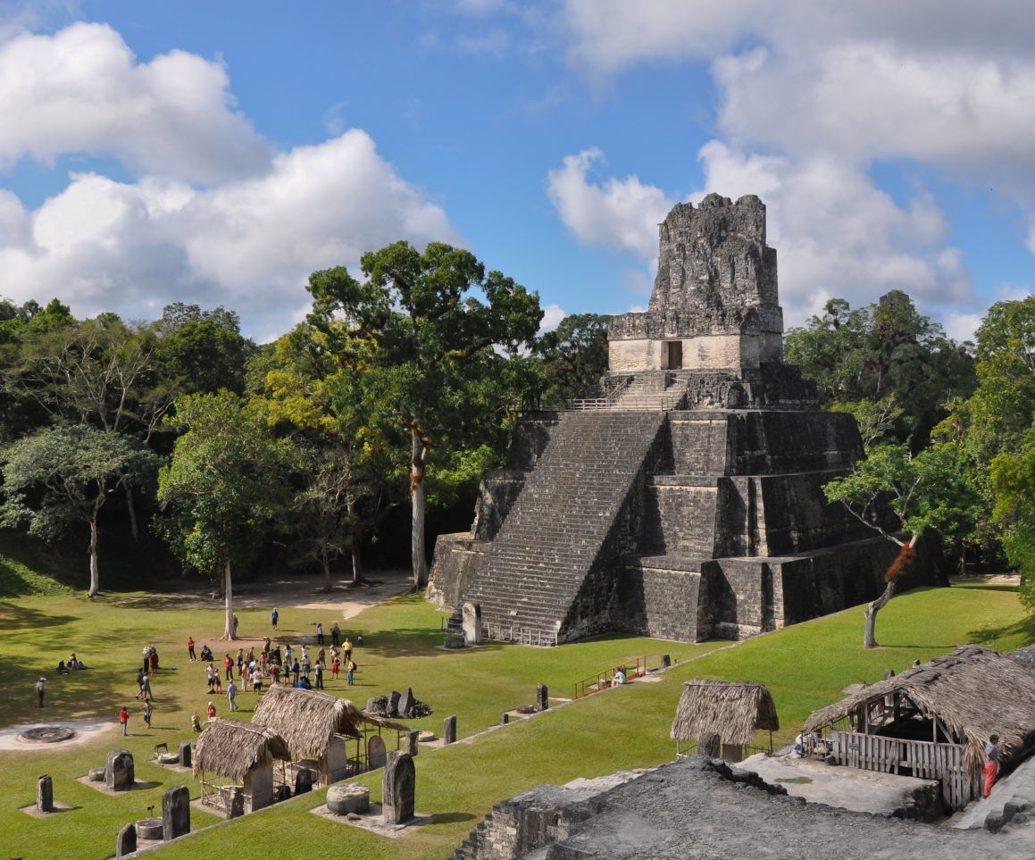
Mayan Empire
Kings or Holy Lords of this civilization claimed to be related to the Gods
Leadership passed from father to son (hereditary succession)
300-900 C.E. the Maya built more than 80 large ceremonial centers
Tikal was the most important

Slide 3
Mayan Empire
Advanced Society and Excelled in
Mathematics
Agriculture
Pottery
Hieroglyphics
Writing: Most advanced writing system of all early Native Americans
Wrote history, poetry, myth, genealogy, astronomical records

Slide 4
Mayan Culture
Created an elaborate calendar
It consisted of a solar year with 365 days (like our calendar today)
Also contained a ritual year with 260 days
Maya believed each day had specific characteristics based on the day in both calendars
It took 52 years for the first day of both calendars to coincide
That gave 18,980 different combinations of characteristics for each day

Slide 5
Mayan Culture
Invented a distinct sport, Maya Ball Game
Players to score points by propelling a rubber ball through a ring or onto a marker without using their hands
Ball was heavy and hard
Sometimes the ball game was played for sport
Other times captives were forced to play
The losers lost their lives
They believed these executions pleased the Gods
Displayed the skulls along the side of the courts

Slide 6
Define Artifact
An item from human civilizations with cultural or historical significance

