Slide 1
Mapping Basics

Slide 2
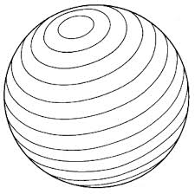
Latitude
Runs East to West
Measures North and South
0˚ Latitude= Equator

Slide 3
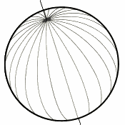
Longitude
Runs North to South
Measures East to West
0˚ Longitude= Prime Meridian
We drew latitude and longitude on maps and globes to help us find locations

Slide 4
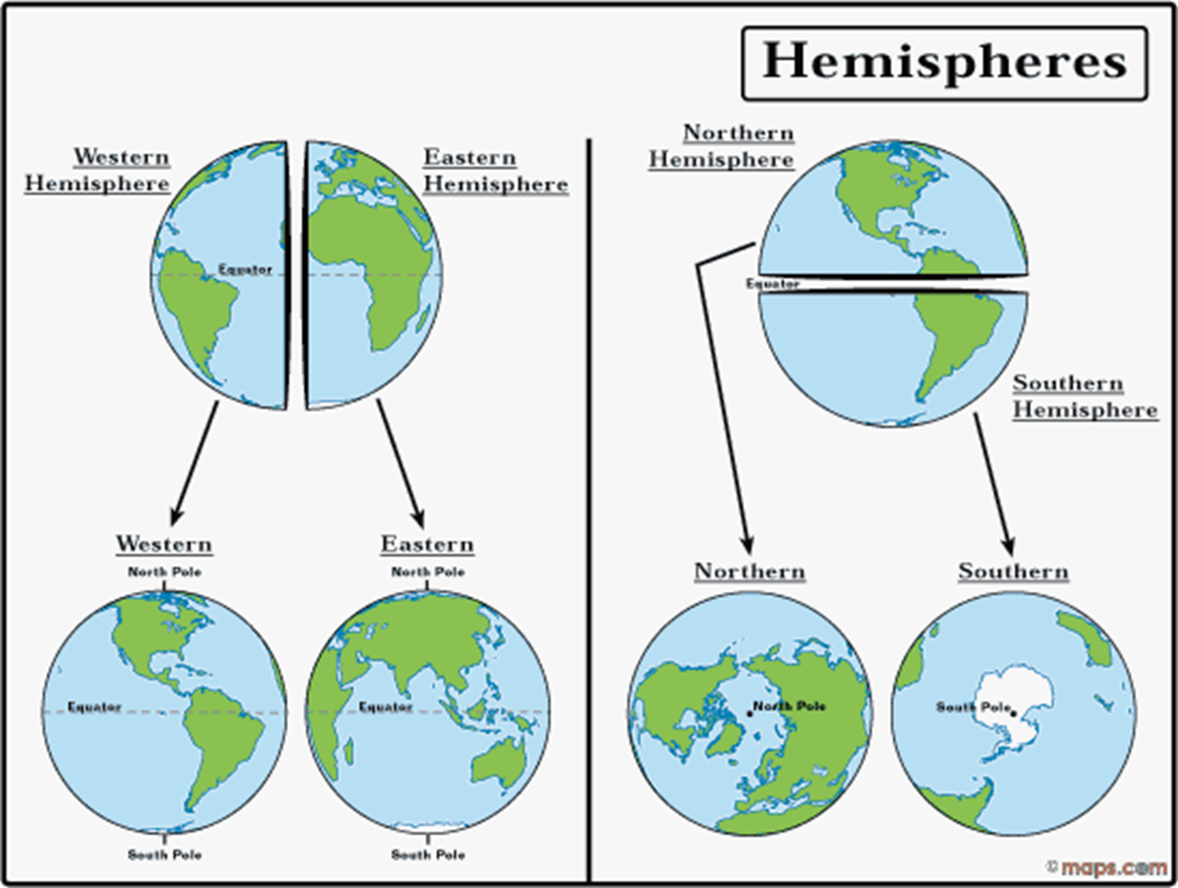
The Hemispheres
Equator (0˚ Latitude) is a line we draw on globes and maps to divide the world in half
This makes Northern and Southern Hemispheres
Prime Meridian (0˚ Longitude) is a line we draw on globes and maps to divide the world in half
This makes Eastern and Western Hemispheres

Slide 5
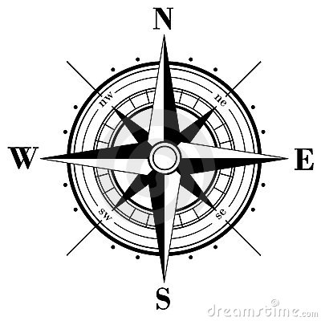
Compass Rose (cross out directions and write compass rose)
Indicates the Cardinal Directions on a map
North, South, East, West
The directions in between are Northwest, Southwest, Northeast and Southeast

Slide 6
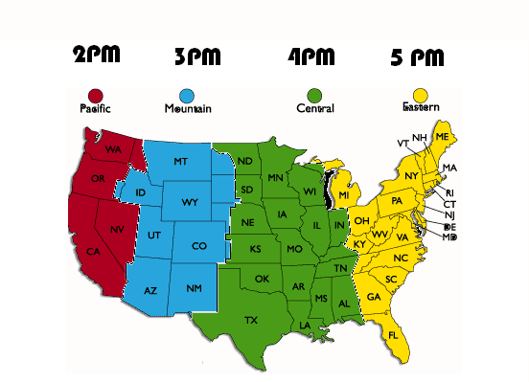
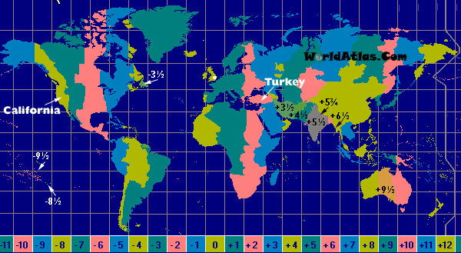
Time Zone
Earth is divided into 24 time zones, corresponding to 24 hours in a day
As the Earth rotates, the sun shines in different areas, moving from east to west
Notes:
Use the globe and a flashlight to demonstrate

Slide 7
Scale
Maps are made to scale
A unit of measurement on the map corresponds to an actual distance
Example: 1 in on the map might represent 1 mile on Earth

Slide 8
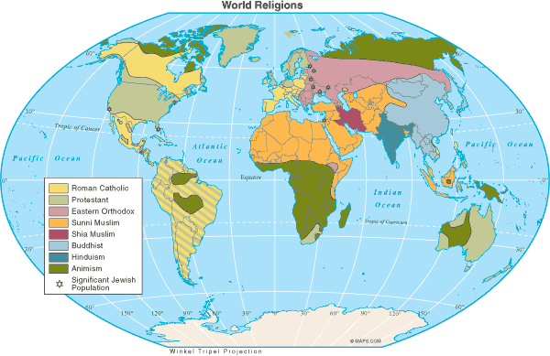
Map Legends
The key to understanding symbols, colors, etc. on a map
LEGEND

Slide 9
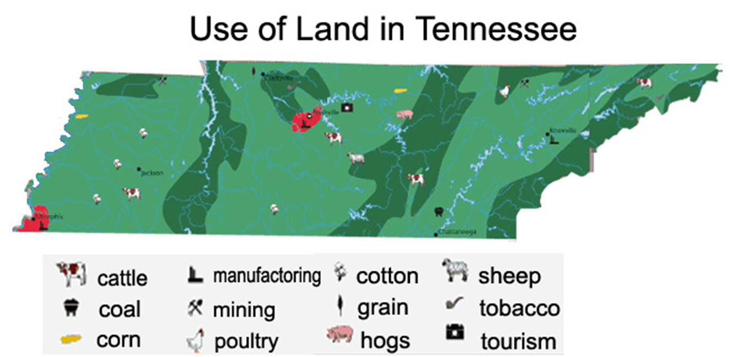

Slide 10
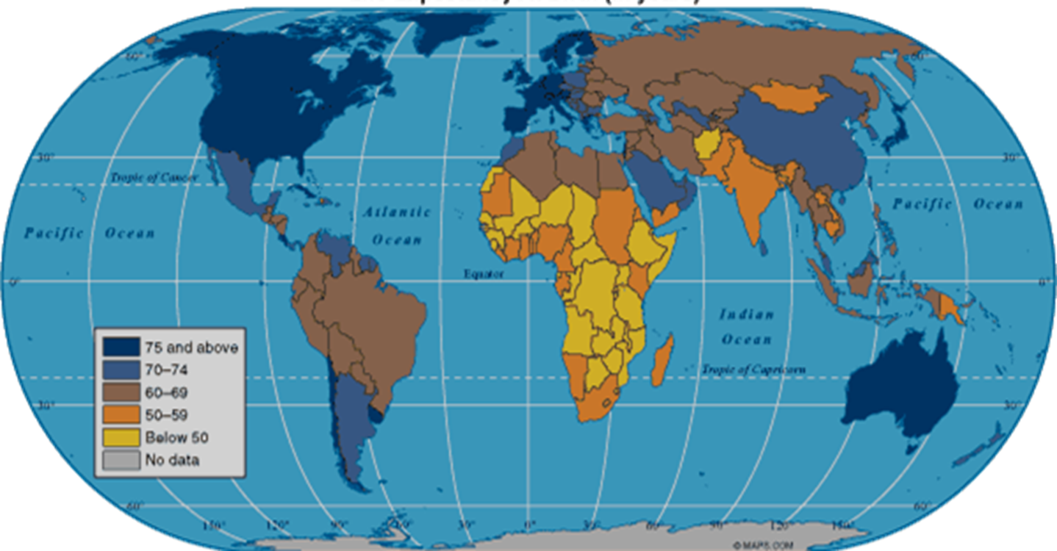

Slide 11
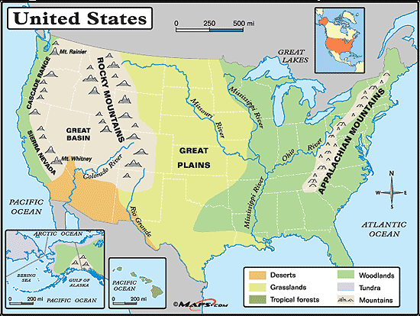
Notes:
Point out scale, compass rose, legend

Slide 12
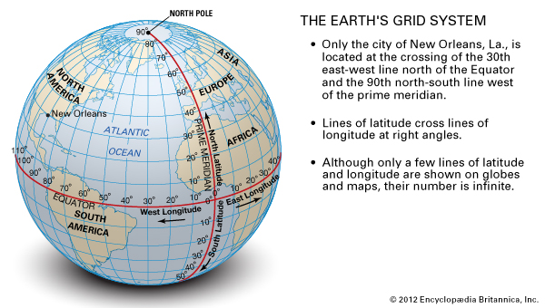

Slide 13
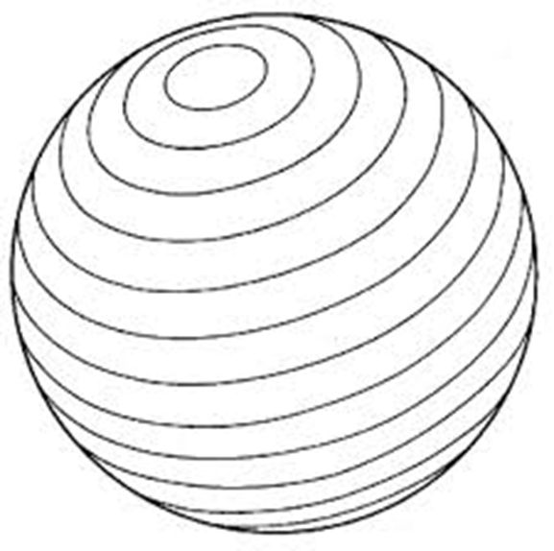
Latitude or Longitude?

Slide 14
International Dateline
Line of longitude exactly on the other side of the world from the Prime Meridian (180˚ Longitude)
International agreement designates this line as the place where each new calendar day begins
East of this line is one day earlier than west side of this line
Utah: August 26
Australia: August 27
http://www.timeanddate.com/worldclock/australia/sydney
Moving West: Add a day
Moving East: Subtract a day

Slide 15
Important Lines
Of Latitude and Longitude

Slide 16
Important Lines of Latitude
Equator 0˚
Tropic of Cancer 23.5 ˚ N and Tropic of Capricorn 23.5˚ S
People who live between these lines live in the tropics
No dramatic change in season because the sun is always high in the sky
People who live north or south of these lines experience more dramatic seasonal changes
Northern Hemisphere has summer when the Southern Hemisphere has winter
Arctic Circle 66.5˚ N
The sun never sets in the summer and the sun never rises in the winter
Antarctic Circle 66.5˚ S
The sun never sets in the summer (which is winter in Utah) and the sun never rises in the winter (which is summer in Utah)

Slide 17
Important lines of Longitude
Prime Meridian
International Dateline

