Slide 1
Map Projections

Slide 2
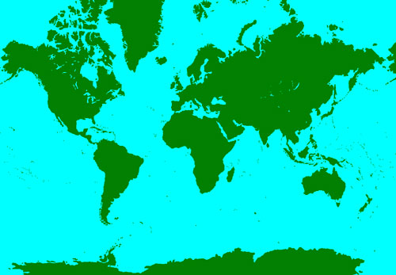
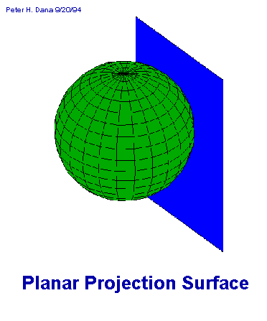
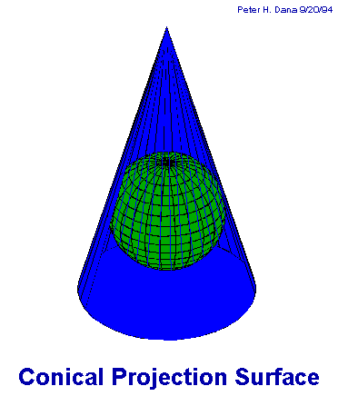
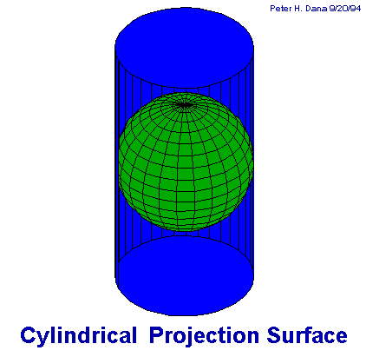
Map Projections
When creating a map, they project the round Earth onto a flat surface
This often makes countries near the poles look inaccurately sized
Greenland looks several times the size of Mexico BUT
Greenland: 830,000 sq. ft.
Mexico: 770,000 sq. ft.
Notes:
Explain there are lots of different projections they try to use to make the map more accurate, but in the end it’s hard to take something round and make it flat without losing accuracy.

Slide 3
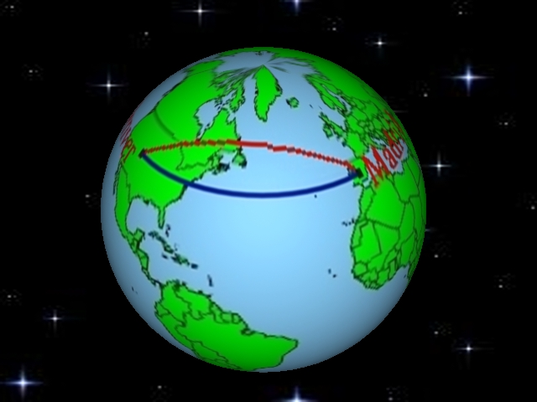
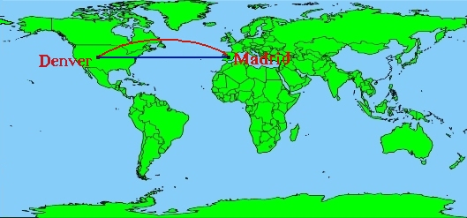
The Great Circle Route

