Slide 1
Major Battles in Greek History

Slide 2
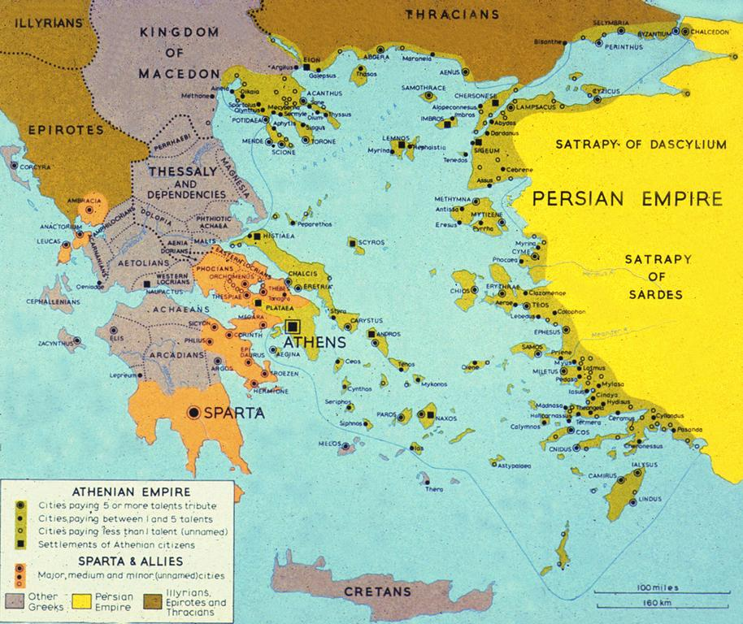

Slide 3
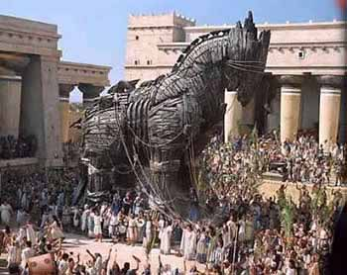
Trojan War
Mycenaean- first Greek State
1600-1100 B.C.
Powerful monarchies
A warrior people
Trojan War
Homer’s Iliad
Achilles
Historians debate whether this actually happened
Notes:
Troy: prince of Troy steals Helen (wife of a Sparta king)-Greece attacks Troy-10 years-sneak inside city inside of a horse-defeat Troy

Slide 4
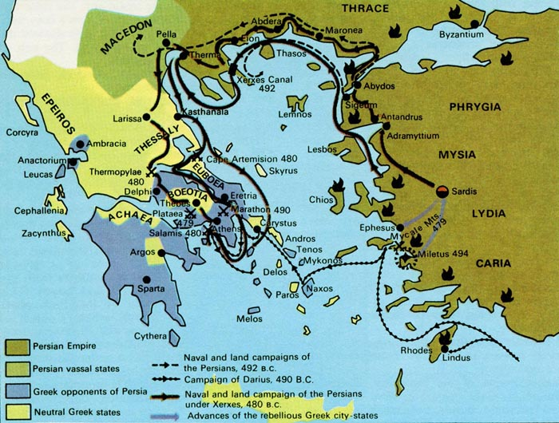
Conflict with Persia

Slide 5
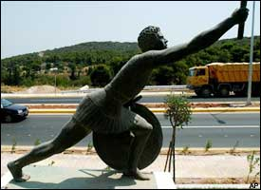
Persian Wars
Persia controlled some Greek States
These states unsuccessfully rebelled with the help of Athenians
Darius seeks revenge on the rebels
Battle of Marathon
Notes:
Marathon: Persians landed in Marathon (near Athens), Outnumbered Athenian army attacked and defeated the Persians, an Athenian runner ran from Marathon to Athens to announce their victory. He died after his announcement. Minor loss for the Persians. But for the Athenians, it proved they could win!

Slide 6
Persian War Continued
Xerxes- Son of Darius wanted to seek revenge and punish Athens
Sparta and Athens work together
Battle of Thermopylae-The Spartans held off the Persians at Thermopylae
Greeks win, Athens takes over leadership of the Greek world
Creates Delian League, defensive alliance between Greek states against Persians
Notes:
Athens built up their navy in preparation for the Persians to come under Xerxes. Some other city states joined under a defensive league formed by the Spartans. Xerxes led a massive invasion force into Greece (180,000 troops and thousands of warships and supply vessels) All the Greek city states joined together to fight this common enemy. Greeks tried to delay the Persians at the pass of Thermopylae. A Greek force of 7,000 held off the Persians for two days. The 300 Spartans in the group were especially brave. Athenians had to abandon city for a time. Eventually the outnumbered Greek fleet defeated the Persians near Salamis and the Persian army at Plataea. Greeks won the war!

Slide 7
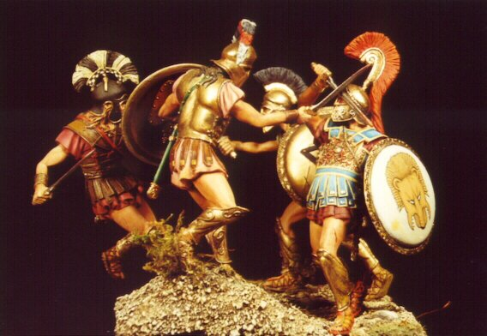
Peloponnesian War, 431 BC
After Persian wars Greek world divided between Sparta and Athens
Athens vs Sparta
Athens: better navy
Sparta: stronger army
Tactics:
Athens: stay behind city’s protective walls
Sparta: surround Athens
Notes:
Sparta feared the growing Athenian Empire and series of disputes led to the outbreak of war.

Slide 8
Which City-State is Superior?
Athens
Sparta

Slide 9
Peloponnesian War
Athens stayed within city walls
Plague Epidemic in Athens
1/3 of people died
Athenian Fleet destroyed in 405 BC
Within a year Athens surrendered
25+ year war
War insured Greek downfall
Focused on each other, they ignored the growing empire to the North
Rise of Macedonia- King Philip and Alexander the Great soon took over all of Greece and forced them to fight against Persia

