Slide 1
Louisiana Purchase
America Doubles in Size

Slide 2
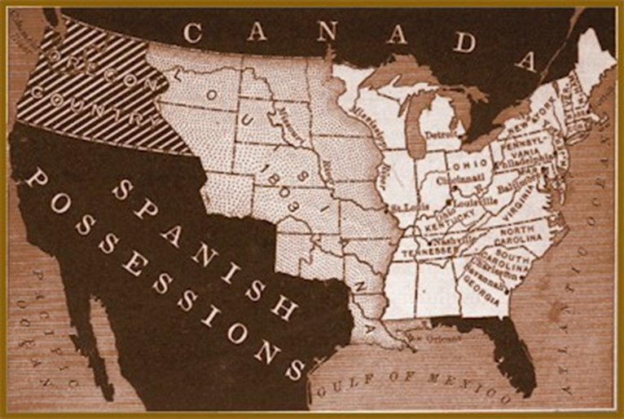
Background to the Purchase
France took over New Orleans from the Spanish
Tension Between U.S. and France
Because U.S. wants access to the Mississippi River through the Port of New Orleans.
Jefferson sends his ambassador to France to find a peaceful answer
Jefferson wants to buy the land, not go to war

Slide 3
Reasons Napoleon Sells
France was about to go to war with Britain, and they didn’t want to fight America as well
Napoleon wanted more money to buy supplies for his armies
If the U.S. owned Louisiana they could challenge France’s enemy, the British
Napoleon’s ultimate goal was to take over the world, he’d sell it to America, and then conquer it back after he defeated all of Europe

Slide 4
Reasons Jefferson Bought
Jefferson wants access to the Mississippi River through the Port of New Orleans
Economic Benefits
Ship from Northeast and west to Mississippi and out through the Gulf of Mexico

Slide 5
Louisiana Purchase
Land deal made with France
U.S. bought the Louisiana Territory from France for $15 million
About 3 cents an acre
Gave the United States the Port of New Orleans
Doubled the size of the United States

Slide 6
How does it influence Expansion?
The Louisiana Purchase offered more room for the U.S. to grow

Slide 7
Opposition to the Purchase
Did everyone want to buy Louisiana?
If Jefferson wanted to, who do you think opposed him?

Slide 8
Exit Slip
Write your answers to the following questions on a sticky note
What is the Louisiana Purchase?
Why did Jefferson want to purchase this land?

