Slide 1
Unit 9: Early American Expansion
I can examine causes and consequences of early American expansion.

Slide 2
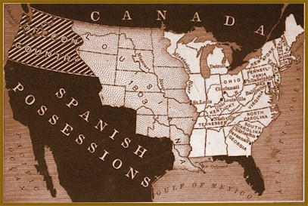
Louisiana Purchase
Mark A next to correct statements, B next to incorrect statements and C next to statements you don’t know on your bubble sheet.
Thomas Jefferson bought the Louisiana Purchase so the U.S. could access the Mississippi River through the Port of New Orleans.
America bought the Louisiana Purchase from Great Britain.
The Louisiana Purchase doubled the size of the United States.

Slide 3
Louisiana Purchase
What do we get?
Louisiana, Arkansas, Missouri, Nebraska, Kansas, Colorado, Wyoming, Montana, North Dakota, South Dakota, Iowa, Minnesota, Oklahoma
Princess and the Frog
Jazz
Swamp People
Wheat: $14.6 Billion
Corn: $63.9 Billion, Largest corn producer in the world (32%)
Write what you would like to learn about the Louisiana Purchase.

Slide 4
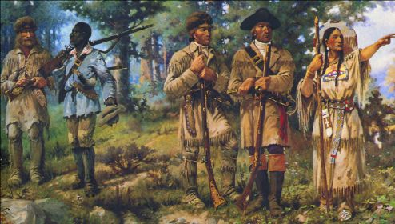
Lewis and Clark
Mark A next to correct statements, B next to incorrect statements and C next to statements you don’t know on your bubble sheet.
4. The members of the Lewis and Clark Expedition are sometimes called the Corps of Discovery.
5. The Lewis and Clark Expedition made U.S. relations with Native Americans worse.
6. One of the goals of the Lewis and Clark Expedition was to find a Northwest Passage.
7. The Lewis and Clark Expedition was unable to find a water route to the pacific.
8. A young Native girl named Sacagawea helped lead the expedition.

Slide 5
Lewis and Clark
Expedition cost $126,000,000 in today’s dollars
Discovered 122 new animals and 178 new plants
Game killed on expedition
1001 deer
375 Elk
227 Bison
113 Beaver
Lewis was shot by a one-eyed member who thought he was an Elk
No fatalities amongst expedition members
Write what you would like to learn about Lewis and Clark.

Slide 6
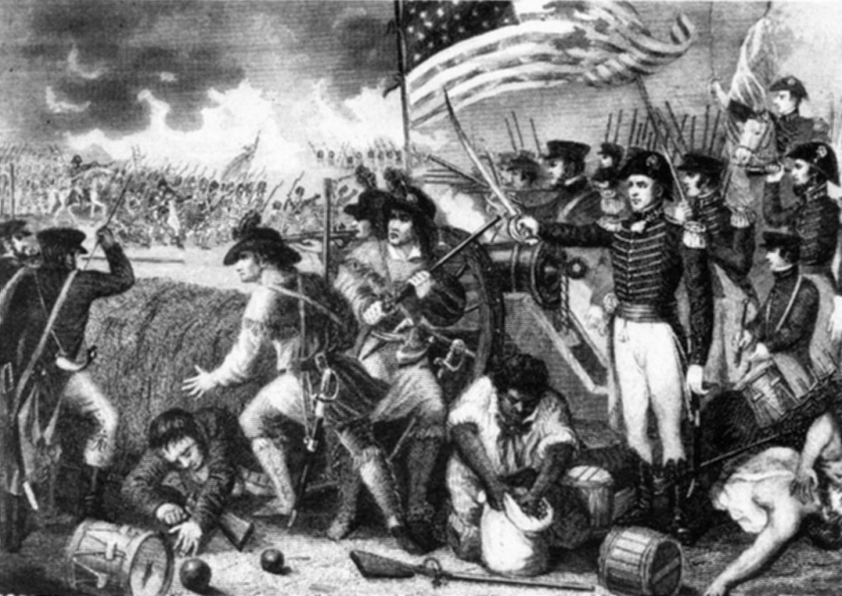
War of 1812
Mark A next to correct statements, B next to incorrect statements and C next to statements you don’t know on your bubble sheet.
9. The term War Hawks refers to Members of Congress that wanted to go to war with Britain.
10. The White House was burnt down during this war.
11. Thomas Jefferson became a war hero during the Battle of New Orleans.
12. The Battle of New Orleans was fought two weeks before the War of 1812 ended.
13. The Star Spangled Banner was written during this war.

Slide 7
War of 1812
Write thoughts and feelings or phrases that stand out to you as you listen to the Star Spangled Banner.
Read along with lyrics.
Write what you would like to learn about the War of 1812.

Slide 8
Star Spangled Banner
Oh, say can you see by the dawn's early light What so proudly we hailed at the twilight's last gleaming? Whose broad stripes and bright stars thru the perilous fight, O'er the ramparts we watched were so gallantly streaming? And the rocket's red glare, the bombs bursting in air, Gave proof through the night that our flag was still there. Oh, say does that star-spangled banner yet wave O'er the land of the free and the home of the brave? On the shore, dimly seen through the mists of the deep, Where the foe's haughty host in dread silence reposes, What is that which the breeze, o'er the towering steep, As it fitfully blows, half conceals, half discloses? Now it catches the gleam of the morning's first beam, In full glory reflected now shines in the stream: 'Tis the star-spangled banner! Oh long may it wave O'er the land of the free and the home of the brave!
And where is that band who so vauntingly swore That the havoc of war and the battle's confusion, A home and a country should leave us no more! Their blood has washed out their foul footsteps' pollution. No refuge could save the hireling and slave From the terror of flight, or the gloom of the grave: And the star-spangled banner in triumph doth wave O'er the land of the free and the home of the brave! Oh! thus be it ever, when freemen shall stand Between their loved home and the war's desolation! Blest with victory and peace, may the heav'n rescued land Praise the Power that hath made and preserved us a nation. Then conquer we must, when our cause it is just, And this be our motto: "In God is our trust." And the star-spangled banner in triumph shall wave O'er the land of the free and the home of the brave!

