Slide 1
Korean War
Cold War Conflicts

Slide 2
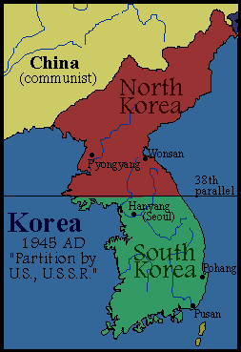
Korea after wwii
Korea was divided between the Northern Soviet zone and the Southern American zone
North became Communistic
South became Capitalist

Slide 3
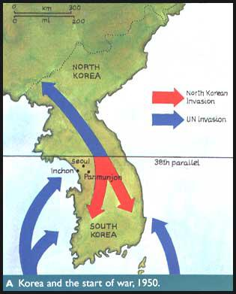
Korean Unification
North Korea wanted to Unify their country
They invaded South Korea to force them to join their Communist regime

Slide 4
US Response
United States was convinced the invasion must have been supported by the USSR
United States pushed North Korea back to the original country boundary
Wanting to unify Korea under a pro-US/capitalism government, the United States continued their advances into North Korea

Slide 5
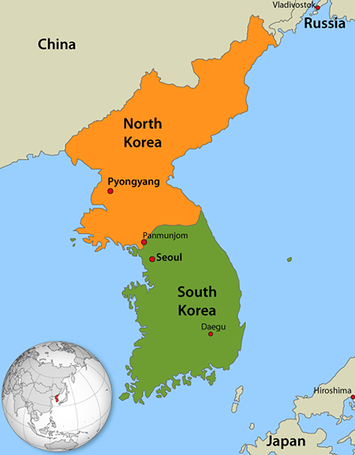
Chinese Response
China was a communist country
China felt threatened by America’s advances
Issued a warning to the US that America ignored
300,000 Chinese soldiers surged into North Korea pushing the line back to the original country boundaries in Korea
After 3 years of fighting and 3 million deaths both sides finally agreed to end the war and keep the Korean boundaries at it’s original location

