Slide 1
Spirituals
Spirituals blended European (white American) hymns with African rhythms
Slave spirituals as we know them today have evolved in words and in song
Jazz, Blues and Gospel music have their roots in spirituals and slave culture (however, they are influenced by other factors as well)

Slide 2
Follow the drinking gourd!
Follow the drinking gourd.
For the old man is a–waiting for to carry you to freedom
If you follow the drinking gourd.
When the sun comes back and the first quail calls,
Follow the drinking gourd.
For the old man is a–waiting for to carry you to freedom
If you follow the drinking gourd.
The riverbank makes a very good road,
The dead trees will show you the way.
Left foot, peg foot, traveling on,
Follow the drinking gourd.
The river ends between two hills,
Follow the drinking gourd.
There's another river on the other side,
Follow the drinking gourd.
When the great big river meets the little river,
Follow the drinking gourd.
For the old man is a–waiting for to carry you to freedom
If you follow the drinking gourd.

Slide 3
Swing low, sweet chariot,
Coming for to carry me home.
Swing low, sweet chariot,
Coming for to carry me home.
I looked over Jordan, and what did I see,
Coming for to carry me home?
A band of angels coming after me,
Coming for to carry me home.
Swing low, sweet chariot,
Coming for to carry me home.
Swing low, sweet chariot,
Coming for to carry me home.
If you get there before I do,
Coming for to carry me home,
Tell all my friends I'm coming too,
Coming for to carry me home.
Swing low, sweet chariot,
Coming for to carry me home.
Swing low, sweet chariot,
Coming for to carry me home.

Slide 4
Oh go down, Moses,
Way down into Egypt's land,
Tell old Pharaoh,
Let my people go.
Oh Pharaoh said he would go cross,
Let my people go,
And don't get lost in de wilderness,
Let my people go.
Oh go down, Moses,
Way down into Egypt's land,
Tell old Pharaoh,
Let my people go.
You may hinder me here, but you can't up dere,
Let my people go,
He sits in de Hebben and answers prayer,
Let my people go!
Oh go down, Moses,
Way down into Egypt's land,
Tell old Pharaoh,
Let my people go.

Slide 5
Mix of Spirituals and 20th Century Jazz
https://www.youtube.com/watch?v=bvEmq-cX0G4

Slide 6
Kansas Nebraska Act

Slide 7
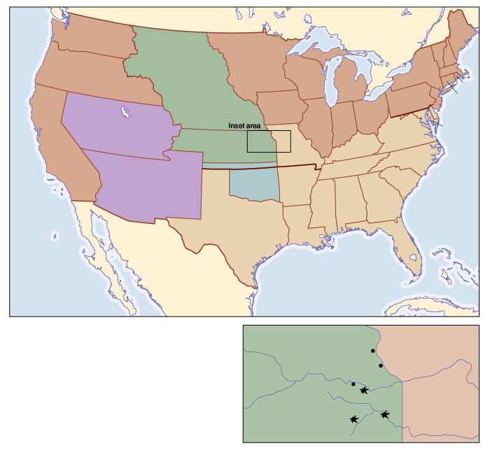
Louisiana Territory: Slave or Free?

Slide 8
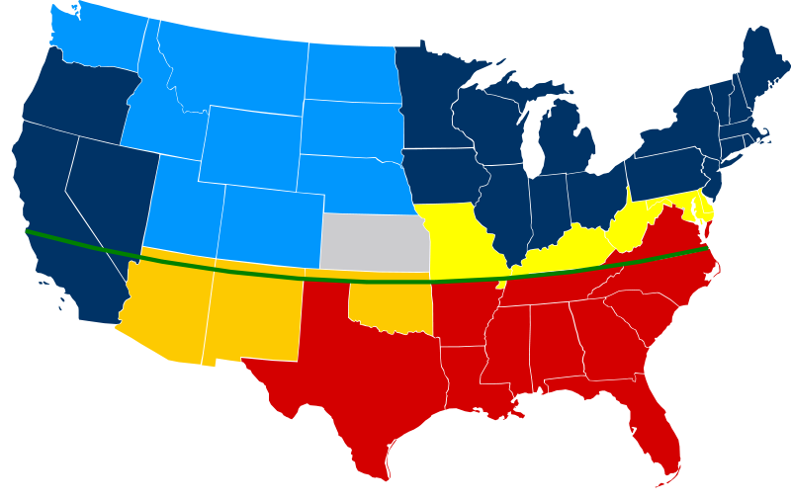
Kansas Nebraska Act
Divide Louisiana Territory into two territories (Kansas and Nebraska)
Popular Sovereignty decided whether it was slave or free
Removed the restrictions of the Missouri Compromise
Notes:
Northerners were outraged that they would get rid of the line established by the Missouri Compromise

Slide 9
Bleeding Kansas
Kansas territory voted on slavery
Thousands of Southerners went to Kansas, voted, and then went home
Thus, the legislature had a huge pro-slavery majority and enacted many laws in favor of slavery
Kansas had a divided government and population, both armed and ready to fight over slavery
Armed violence broke out
This is known as bleeding Kansas
Notes:
You could be killed for helping a slave in Kansas
Story of Senator who beat up the Anti-slavery senator and couldn’t return for three years

Slide 10
Harper’s Ferry
One an example of “Bleeding Kansas” is Harper’s Ferry, led by John Brown
http://www.amazon.com/The-Civil-War-Film-Burns/dp/B004AZCWKC
Start at 27:45
Stop at 32:51

