Slide 1
Israeli Palestinian Conflict
The Fight for Jerusalem

Slide 2
Key Terms
Jew- People who follow religion of Judaism
Israeli- A person from Israel (Usually a Jew)
Muslim- People who follow religion of Islam
Palestinian- Person from Palestine (usually a Muslim and Arab)
Arab- Person with Arabic descent; people from the Middle East
Refugee: person who must leave their home because they have suffered persecution

Slide 3
Key Places
In relation to the Israeli-Palestinian Conflict

Slide 4
Israel/Palestine

Slide 5
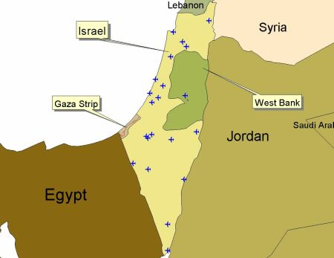
Gaza Strip
Palestinian Territory but is technically controlled by Israel
It is inhabited mostly by Refugees
Poverty and overcrowding
Important because of coast line and proximity to Egypt

Slide 6
West Bank
Palestinian territory but is technically controlled by Israel
Important because of water supply

Slide 7
Sanai Peninsula
Has significant economic importance
Suez Canal connects the Mediterranean Sea to the Red Sea

Slide 8
History of the Conflict
Wars and Peace Treaties

Slide 9
Zionism
The desire for Jews to have their own country in Israel
This movement began in the 1800’s but gained support after WWII

Slide 10
Pre-1947 British Controlled

Slide 11
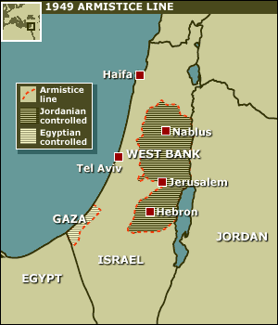
UN Resolution
UN Plan
After Arab-Israeli War
After WWII UN created a plan to make a country for Jews- Israel
Jews who made up 33% of population would receive 55% of the land
Arab states rejected this plan
5 nations attacked Israel
Israel won the war, conquering more land than before
Created 3 million Palestinian refugees, who still don’t have their homes
These Palestinians moved into the Gaza Strip and the West Bank

Slide 12
The 6 Day War
Israel launches attacks against Palestinians
Israel then controlled of Jerusalem, West Bank, Gaza Strip, Sinai Peninsula

Slide 13
Camp David Accords
First peace treaty between Arabs and Israelis
Organized by US President
Egypt agreed to recognized Israel as a country in exchange for the Sanai Peninsula
Palestinian leaders refused to negotiate
Islamic extremists assassinated the Egyptian President for his cooperation with Israel

Slide 14
1st Intifada
An uprising of Palestinians
Fought against poor treatment, poverty, loss of homes, loss of country, loss of Jerusalem etc.
Palestinians didn’t have near the weapon power to compete with Israel
160 Israelis died
1162 Palestinians died

Slide 15
Oslo Accords
Israeli Prime Minister met with the Palestinian Liberation Organization and the US President Bill Clinton
Both Israel and Palestine wanted complete control of Jerusalem
This attempt at peace failed

Slide 16
2nd Intifada
Palestinians used suicide bombing and terror tactics
Israelis assassinated leaders who ordered these suicide attacks
Entered Palestinian towns with tanks and strong force

Slide 17
Israel’s Relationship with Neighbors
Egypt- Recognizes Israel
Jordan- Recognizes Israel
Syria- No recognition
Lebanon- Formally at war with Israel, no recognition
Saudi Arabia- No recognition
Iraq- No recognition
Iran- No recognition, threatens to destroy Israel
U.S.- Recognizes Israel and traditionally supports Israel, however, Obama has been more lenient toward Palestinians than any previous president

Slide 18
Claim to Israel/Palestine
Jews-Israel
Muslims-Palestinians
Temple Mount
Western Wailing Wall
Promised Land from ancient times
Now lived there for 50 years
Won land in war
Palestinian homeland for hundreds of years
Dome of the Rock
Land unfairly taken from them

Slide 19
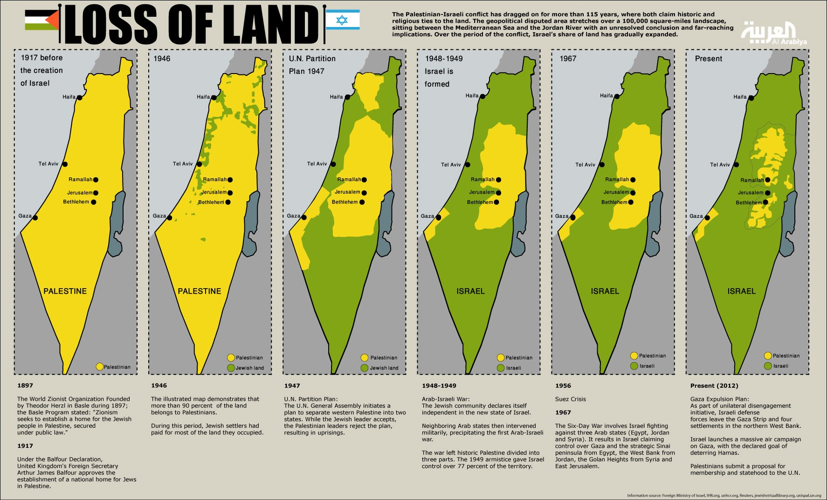

Slide 20
Sources
http://news.bbc.co.uk/2/shared/spl/hi/middle_east/03/v3_israel_palestinians/maps/html/1967_and_now.stm

