Slide 1
Incas

Slide 2
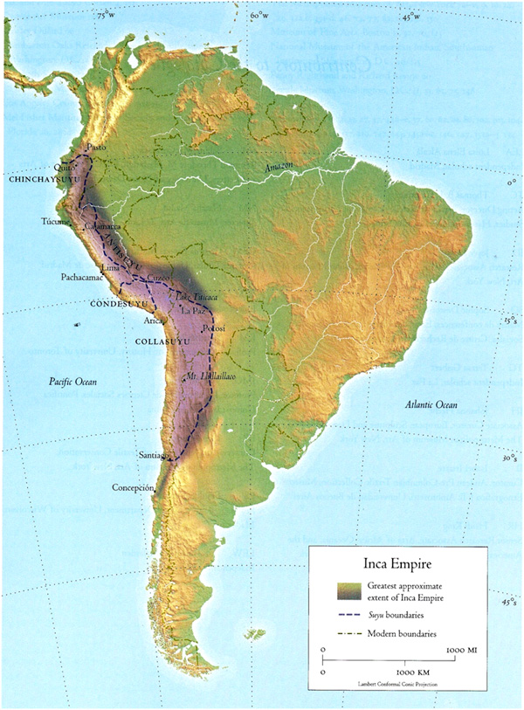
Inca Empire
At first, the Incas lived peacefully amongst other natives within the Andes Mountains
In 1438, the Inca ruler Pachacuti (Earthshaker) launched military campaigns to expand the Incas’ authority
This began the Inca Empire
Inca empire became the largest empire in the pre-Columbian Americas

Slide 3
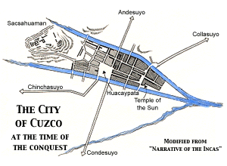
Inca Culture
Jaguar was an important symbol
Believed the Jaguar was capable of transforming into a human and is a symbol of prosperity
Capitol City, Cuzco was shaped in a jaguar

Slide 4
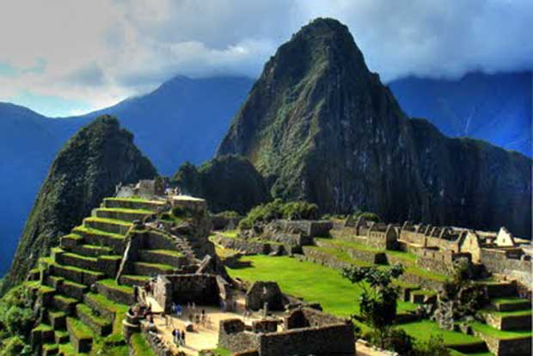
Inca Culture
Religion
Incas worshipped the Sun God
Participated in Human Sacrifice
Architecture
Incas had impressive architecture
They used such precision in stonecutting they did not need to use mortar; each block fit exactly with the next.
Incas built bridges between their mountainous villages using grass
This bridges could hold several people at a time
Machu Picchu is one of the most famous Inca ruins and has survived hundreds of years

