Slide 1
Revolutionary War
American v. British

Slide 2
April 1775: Battle of Lexington and Concord
June 1775: Battle of Bunker Hill
July 1775: Olive Branch Petition
January 1776: Common Sense
July 1776: Declaration of Independence
  Labeled them traitors to Britain

Slide 3
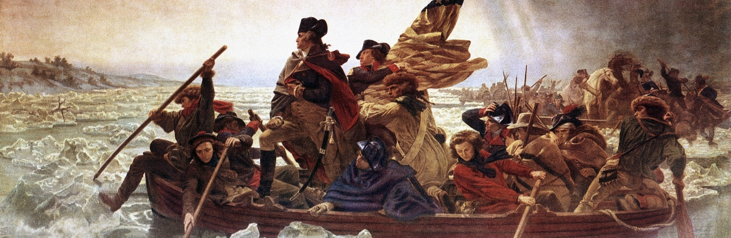
Battle of Trenton- December 1776
American soldiers secretly crossed the Delaware river on Christmas night and attacked the day after Christmas.
Patriots captured more than 900 Hessians, only 5 American casualties
Read speech
Patriots won the Battle of Princeton just a few weeks later
Notes:
British thought they’d win the war quickly, so they settled down in New York for the winter. They planned to crush any rebellion left in the spring. They left Trenton, New Jersey in the hands of the Hessians.

Slide 4
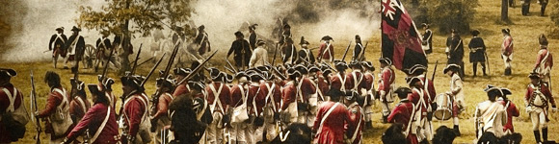
Battle of Brandywine Creek- Sept 1777
American lost their political center, Philadelphia to the hands of the British
Twice as many American causalities as British

Slide 5
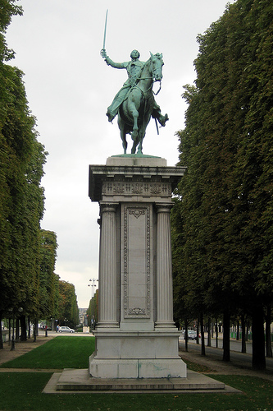
Battle of Saratoga-Sept 1777
American victory
Convinced the French to aid American forces

Slide 6
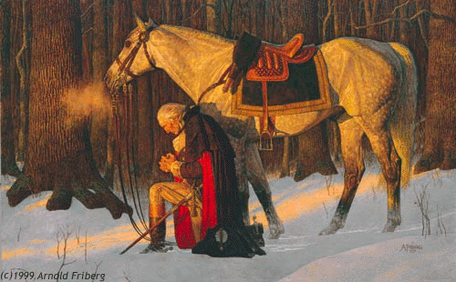
Valley Forge Winter 1777- 1778
Americans settled in Valley Forge for the winter, suffered from food and clothing shortages
Many died from starvation, freezing or disease
http://www.history.com/topics/american-revolution/american-revolution-history/videos/surviving-valley-forge

Slide 7
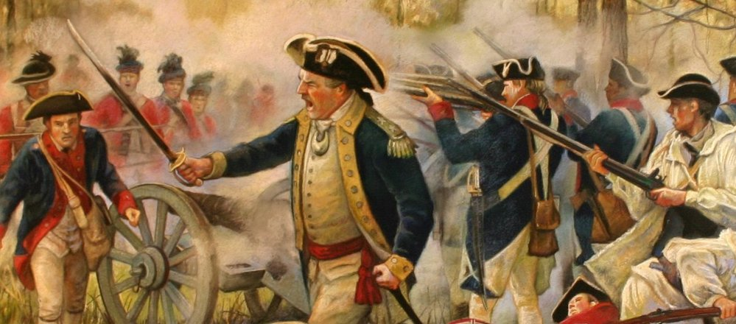
Battle of Camden- August 1780
American forces panicked, breaking the American line and losing to the British
Americans lost their southern army

Slide 8
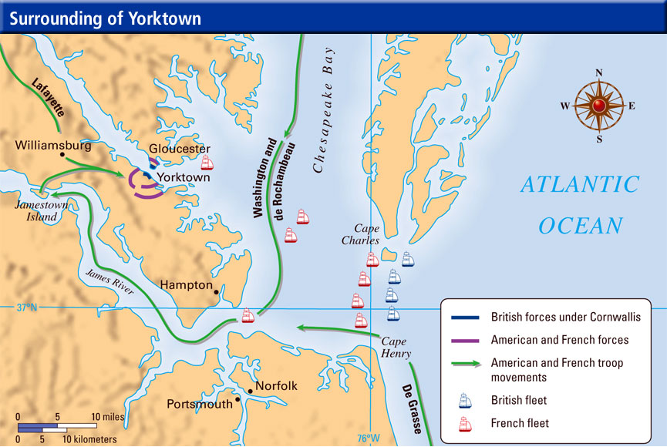
Battle of Yorktown Sept- Oct 1781
Washington laid siege on Yorktown with the help of French soldiers and fleet
Cornwallis was forced to surrender
Last battle of the war
http://www.history.com/topics/american-revolution/siege-of-yorktown/videos/yorktown
Notes:
General Cornwallis wanted to tighten hold on the Southern colonies. He moved his troops to Yorktown, Virginia. He wanted to attacked a small force led by Lafayette.
Meanwhile, Washington was in New York. A large French army just arrived in New York.
French fleet came and took control of the Chesapeake Bay so no British ships could get in or out.
Washington and the other French soldiers moved their troops south. They surrounded Cornwallis with 16,000 Patriot soldiers.
For weeks, Washington held Yorktown under siege. He prepared for a major attack but Cornwallis saw it coming. He surrendered.

