Slide 1
Greek Philosophy
Socrates, Aristotle, Plato

Slide 2
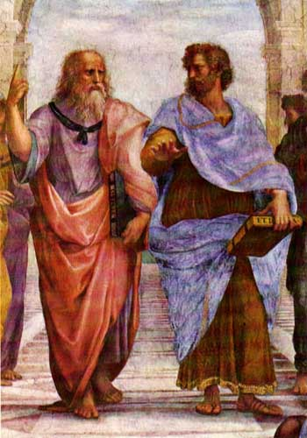
Greek Philosophy
Philosophy: to study the reason, the significance, and the nature of knowledge, reality, existence
Allegory: a story that represents or symbolizes human life; usually has a moral
https://www.youtube.com/watch?v=LTWwY8Ok5I0

Slide 3
Plato’s Allegory of the Cave

