Slide 1
European Settlement of the Americas

Slide 2
Why did Europeans Settle in Americas?
Europeans settled in the Americas for similar reasons that they started exploring
God: Spread Christianity. They thought it would “civilize” the Native Americans
Gold: Take the wealth and resources of the Americas and use to for their own country’s benefit
Glory: Expanding the influence of their country and settling new lands gave European countries more prestige and power

Slide 3
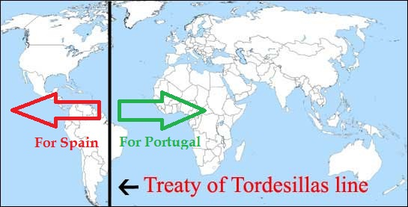
Treaty of Tordesillas, 1494
As other European countries learned of Columbus’s discoveries, they all wanted to explore this New World
Spain feared they would lose the land they found
Spain convinced the Pope to create a boundary line
Treaty of Tordesillas created a line showing the land that Spain could explore and claim and the land Portugal could explore and claim
Spain claimed west of the line (This is why most of South American speaks Spanish)
Portugal claimed east of the line (This is why Brazilians speak Portuguese)
Because Europeans hadn’t explored all of South American yet, no one realized just how clearly this line favored the Spanish

Slide 4
Potosi
http://www.history.com/shows/mankind-the-story-of-all-of-us/videos/spanish-silver

Slide 5
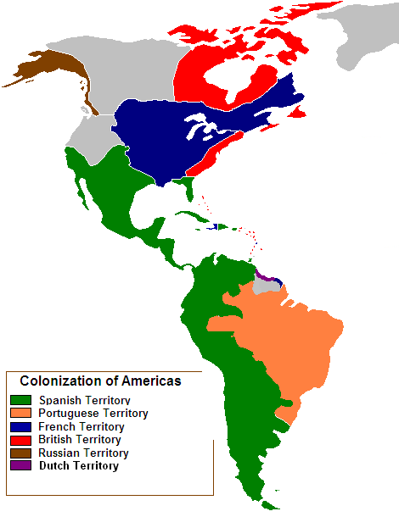
Settlement of the Americas
Despite the Treaty of Tordesillas, over the course of 200 years many European countries began laying claim to lands in the Americas
Ignore the purple and brown colors

