Slide 1
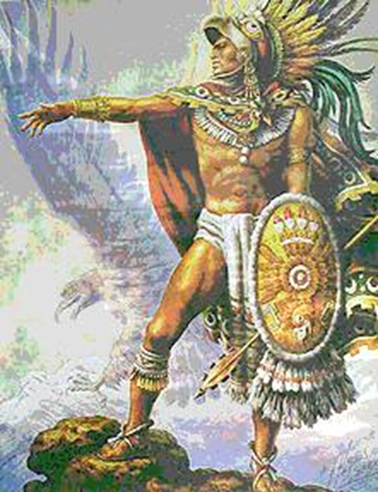
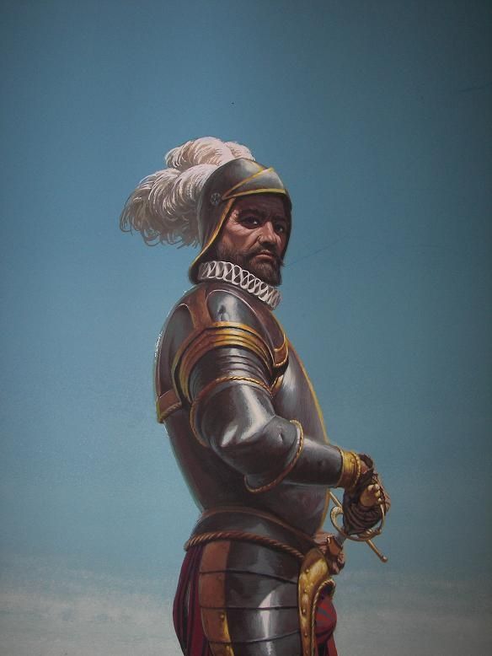
Why were Europeans able to dominate American Indian Nations?
European Domination

Slide 2
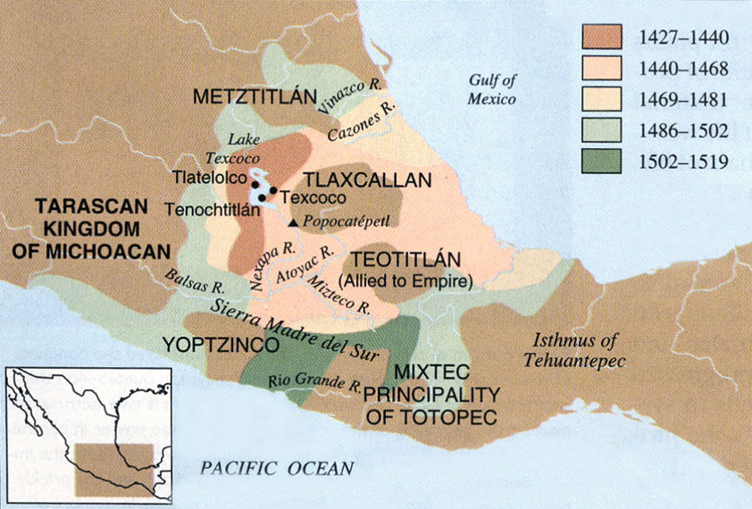
1. Native Disunity
A lot of natives were sick of their rulers
They saw the Europeans as a way to escape their rulers
Image Source: http://www.latinamericanstudies.org/aztec-maps.htm

Slide 3
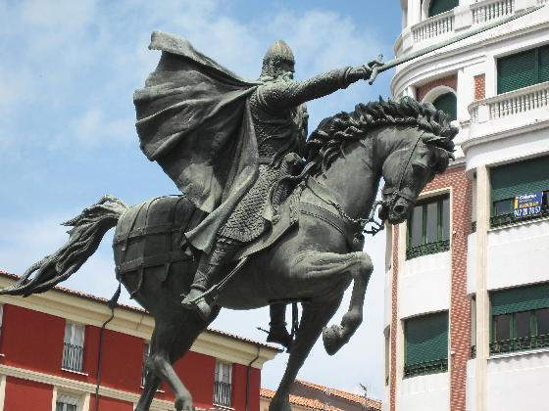
2. Weaponry
The Conquistadors benefited from Steel weapons
Whereas the Indian nations used Stone and Bronze weapons.
Gun Powder is in it’s infancy
But will be used against Native people very soon
Europeans didn’t develop better weapons because they were smarter
They had better resources and food supply to support the development of such weapons

Slide 4
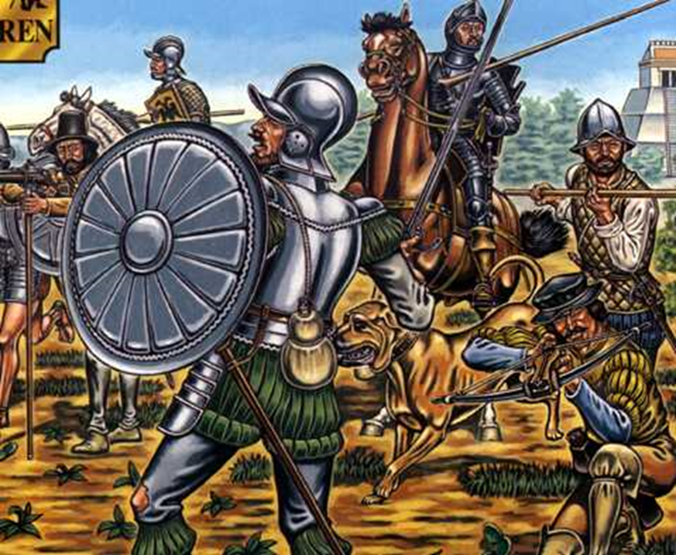
3. Culture of War
AZTECS (Natives) | CONQUISTADORS
Capture enemies, not kill Sacrifice enemies to Gods for divine blessings Relied on strength and skill of body | Relied on the strength of weapons Advantage of horses Kill quickly and in high quantities

Slide 5
4. Disease in the New World
As many as 90% of the Native population was wiped out by disease
Infected Indians fled to other villages
Carrying the disease
Why so much disease in the Old World and not in the New World?
Native American cities were more clean than European cities
Indians didn’t have cattle and pigs at all, let alone in their homes
Many diseases come from animals, Europeans lived close with animals while Natives didn’t
Show video clip “Inventors” 19:40

Slide 6
Why did disease affect Natives so much?
Native Americans didn’t have immunities
They had very few serious diseases in their population, so they weren’t used to fighting bacteria and viruses

Slide 8
Aztec vs. Conquistador
Image Source: http://royalcello.websitetoolbox.com/post?id=3414946
Image Source (Aztec Warrior and Pyramid): http://www.solarnavigator.net/history/aztecs.htm
Image Source (Good Conquistador Close up): http://www.comicartfans.com/gallerypiece.asp?piece=314870&gsub=60597

