Slide 1
Ancienct Egyptians

Slide 2
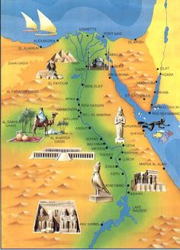
Egyptian Civilization
Egypt developed along the banks of the Nile
This allowed for agriculture
Because the Nile was the source of life, it played a significant role in Egyptian religion

Slide 3
Architecture
Built temples, pyramids, and other monuments.
Built these monuments through advances in math.

Slide 4
Architecture and Art
Sculpted and drew paintings with frontal and profile view to confirm that all the sides were showing.

Slide 5
Architecture
http://www.history.com/topics/ancient-history/ancient-egypt/videos/mankind-the-story-of-all-of-us-building-the-pyramids?m=528e394da93ae&s=undefined&f=1&free=false

Slide 6
Papyrus

Slide 7
Papyrus
Paper made from papyrus reed.
Grew along the Nile
Provided Egyptians a form of communication

Slide 8
Papyrus
http://www.youtube.com/watch?v=DCR8n7qS43w

Slide 9
Hieroglyphics
Discovery of the Rosetta Stone http://www.youtube.com/watch?v=ptXlmZzSVV8

Slide 10
Hieroglyphics
Began around 3000 BC
Means “priest carvings” or “sacred writings”
Appears on writing in temple walls and tombs
Hieratic script is the simpler form used in everyday life.

Slide 11
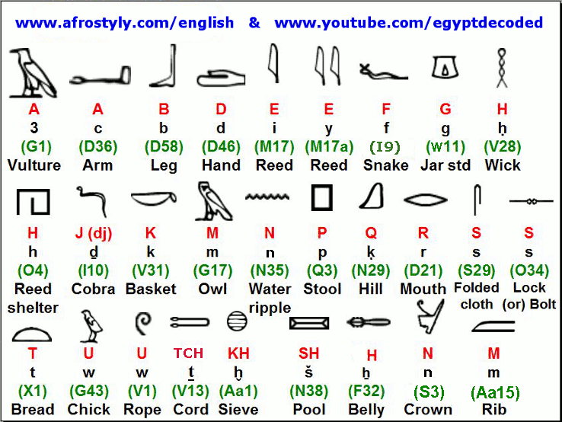

Slide 12
Mummfication
http://www.history.com/topics/ancient-history/ancient-egypt/videos/how-to-make-a-mummy

Slide 13
Mummification
“Process of slowly drying a dead body to prevent it from rotting.”
Done to prepare the dead Pharaoh for his journey through the afterlife.

Slide 14
Religion
Egyptians had a polytheistic religion
They believed in many Gods
Egypt’s Pharaoh’s took the title “Son of Re”
They were seen as the Earthly form of Re

Slide 15
Religion
Cult of Osiris
Dead Pharaoh was brought to the judgment before Osiris (God of the Underworld) and 42 judges. He had to proclaim himself sinless.

Slide 16
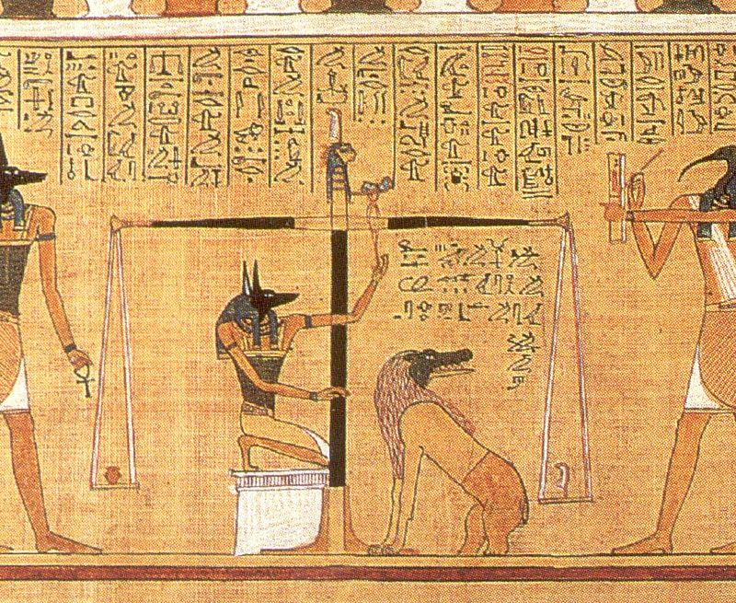
If the Pharaoh passed the judgment, his heart would be weighed by Osiris. If the heart was lighter than the feather, he would enter Osiris's kingdom.
If not…..

Slide 17
Religion
The Pharaoh would be eaten by Amit. Half hippopotamus, half alligator, and half lion.

Slide 18
Religion

