Slide 1
Economic Systems
Capitalism v. Communism

Slide 2
Capitalism
Private Ownership
Free Enterprise: Private investment in business
Take Risks: make and keep profit, or go out of business
Free Market: Quantity and Price is determined by market not government
Hard Work
Competition
Little government involvement
Focus on Profit

Slide 3
Socialism
Government property and businesses
Many countries see this as a stepping stone to Communism

Slide 4
Communism
Business is for the benefit of society not the individual
Focus on Equality over profit
No private property
Government ownership UNTIL society is ready for community ownership of property and business
  (In reality no communist country has ever made it to this point)
Cooperation: everyone does their fair share of the work
Possessions based on needs first
Eventually there will be no social classes and government will not be necessary
“From all according to his ability, to all according to his need”

Slide 5
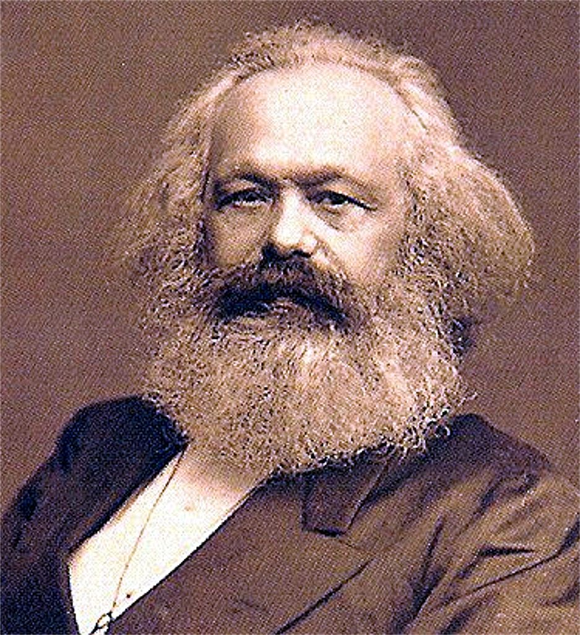
Karl Marx’s Philosophy
Karl Marx believed history was a story of class struggle
    Proletariat v. Bourgeoisie
    Lord v. Serf
    Rich v. Poor
    Noble v. Peasant
    Workers v. Factory Owners
The Best societies would need to stop exploiting the workers

Slide 6
Karl Marx’s Philosophy
Capitalism
Class Struggle
Workers Revolt
Socialism
Communism

Slide 7
Capitalism v. Communism
1700’s-1800’s: Countries start breaking away from absolute monarchies
1900’s: Now these countries have to decide if they want to be Capitalists or Communists
After poor working conditions of the Industrial Revolution, WWI, The Great Depression, and WWII
  Many people are weary Capitalist countries like Great Britain, United States, etc.
This fight between capitalism and communism is the root of the Cold War

Slide 8
Economies are Not Black and White
No country in the world is purely Capitalist
  US still has government ownership in some instances
No country in the world is purely Communist
  No communist country has ever progressed to true communism where everything is owned communally

