Slide 1
DARK AGES
The Middle Ages of Europe

Slide 2
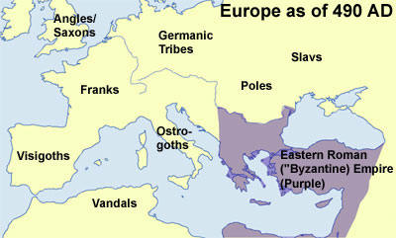
Europe after fall of Rome
Germanic Peoples
Byzantine Empire
Notes:
An Empire No More
Western half falls to Germanic peoples in 476
Eastern half survives for another 1,000 yrs as the Byzantine Empire.
The Byzantine emperors ruled from Constantinople.
The Byzantine emperors saw themselves as heirs to the Empire of Rome

Slide 3
DARK AGES
During the early Middle Ages much of Europe passed through a time of turmoil and confusion, of ignorance and lawlessness...The early Middle Ages may justly be called the Dark Age...During the early Middle Ages, from 476 to about 1100, European civilization slipped back into semi-barbarism. The chief cause of this decline was lack of a government which could keep order. The Germanic Kingdoms which had been set up by 476 were unable to suppress violence. There were so many highway robbers that travel became dangerous. Europe suffered a decline in commerce and manufacturing, in education, in literature and the arts, and in almost all that makes possible a high civilization. Cities grew smaller and in some cases practically disappeared, and western Europe became a region of poverty-stricken farming communities, each virtually isolated from the rest of the world.
Source: Roehm, A., Buske, M., Webster, H. & Wesley, E,. (1954). The Record of Mankind. Heath and Company.

Slide 4
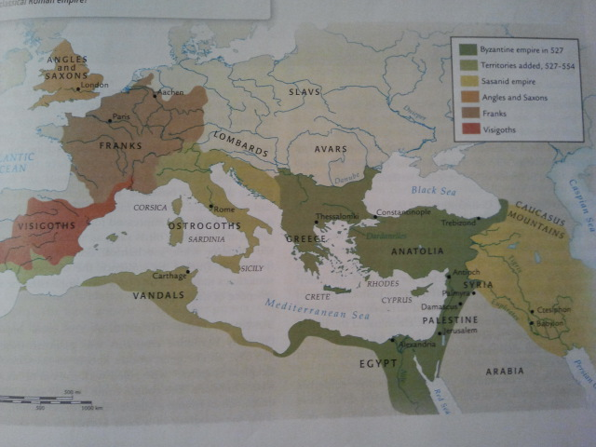
Germanic Tribes
Franks, Visigoths, Vandals, Angles, Saxons, Ostrogoths
Violent, Warring tribes and kingdoms

Slide 5
Feudalism
Political and class system where nobles were granted the use of the land that legally belonged to the king
Why did this come about?
Notes:
- Vikings and other invaders posed a large threat to the safety of the people throughout Europe
- People began to turn to local land aristocrats for protection in return for service, thus the beginning of feudalism

Slide 6
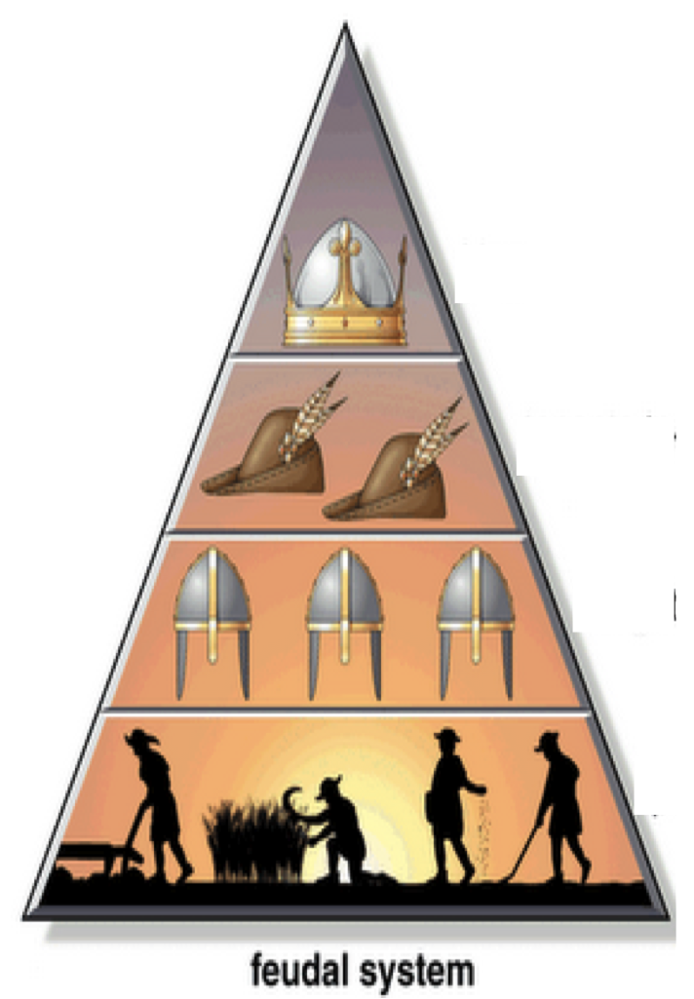
Kings granted land to Lords in return for loyalty
Lords granted Knights land in exchange for defense
Serfs were bound to the land
Needed land to live and Lord for protection
  Majority of Society
  Paid high taxes to Lord
  Not Slaves

Slide 7
Life of Serf
  Paid tax on all their food
  Paid tax on marriage
  Paid 1/10 of income to village priest
  Lived in crowded cottages
  Couldn’t travel more than 25 miles away from homes
  Didn’t live very long (avg. life=35 years)

Slide 8
Monte Python
http://www.youtube.com/watch?v=rAaWvVFERVA

