Slide 1
DO NOT SHOW THIS SLIDE
Qing Dynasty was heavily influenced by western Imperialists
Many Chinese started to rebel against this foreign involvement
Boxer Rebellion
Qing Dynasty is unable to restore order and falls
China ends up being overrun with warlords contending for power
Nationalists start to develop political strength
Ultimately they want to establish western democracy in China
Notes:
Boxer Rebellion: Boxers (members of a secret organization) roamed China killing foreign missionaries, Chinese Christians and other foreign people or cultures

Slide 2
DO NOT SHOW THIS SLIDE
Nationalists join with the Communists
Goal was to oppose warlords
Drive out imperialist powers
At first, both groups relied on the alliance
After gaining some stability the Nationalists turned on the Communists
Notes:
Nationalists hoped to gain from the expertise and support of the Soviet Union

Slide 3
DO NOT SHOW THIS SLIDE
Communists go into hiding for many years to rebuild support
Nationalists try to push Communists out of their headquarters
Nationalists blockaded Communists to starve them out
Communists eventually push past the blockade and start on a long march to safety
Of the 90,000 who left, only 9,000 made it to safety
Mao Zedong became the clear leader of the Communist party during this time period

Slide 4
Chinese Communism
Cultural Revolution and the Great Leap Forward

Slide 5
China by the End of WWII
China had no clear, unified leader
Communists built a stronghold in the North
Led by Mao Zedong
Nationalists built a stronghold in South and Central China
Nationalists wanted to establish democracy

Slide 6
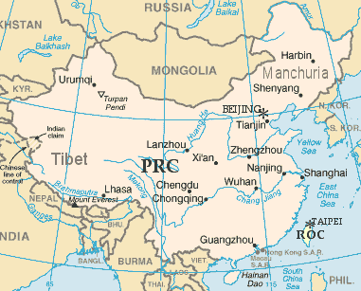
Nationalists Flee to Taiwan
Mao Zedong led an army of Communists against the Nationalists
The Nationalists fled to Taiwan
People’s Republic of China- Communism on mainland
Republic of China- Democracy in Taiwan
Both claim to be the rightful ruler of the other

Slide 7
The Great Leap Forward
Mao wanted to quickly surpass the industrial strength of America
Destroyed Private Ownership
This attempt failed epically
Created a famine that killed up to 20 million people

Slide 8
Cultural Revolution
A movement promoted by Mao Zedong and largely supported by zealous Chinese youth
Destroy the Four Olds: Old ideas, old culture, old customs and old habits
Attacked anyone who supported anti-communism or foreign culture
Vicious attacks on people, destruction of property, extreme violence, public embarrassment

Slide 9
China Today
Like the Soviet Union, China has taken steps away from Communism
Extreme poverty and a lack of progress caused many people to revolt

