Slide 1
Cuban Missile Crisis

Slide 2
Cuba: 90 miles from the coast of the US

Slide 3
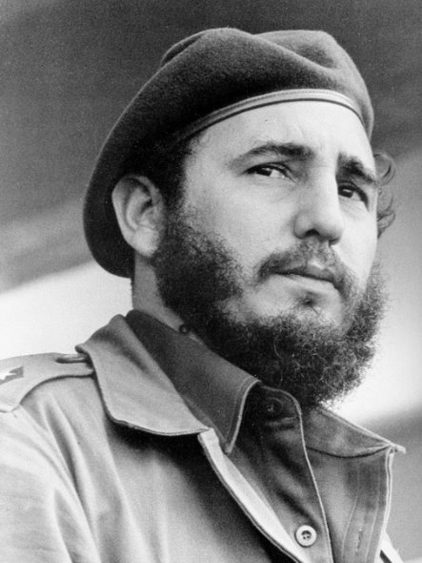
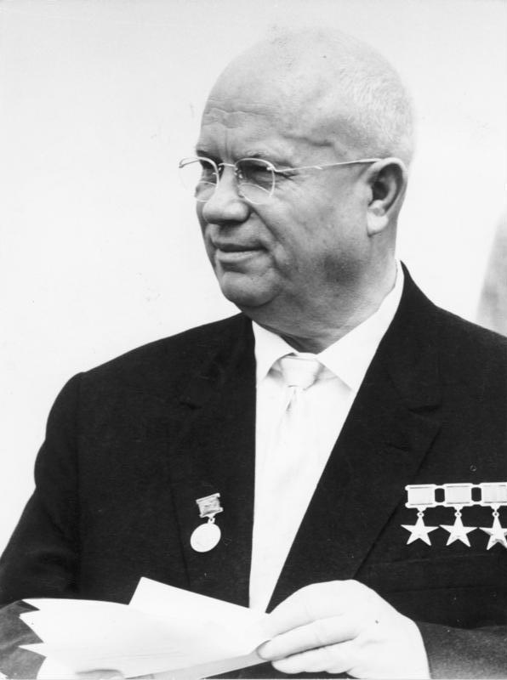
People Involved
John F. Kennedy
USA
Fidel Castro
Cuba
Nikita Kruschev
Soviet Union

Slide 4
Communism in Cuba
Fidel Castro (communist) overthrows the government in Cuba.
A group of 1,500 rebels is willing to fight to free Cuba from the communists.

Slide 5
Based on the Truman Doctrine, what would the US do?
Bay of Pigs invasion

Slide 6
http://www.history.com/topics/cold-war/bay-of-pigs-invasion/videos/bay-of-pigs-cias-perfect-failure

Slide 7
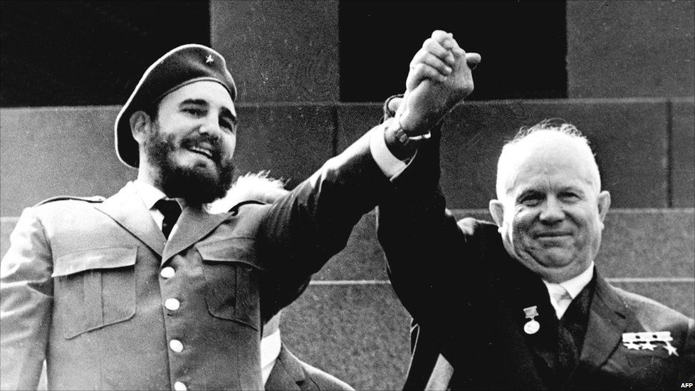
Cuba
Cuba is still controlled by the communists….
And joins into an alliance with the Soviet Union.

Slide 8
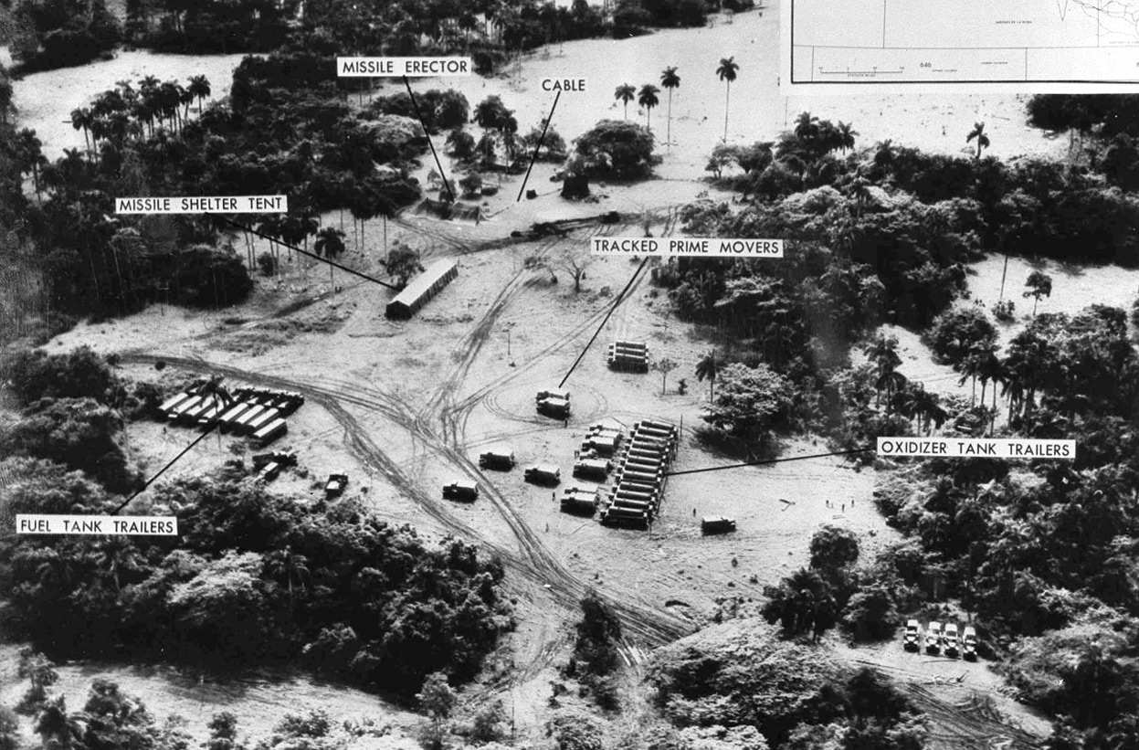
A pilot flying over Cuba comes back with these pictures.

Slide 9
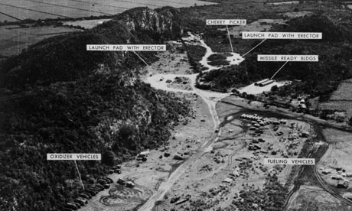

Slide 10
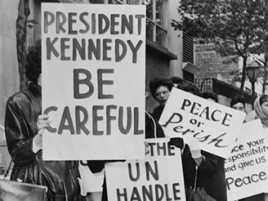

Slide 11
Cuban Missle Crisis
Kennedy calls together the EXCOM.
Group of security advisors.
They know they are in danger, but also know that if they attack Cuba, they could start a full scale nuclear war.

Slide 12
Cuban Missile Crisis Simulation

Slide 13
Blockade
They decide to create a blockade around Cuba.
BLOCAKDE: Using ships around Cuba to keep supplies from entering or leaving.

Slide 14
Missile Trade
The US agreed to give up the nuclear missiles they had in Turkey, if Russia would get rid of the ones they had stationed in Cuba.

Slide 15
War Averted
The war was averted. In later years, a high end Cuban official said that if the US had invaded, Cuba could have launched the nuclear missiles, the Soviet Union could have declared War, resulting in a large scale nuclear war. World War III

