Slide 1
Compromise of 1850

Slide 2
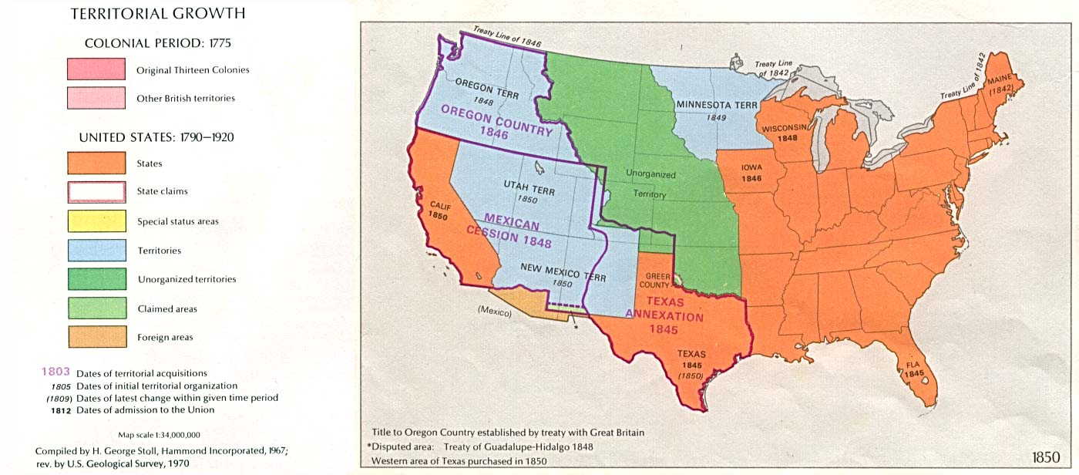
Mexican Cession: Slave or Free?

Slide 3
Options for Mexican Cession
Continue line of Missouri Compromise
No slavery in any part of the territory (Wilmot Proviso)
Popular Sovereignty
  Allow voters in territory to decide whether they wanted to ban or allow slavery
Notes:
David Wilmot proposed this during the Mexican American War

Slide 4
Compromise of 1850
California enter union as free state
Utah and New Mexico territories would have popular sovereignty
Congress passed Fugitive Slave Act

Slide 5
Fugitive Slave Act
Forced all citizens to help in the recovery of any runaway slave
Federal crime to help runaway slaves
Officials could arrest runaways in areas where slavery was illegal
Notes:
If commissioners rejected a slaveholder’s claim they got $5 for services. They got $10 if they returned a suspected fugitive to the slaveholder in the South

